Slide 1
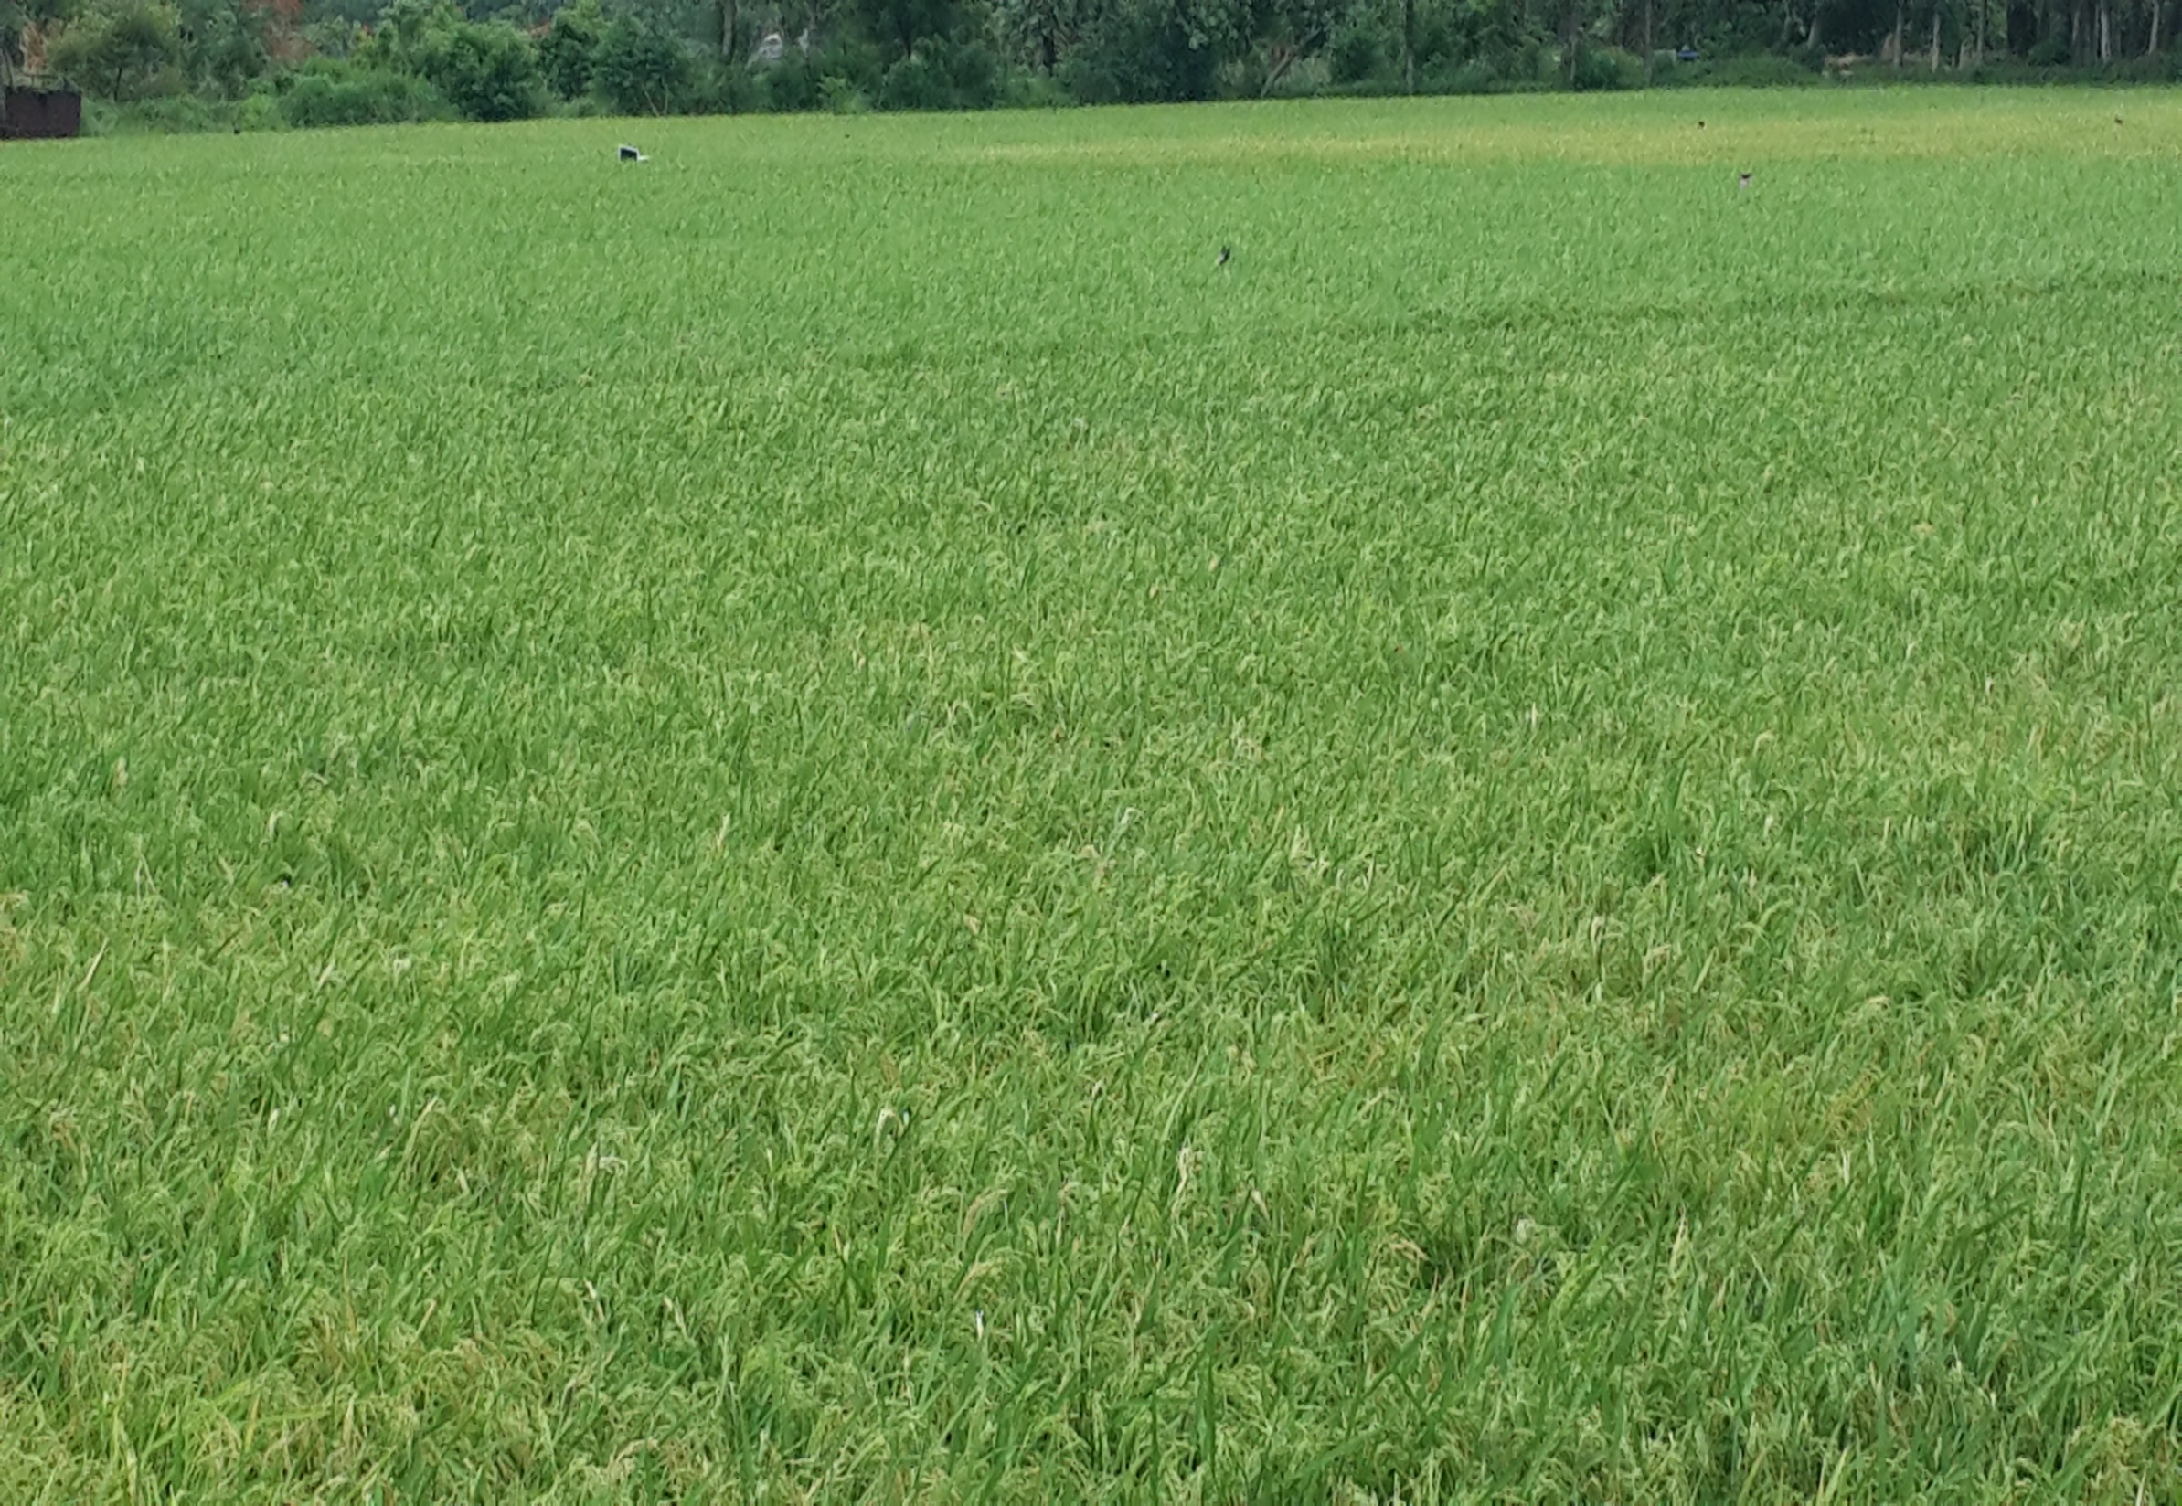

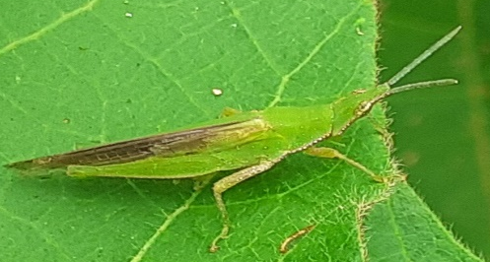
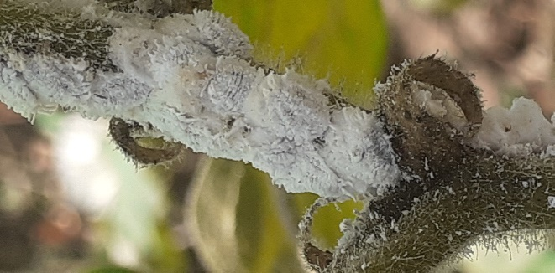
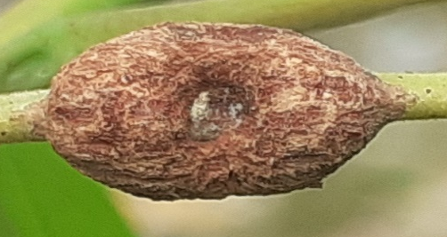
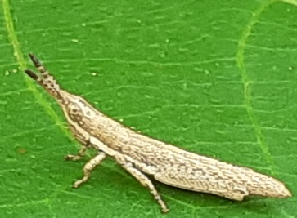

Pandit Jawaharlal Nehru College of Agriculture
and Research Institute, Karaikal -609 603
Advisory Committee Meeting
DBT – SCS
Department of Agricultural Entomology
Department of Biotechnology
Ministry of Science and Technology
Government of India
New Delhi, India

Slide 2

A. New practicals introduced in the current curriculum
UG Entomology courses | New practicals introduced in current curriculum
1. AEN 101 Fundamentals of Entomology (2+1) | Extraction of soil borne insects from soil and plant debris with Berlese funnel trap Collection of parasitic hymenopteran with yellow pan and malaise traps and identification of insects with binocular stereo zoom microscope
2. AEN 201 Principles of Integrated Pest Management (1+1) | Mass production of rice moth, Corcyra cephalonica with Corcyra mating drum and enamel tray Mass production of green lace wing fly, Chrysoperla carnea with Chrysoperla rearing cage Application of insecticides on fruit trees for insect pest management with rocker sprayer and knap sack and power sprayer in other crops

Slide 3
UG Entomology courses | New practicals introduced in current curriculum
3. AEN 302 Management of beneficial insects (1+1) AEN 211 Apiculture, Sericulture and Lac culture (1+1) | Identification of different types of bee hives - Italian bee hive Maintenance of honeybee colonies with bee veil, smoker, decapping knife, comb foundation sheet, queen excluder and queen cage. Honey extraction with honey extractor
4. EXP 418 Commercial Sericulture (0+5) ELP 402 Commercial Sericulture (0+10) | Experiential learning on mulberry cultivation and silkworm rearing Visit to sericulture institutions/ organizations in Tamil Nadu Preparation of hand craft items from waste silkworm cocoon

Slide 4
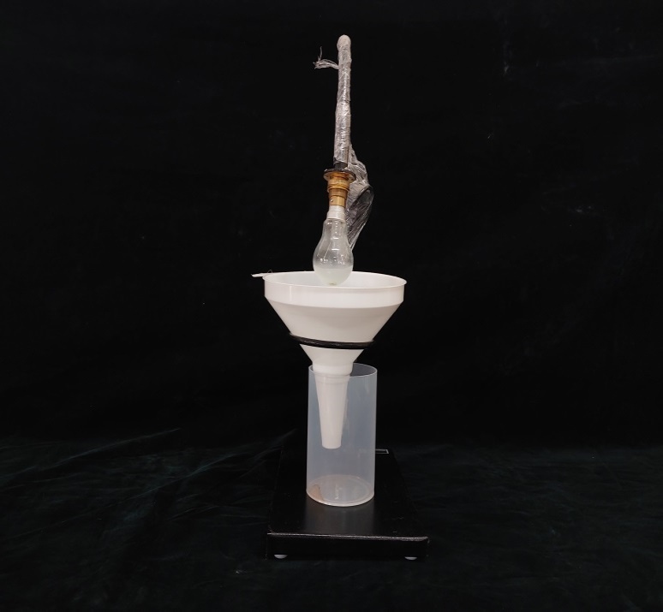
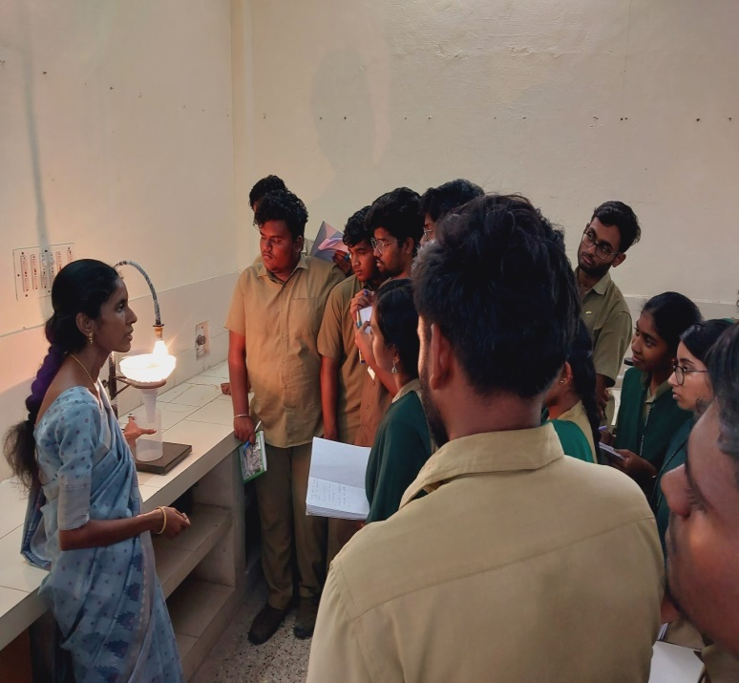
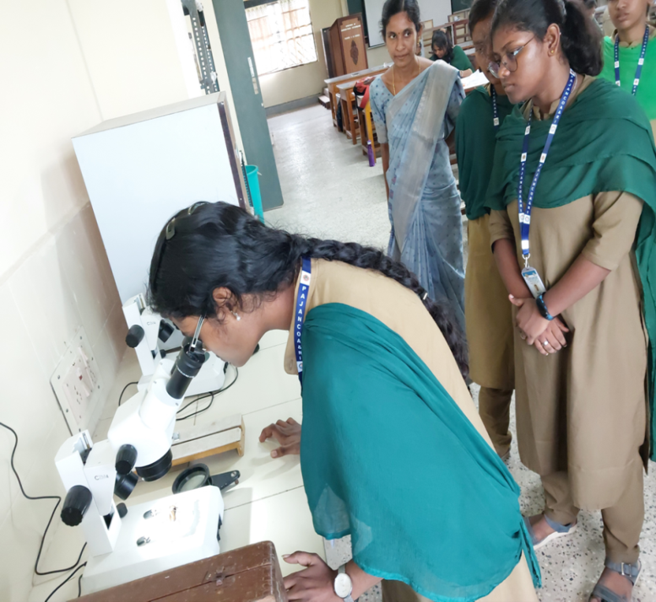
Extraction of soil borne insects from soil and plant debris with Berlese funnel trap
Berlese funnel trap
Binocular stereo zoom microscope

Slide 5

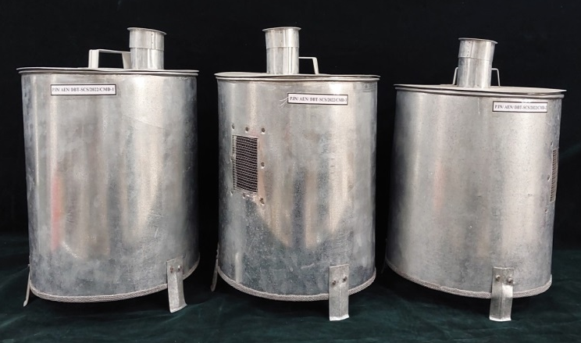
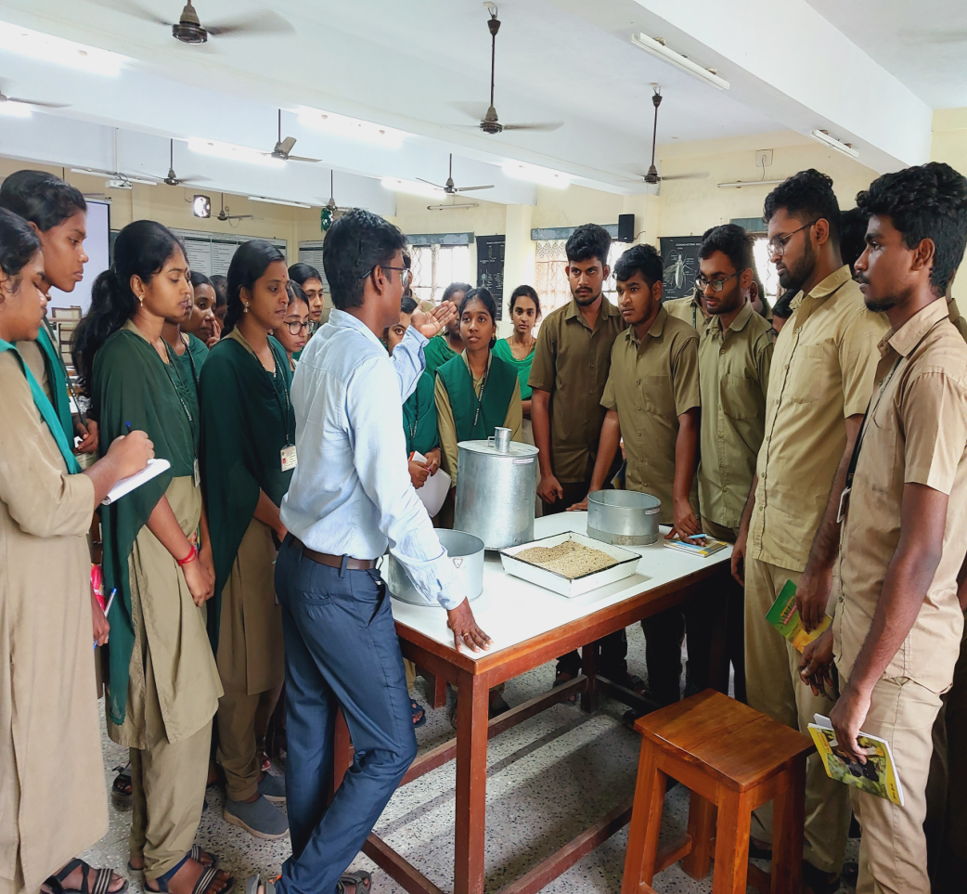
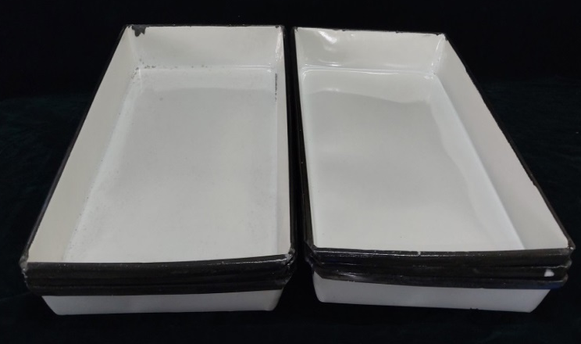
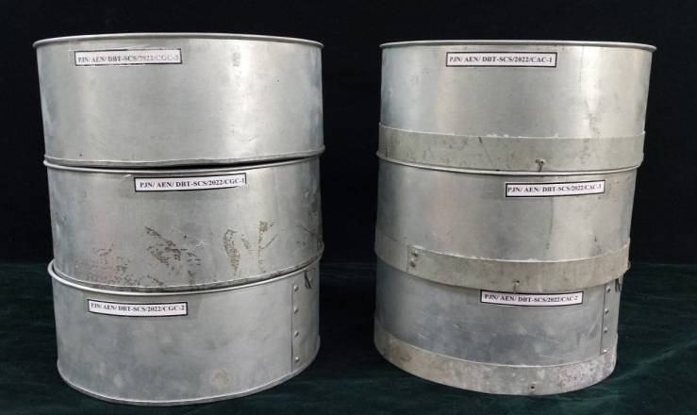
Mass production of rice moth, Corcyra cephalonica with Corcyra mating drum and enamel tray
Corcyra matting drum
Enamel tray
Chrysoperla rearing cage

Slide 6
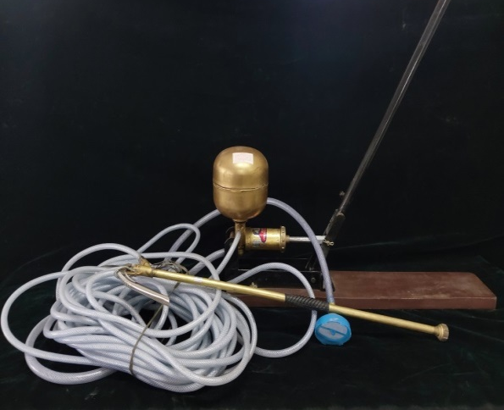
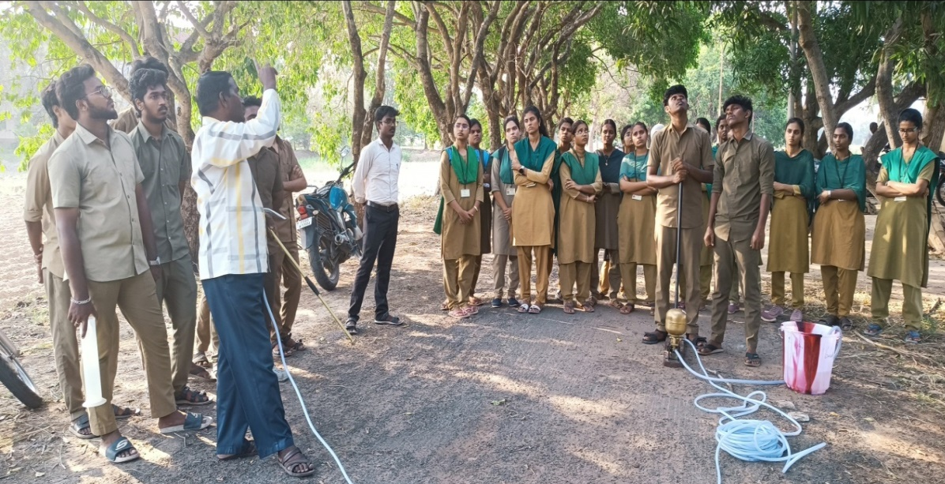
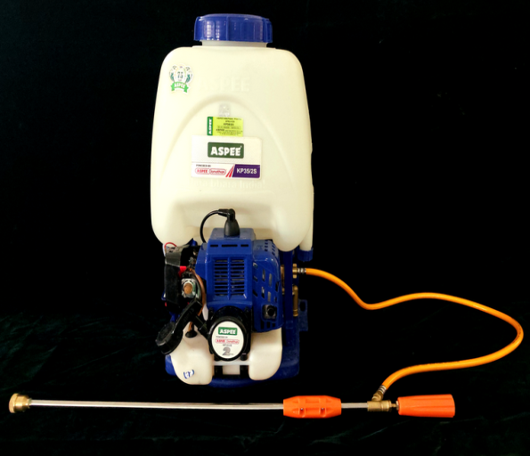
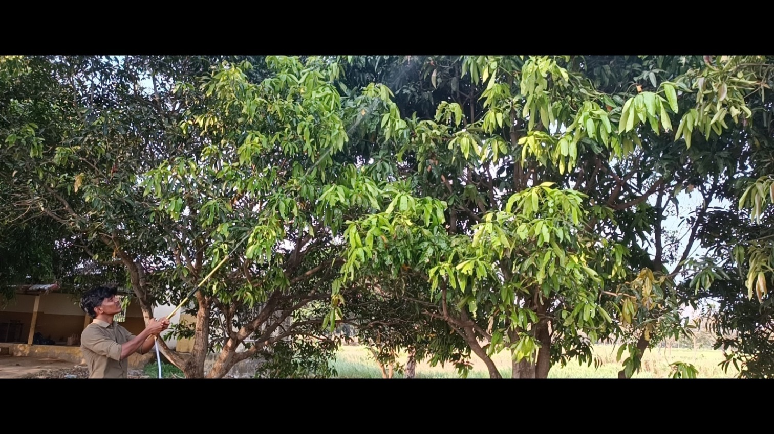
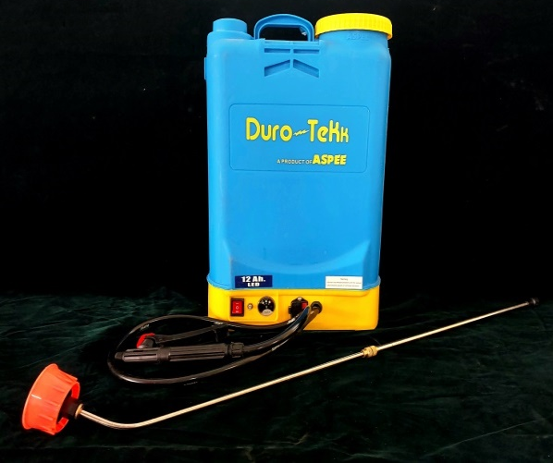
Practical exposure on handling of Plant Protection equipments
Rocker sprayer
Power sprayer
Knapsack sprayer

Slide 7
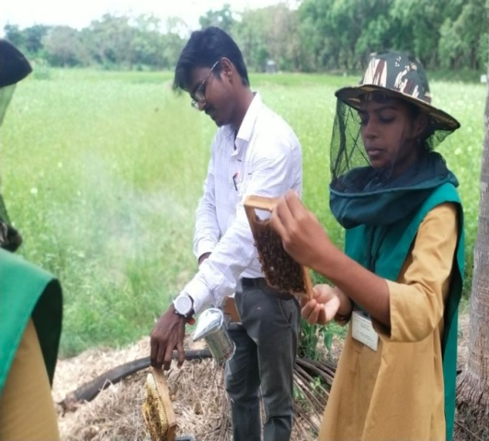
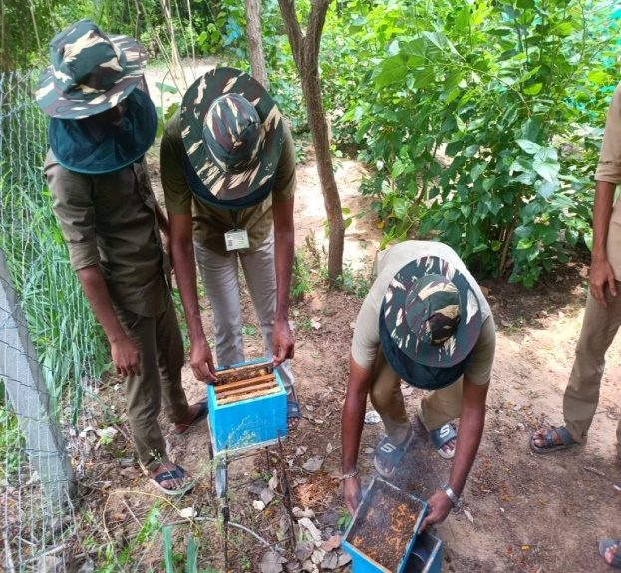
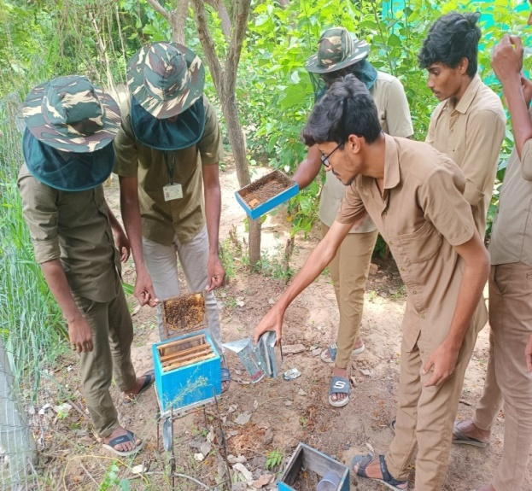
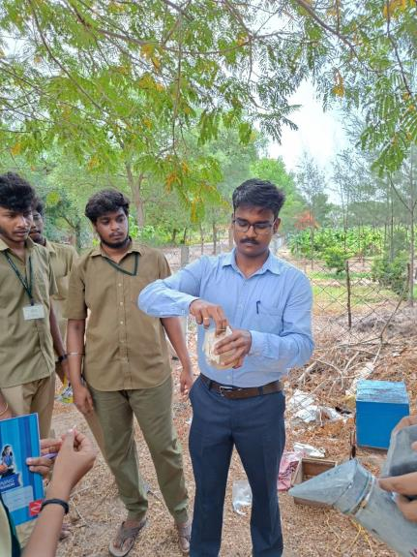
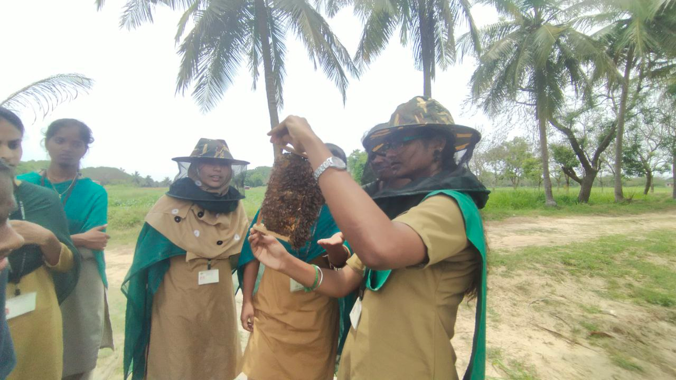
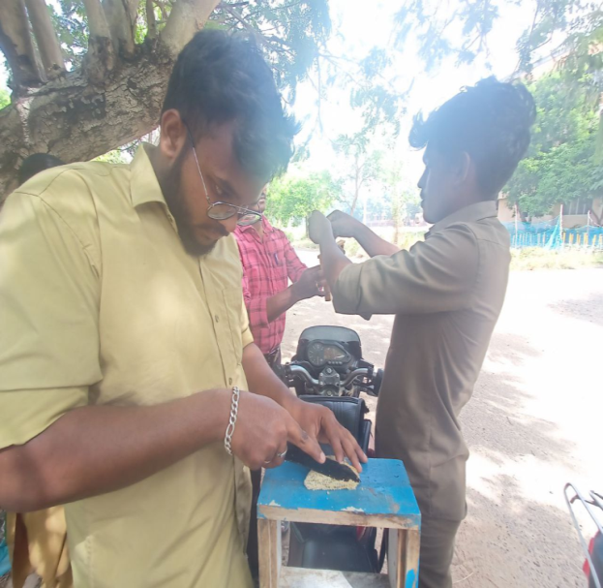
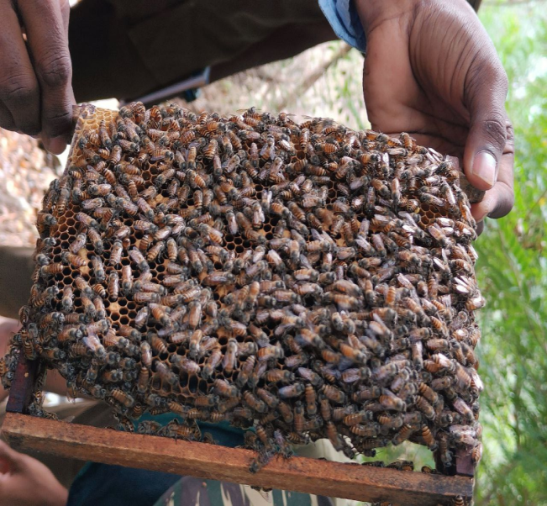
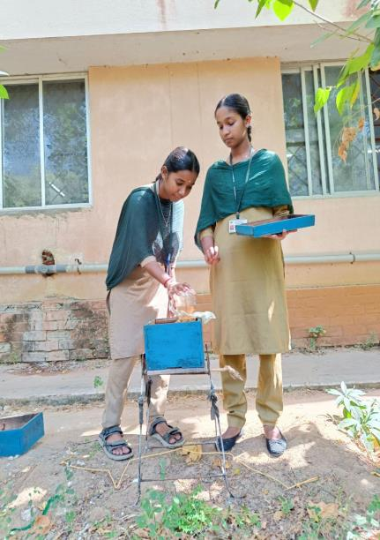
Handling of Indian honeybee

Slide 8
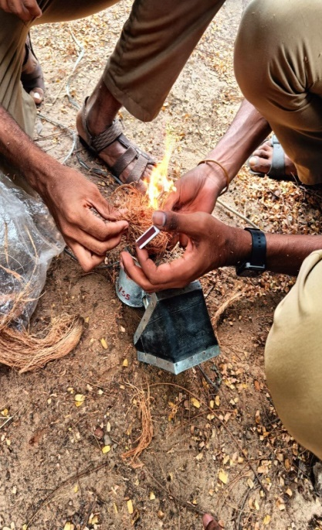
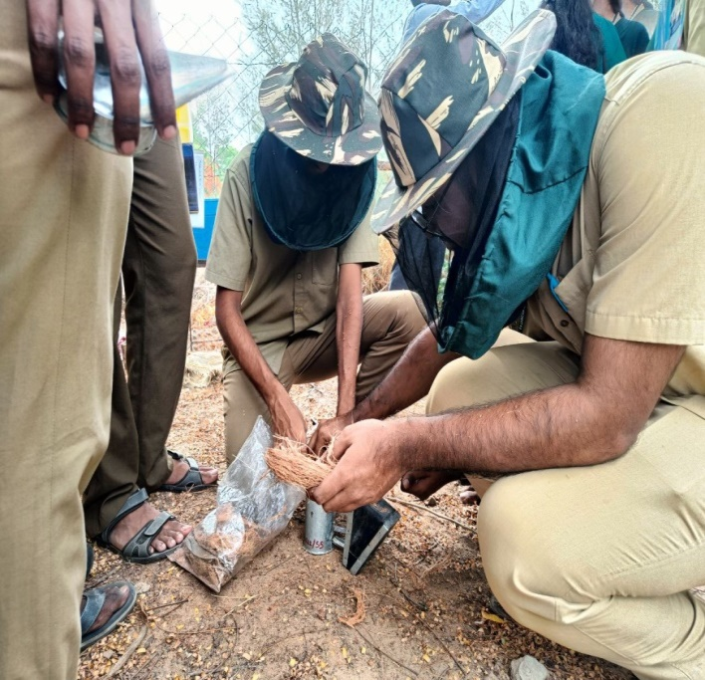
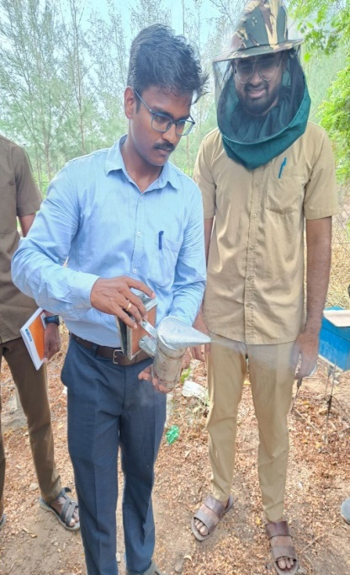
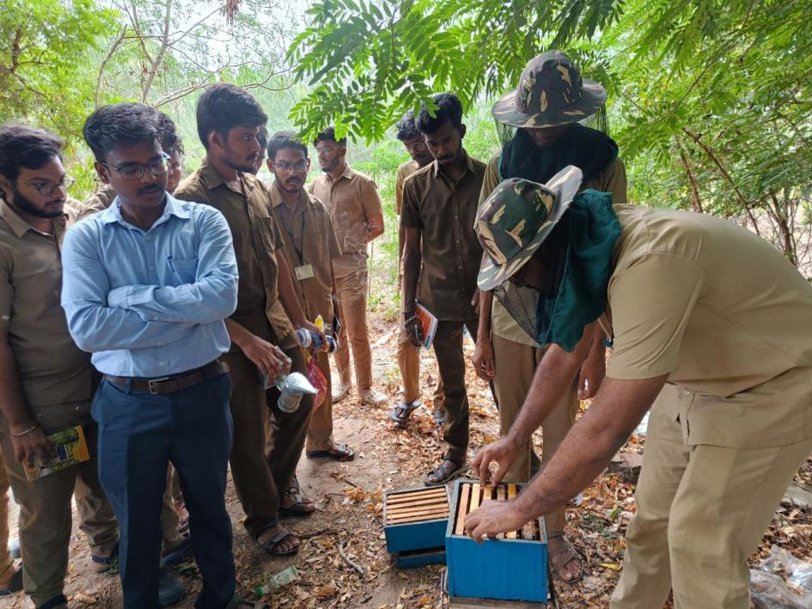
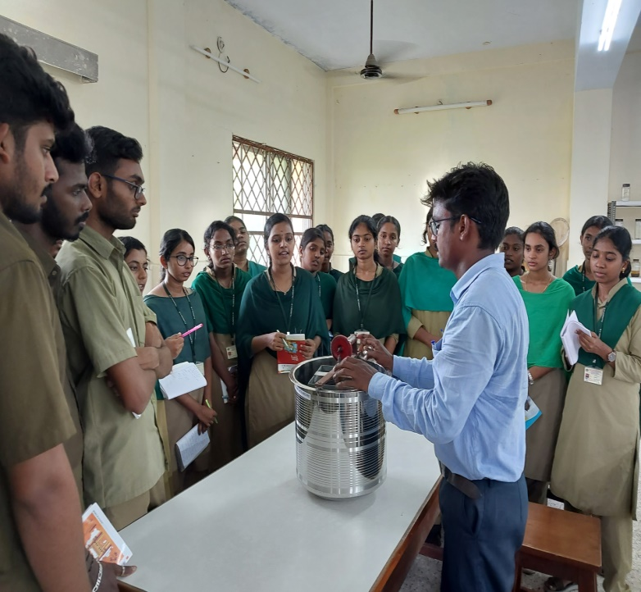
Hive inspection and Honey extraction

Slide 9
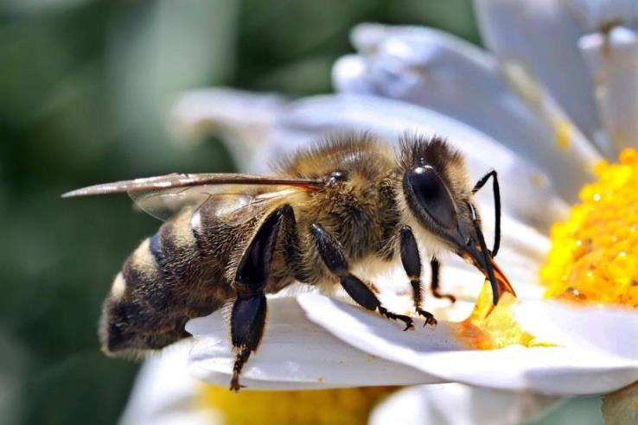
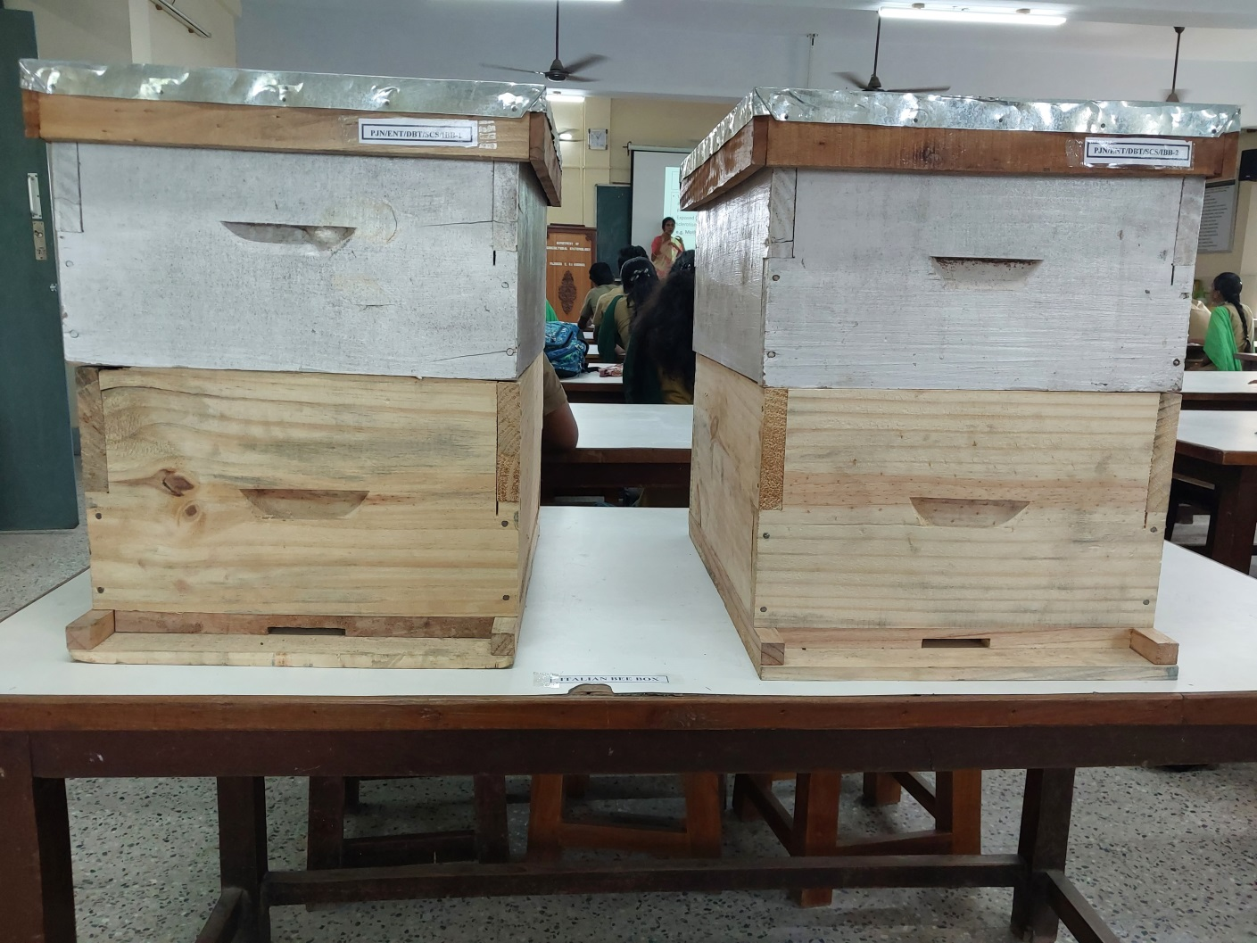
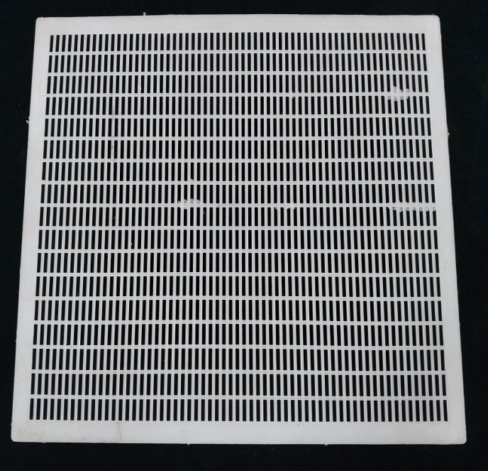
Proposed to introduce Italian honeybee at PAJANCOA & RI, Karaikal
Italian bee hives
Queen excluder

Slide 10
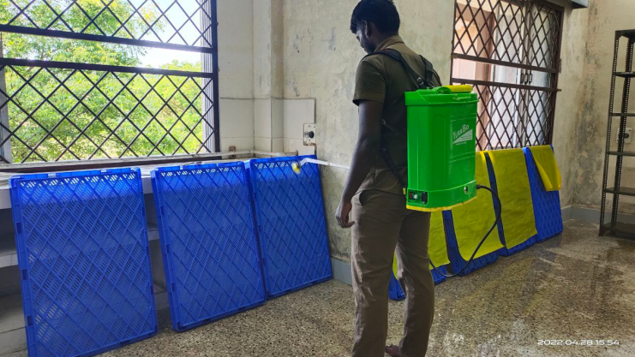
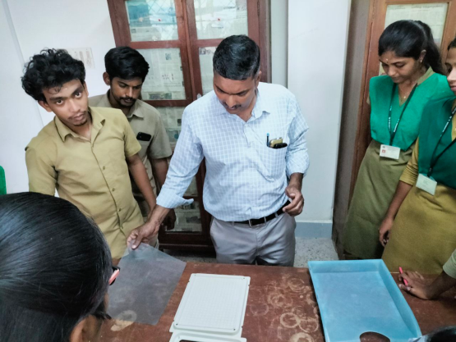
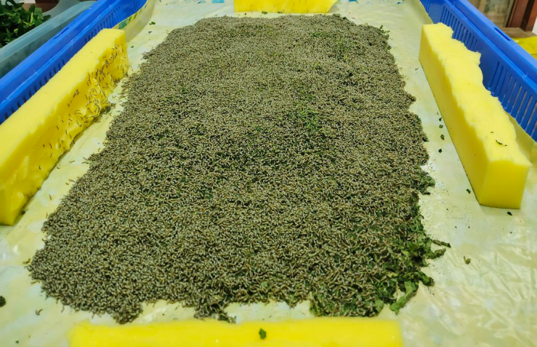
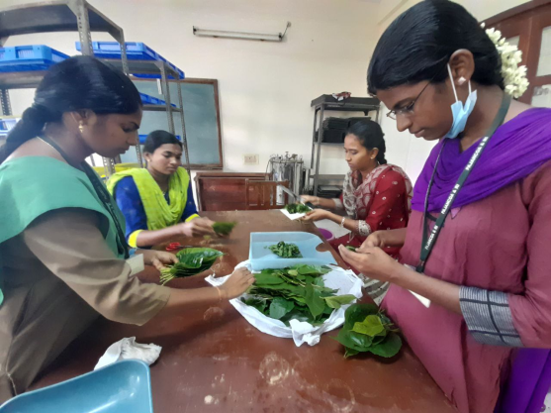
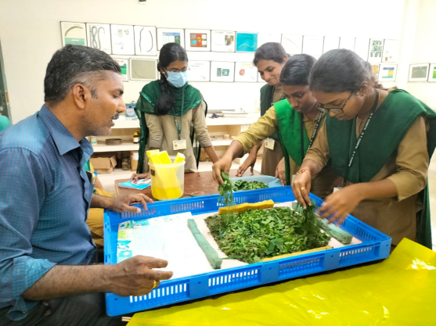
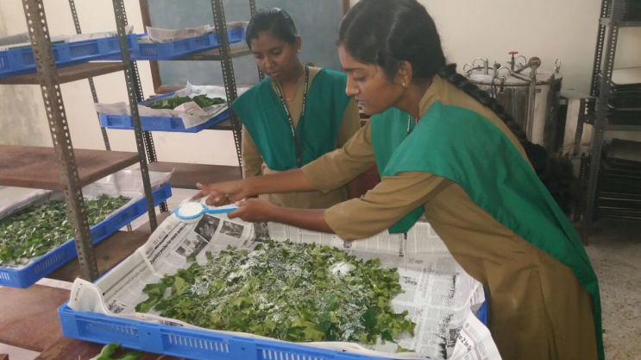
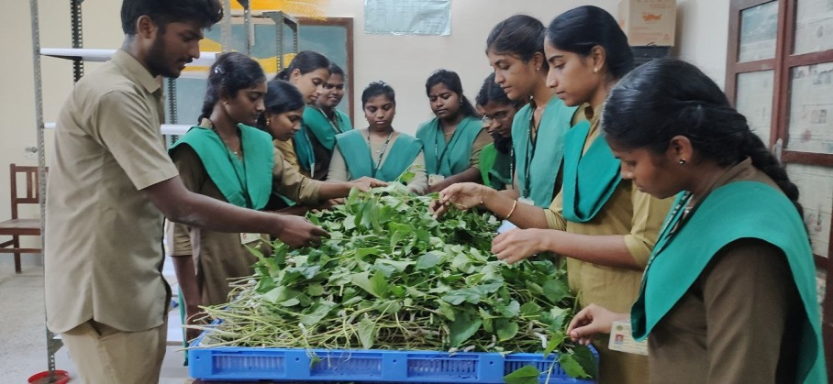
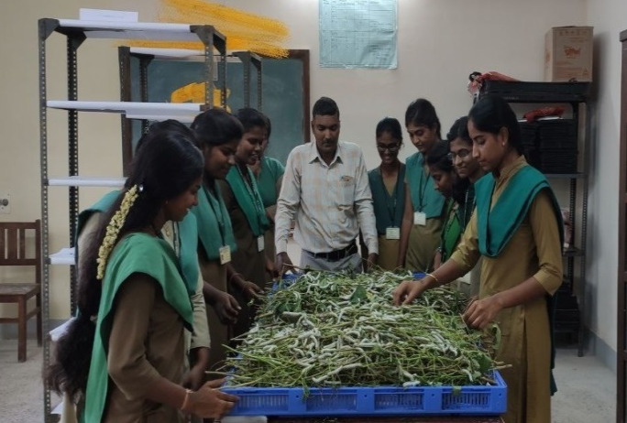
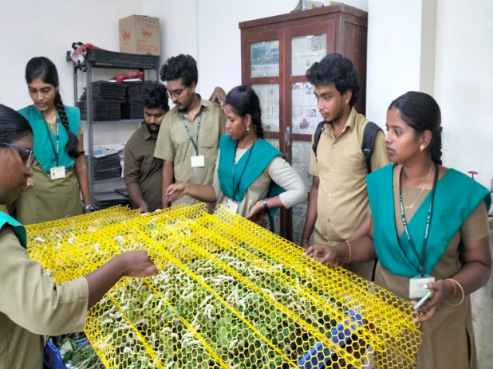
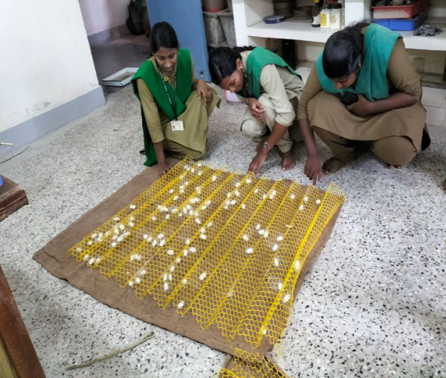
Experiential learning on mulberry silkworm rearing
Disinfection of rearing house and appliances
Silkworm egg incubation
Brushing of chawki larvae
Chopping tender leaves for feeding chawki worms
Feeding worms with chopped mulberry leaves
Application of bed disinfectant
Late age silkworm rearing with 1 meter mulberry shoot
Observation of spinning behaviour
Spreading plastic mountage for spinning
Cocoon harvesting

Slide 11
B. Equipments procured for proposed practical – non recurring head
S. No. | Name of Equipment | Unit Cost (Rs.) | Number of Units | Actual Cost (Rs.)
1. | Rocker sprayer | 8,100 | 1 | 8,100
2. | Yellow sticky pan trap (10/pack) | 944 | 1 | 944
3. | Berlese funnel trap | 4,012 | 1 | 4,012
4. | Wooden Insect box | 1,750.50 | 55 | 98,753
5. | Square type wooden insect box with glass top | 1890 | 52 | 98,280
6. | Battery operated knapsack sprayer | 4,500 | 1 | 4,500
7. | Power sprayer | 11,700 | 1 | 11,700
8. | Binocular stereo zoom microscope | 49,442 | 2 | 98,884
9. | Malaise trap | 30,090 | 1 | 30,090
10. | Honey extractor | 6,500 | 1 | 6,500
11. | Drone trap | 200 | 5 | 1,000
12. | Queen gate/comb foundation sheet | 200 | 5 | 1,000
13. | Decapping knife | 200 | 5 | 1,000
14. | Smoker | 300 | 5 | 1,500
15. | Corcyra matting drum | 2,950 | 3 | 8,850
16. | Chrysoperla adult rearing cage | 708 | 3 | 2,124
17. | Chrysoperla grub rearing cage | 708 | 3 | 2,124
18. | Italian bee hive | 4,088 | 2 | 8,176
19. | Queen excluder | 224 | 10 | 2,240
20. | Queen cage | 33.6 | 10 | 336
21. | Bee veil | 224 | 10 | 2,240
22. | Pollen trap | 336 | 5 | 1,680
23. | Enamel tray | 613 | 9 | 5,522
Total |  |  |  | 3,99,555

Slide 12
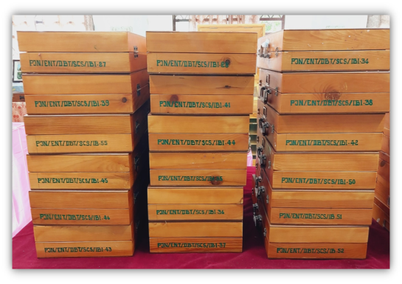
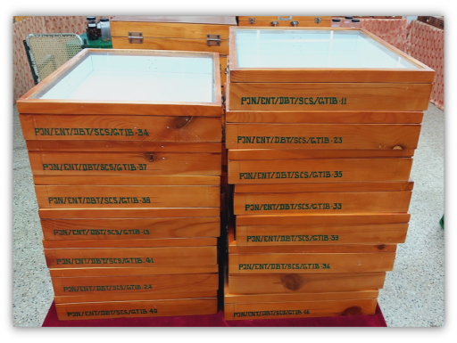
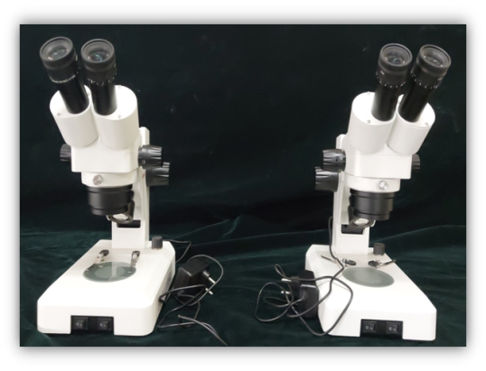

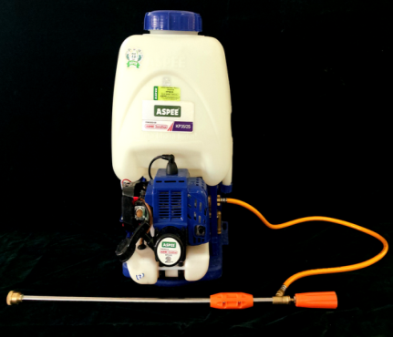
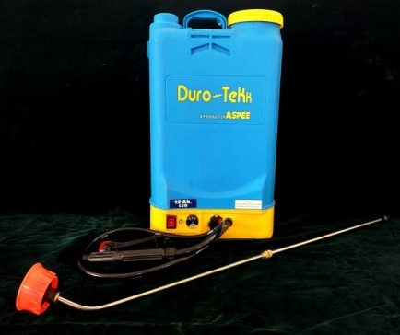
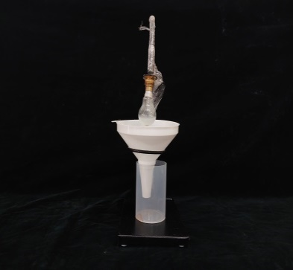
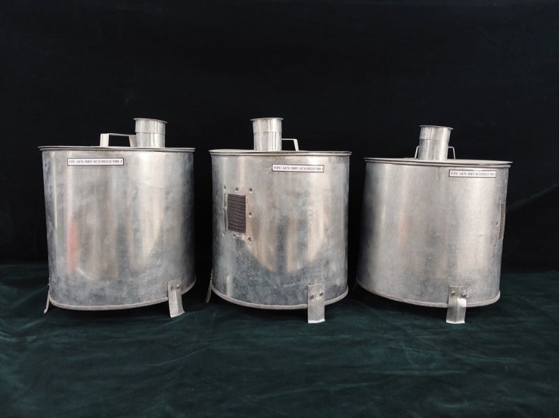










Equipment’s procured for proposed practicals – Non Recurring head

Slide 13



Wooden insect storage box
Box purchased : 55 nos.
Total cost: Rs. 98,753

Slide 14
Laboratory consumables and students exposure visits – Recurring head
S. No. | Name of the chemical | Cost (Rs.)
1. | Camphor | 43,078
2. | Carbitol 500 ml | 7,906
3. | Ethyl Acetate - 500ml | 5,097
4. | Chloroform 2.5L | 4,002
5. | Glycerol 98% Extra pure- 500ml | 1,118
6. | Formaldehyde solution 37% Extra pure - 500ml | 699
7. | Balsam Canada - 50 ml | 1,305
8. | Ninhydrin AR/ACS - 10g | 1,491
9. | Gentian Violet (Aqueous) - 125 ml | 428
10. | Micro slide 75 x 25mm 1.45mm thickness | 371
11. | Cover slips 22 x 22mm | 451
12. | Absorbent cotton | 3,220
13. | Non-absorbent cotton | 1,281
14. | Sorbic acid - 500g | 1,566
15. | Ascorbic acid - 500g | 7,004
16. | Casein soluble - 500g | 1,957
17. | Methyl-4-hydroxybenzoate - 500g | 1,906
18. | Fuchsin acid - 25g | 587
19. | Filter paper grade: 42 - 12.5cm (100/pack) | 9,409
20. | Sodium sulfate anhydrous - 500g | 358
21. | Tween 80 - 500 ml | 1,878
22. | Naphthalene balls | 344
23. | Students exposure visit | 53,987
Total |  | 1,49,452

Slide 15
Books purchased under DBT-Star College Scheme - Contingency
Sl. No. | Name of the book | Author and year
1. | The insects: Structure and Function | Chapman, R.F. 1998
2. | Objective Entomology | Prasad T.V. 2019
3. | A Textbook of Applied Entomology, Vol 1: Concepts in Pest Management | Srivastava, K.P. and Dhaliwal, G.S., 2012
4. | A Textbook of Applied Entomology, Vol 2: Insects of Economic Importance | Singh G, K, Srivastava, K.P. and Dhaliwal, G.S., 2012
5. | Dictionary of Entomology | Butani D.K and Srivastava K.P. 2009
6. | Elements of Economic Entomology | David B.V. and Ramamurthy V.V. 2016.
7. | Applied Entomology | Reddy D.S. 2010
8. | Entomology Treatise | Prasad T.V. 2014.
9. | Handbook of Entomology | Prasad T.V. 2014.
10. | Techniques in Host Plant Resistance to Insects | Chakravarthy A.K, Shashank P.R, Chandrashekharaiah and Doddabasappa B. 2012
11. | Agricultural Pests of South Asia and their Management. | Atwal A.S. and Dhaliwal G.S. 2014
12. | Elements of Insect Ecology | Peterson P.G. 2017
Contd..

Slide 16
Sl. No. | Name of the book | Author and year
13. | An outline of Entomology | Dhaliwal G.S. 2017
14. | Question Bank on Entomology | Biswas S. 2016
15. | Entomology Refresher | Viji C.P. and Kumar K.P. 2017
16. | The Insects - Structure, Function and Biodiversity | Ambrose P.D. 2015
17. | The Insects: Beneficial and Harmful Aspects Hardcover | Ambrose P.D. 2018
18. | Insect physiology | Sanjayan K.P. 2018
19. | An Introduction to Sericulture | Ganga G. and Chetty J.S. 2020
20. | Sericulture and Seri-Biodiversity. | Srivastav P.K. and Thangavelu K. 2016
21. | Beekeeping: A Compressive Guide to Bees and Beekeeping | Abrol. D.P. 2010
22. | Toxicology of Insecticides. | Singh S.B., Upadhyay S.N. and Badaya A.K. 2019
23. | Insecticides: Toxicology and Uses | Gupta H.C.L. 2020
24. | An Outline on Objective Entomology | Tiwari C., Kumar. P. and Nath L. 2022

Slide 17
Contd..
Sl. No. | Name of the book | Author and year
25. | General and Applied Entomology | David. B.V. and Anandhakrishnan T.N. 2004
26. | Basic Entomology: A Practical Manual | Sathe T.V. 2005
27. | Stored Grain Pests and their Management. | Khare B.P. 2006
28. | Crop Pest Management: At a Glance. | Sharma R.K. and Chandravanshi H. 2017
Total cost of purchase: Rs. 19,879

Slide 18


Books purchased under DBT-Star College Scheme - 2022

Slide 19






F. Students exposure visit to Sericulture institutions in Tamil Nadu
Government mulberry nursery, Trichy
Government Grainage Centre, Trichy
Silk reeling & Weaving unit, Coimbatore
Government Cocoon market, Coimbatore
Dept. of Sericulture, FC & RI, Mettupalayam
Insect Museum, TNAU, Coimbatore

Slide 20





E. Outreach activity on insect biodiversity to school students of Karaikal at Insect repository, Dept. of
Agrl. Entomology, PAJANCOA & RI
Kamaraj Government High School, Poovam, Karaikal
Government Primary School, Serumavilangai, Karaikal
Government High School, Akkaraivattam, Karaikal
Annai Therassa Government Girls Higher Secondary School, Karaikal
Government Middle School, Vadamattam, Karaikal

Slide 21

J. Impact of the star college scheme
Name: S. VINOTHA
Batch: 2018-22
Fellowship: ICAR JRF
University: IARI, New Delhi
Degree: M.Sc., (Agri) Entomology

Slide 22















Outcome of students exposure visit

Slide 23
K. Budget expenditure
Sl. No. | Particulars | Grant allocated (Rs.) | Expenditure (Lakhs Rs.)
1. | Non-Recurring | 4,00,000 | 3,99,555
2. | Recurring | 1,50,00 | 1,49,452
3. | Contingency | 20,000 | 19,879
 | Total | 5,70,000 | 5,68,886

Slide 24

L. Future activities
Collection of more species of parasitic hymenopterans with malaise trap
Introduction and establishment of Italian honey bee at PAJANCOA and RI ecosystem
Chawki and late age silkworm rearing
Training on Indian honey bee keeping to the farmers of Karaikal by ELP students
Mass production of Chysoperla cornea and Trichogramma sp.

Slide 25



Thank u

