Slide 1

PANDIT JAWAHARLAL NEHRU COLLEGE OF AGRICULTURAL AND RESEARCH INSTITUTE, KARAIKAL 609 603
Sponsored scheme | : | DBT-STAR college scheme
Total allocated budjet | : | Agricultural Microbiology
Benefited Unit | : | 3.0 lakhs
Coordinator | : | Dr.P.Pushpakanth, Assistant professor
Project coordinator |  | Dr. V. Sundaram, Professor

Slide 2
Proposed objectives for the DBT STAR college scheme by Agricultural microbiology unit
1. To create infrastructural facilities with instruments and chemicals to conduct practical classes for undergraduate students without any hindrance.
Accomplished with the due support by DBT
2. To plan for student exposure visit to different institutes which will improve the quality of students and upgrade their knowledge to a greater extent.
Accomplished with the due support by DBT

Slide 3
The following highlighted Key Performance Indicators fulfilled by Agricultural microbiology unit supported under the scheme
a. | A. New practicals introduced/planned in Agricultural Microbiology supported under the scheme
b. | Equipments procured for the proposed new practicals conducted using these equipment
c. | Interdisciplinary/interdepartmental projected executed/planned by the students
d. | Workshops and seminars organized/planned for students by the department supported under the scheme
e. | Faculty improvement programs initiated/planned for the faculty
f. | Visits to industry and important labs of ntional eminence
g. | Lectures delivered/planned by experts/speakers in the relevant subject area
h. | Outreach activities
i. | Training of lab manpower
j | Impact of STAR college scheme
k. | Budget expenditure
l. | Future activities

Slide 4
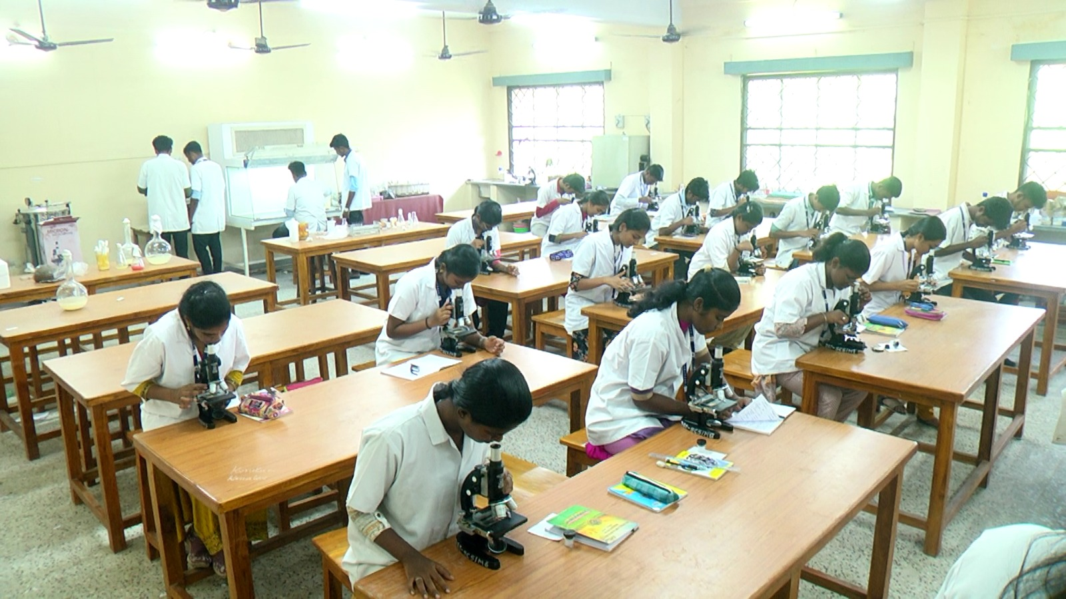
A. New practicals introduced/planned in Agricultural Microbiology supported under the scheme
Earlier there were only 1 microscope for every 5 students.
Now, the financial support provided by DBT-SCS facilitate each one with handling individual microscopes.

Slide 5
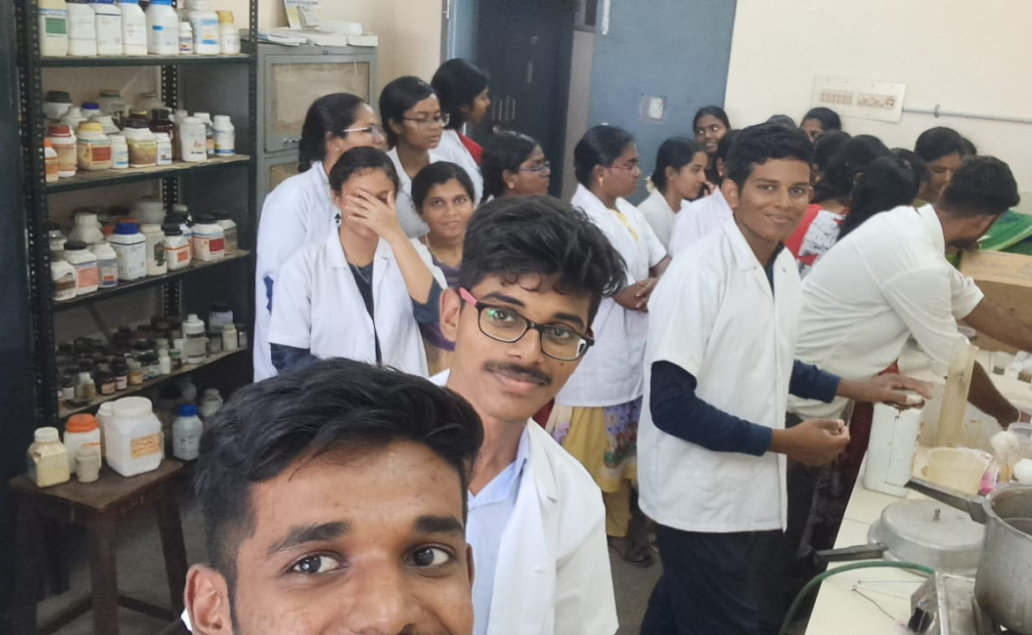
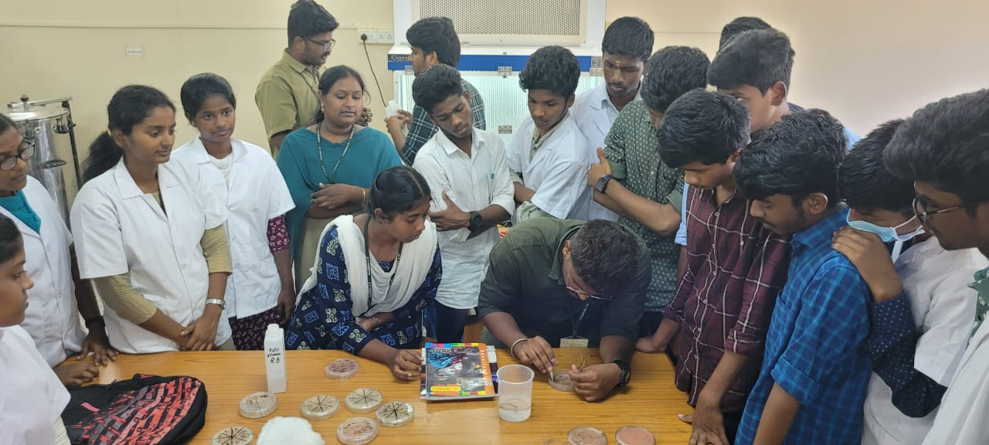
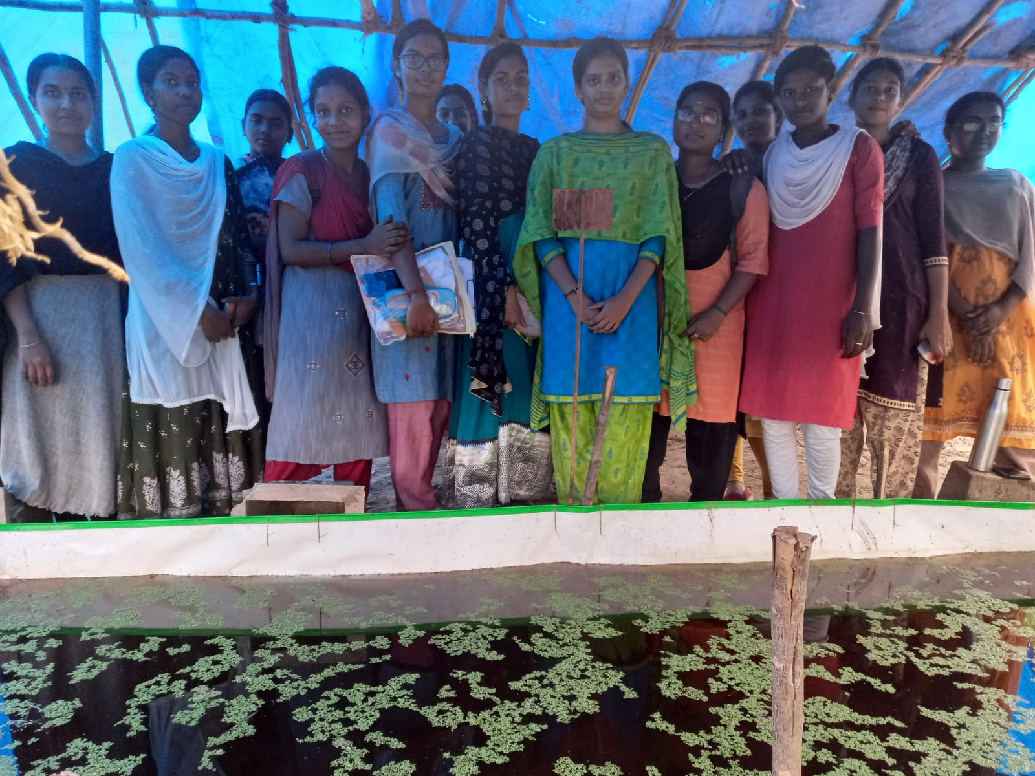
Current I year B.Sc (Hons) Agriculture students involved in Media preparation with newly availed chemicals from DBT scheme
Current I year B.Sc (Hons) Agriculture students guided by final year students to separate nodules from legume crop for rhizobium isolation
Current I year B.Sc (Hons) Agriculture students invoved and learnt mass multiplication of Azolla in shade net during their practical session
New practical experiments (viz, Methylobacterium/Gluconoactobacter isolation, Exopolysaccharide production, consortia development, Blue green algae and azolla mass cultivation) can be effectively taken by the students mainly by availed new chemicals

Slide 6
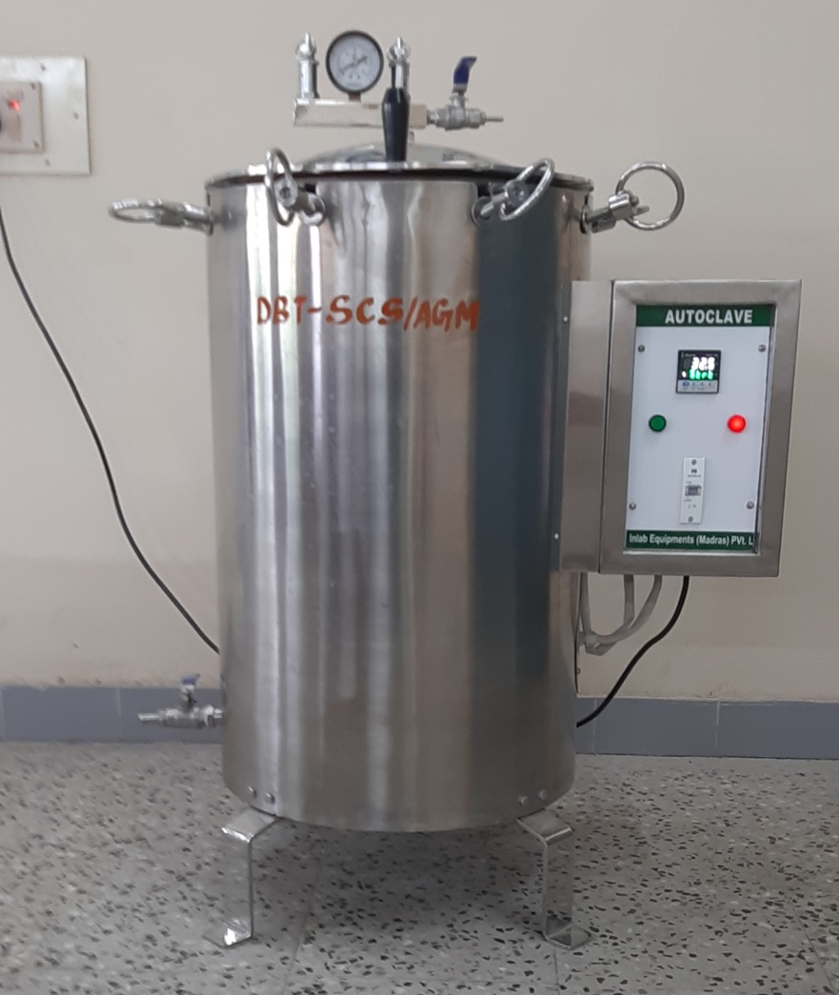
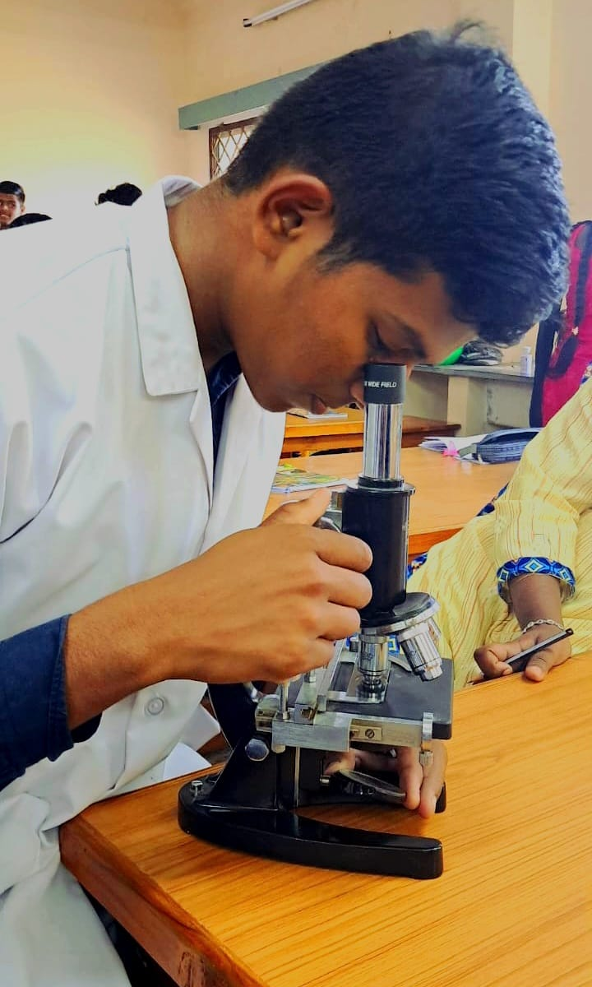
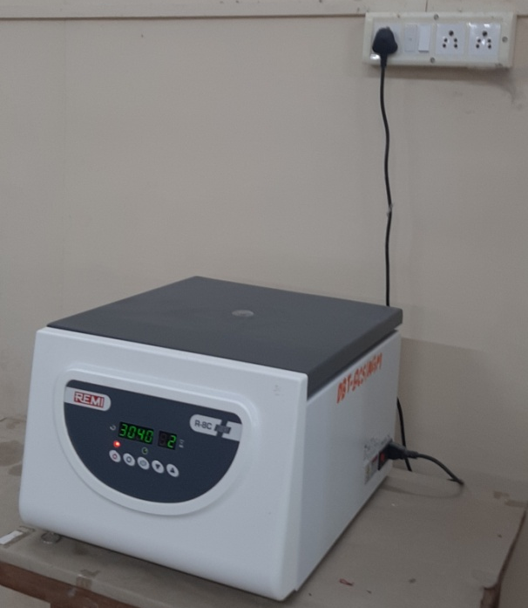
B. Equipments procured for the proposed new practicals conducted using these equipment
A student I year B.Sc (Hons) Agriculture observing specimen from the newly availed microscope by DBT scheme
centrifuge
Autocalve

Slide 7
The following courses gets benefited by DBT-SCS fund
Agricultural microbiology(2+1)- Agriculture
Introductory microbiology (1+1) - Horticulture
Bioinoculant production technology (0+10)
Applied microbiology (2+1) - Agriculture
Environmental studies and disaster management (2+1) -Agriculture
Environmental studies and disaster management (1+1) -Horticulture
Basic laboratory skills (0+2) – Post graduate students
With the financial support by DBT-SCS, glasswares, chemicals, intruments/equipments and stationaries is now suffficient to carryout all the practical experiments without any hindrance by the students.

Slide 8
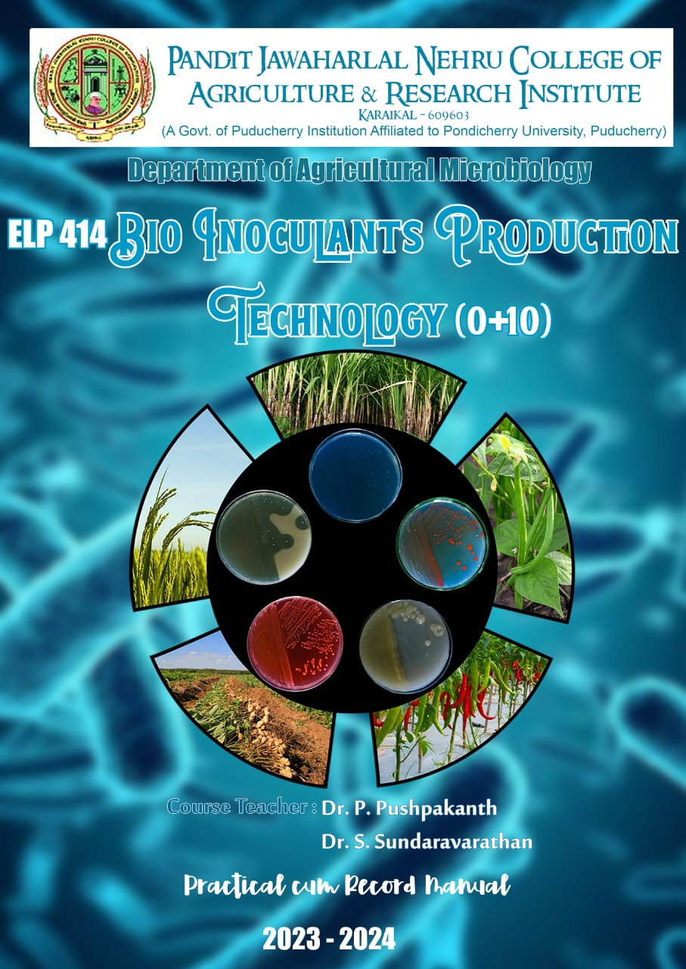
C. Interdisciplinary/interdepartmental projected executed/planned by the students
Course code and title – ELP414 Bioinoculant production technology (0+10)
Duration – 5 months
Target – Publication in NAAS rated journal/Conference/symposium/product development/skill development.
The following 5 different areas were chosen for each group which consist of 6 students.
Each of th 5 group has been alloted with Methylobacterium, rhizobium, Azospirillum, ZSB and Azotobacter.

Slide 9
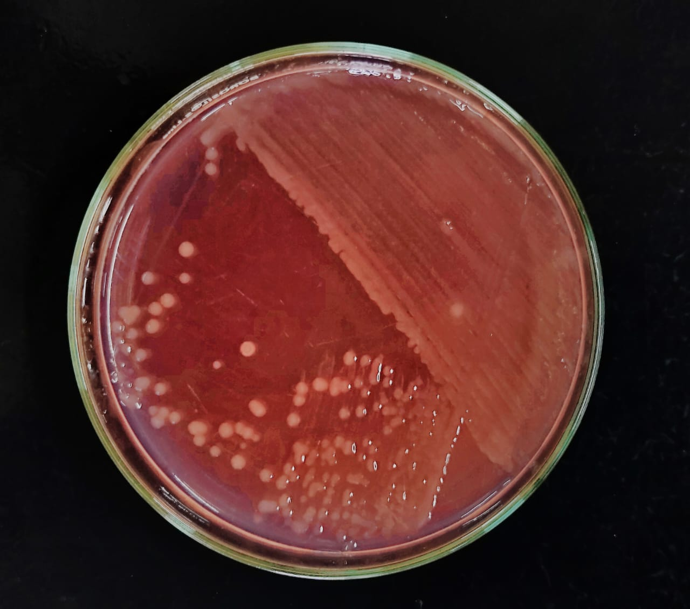
ISOLATION, CHARACTERIZATION AND SCREEENING OF RHIZOBIUM FROM NODULES OF DIFFERENT LEGUME CROPS AND THEIR GROWTH PROMOTING EFFECT ON BLACK GRAM (Vigna mungo)
Team members:
Anbuvanan. P
ArokiaSheela. A
Dharshinii. PA
Eswar Chandra Vidyasagar. Y
Sharan. R
Siranjeevi. R

Slide 10
Objectives
1. Isolation of Rhizobium from root nodule of different pulse crops.
2. Characterization of refined isolates for confirmation of Rhizobium by authentication tests.
3. To evaluate the Rhizobium for their nodulation efficiency by seed inoculation assay

Slide 11
Details of sample collection and isolate details
Crop name | Variety | Age at the time of collection | Previous crop | Soil type | Place of collection | Isolates in hand
Lab Lab | CO 4 | 45 DAS | - | Sandy loam | Karaikal | 13
Blackgram | VBN 8 | 70 DAS | - | - | Dindigul | 24
Groundnut | TMV 7 | 70 DAS | Blackgram | Clay loam soil | Nettapakkam (Pondicherry) | 4
Groundnut | TMV 7 | 55 DAS | Paddy | Red soil | Alanganallur (Madurai) | 8
Blackgram | ADT 6 | 45 DAS | Paddy | Clay loam soil | Karukangudi (Karaikal) | 5
Groundnut | G 7 | 90 DAS | Groundnut | Sandy soil | Thirukadaiyur | 7
Groundnut | TMV 7 | 81 DAS | Bhendi | Sandy loam | Cuddalore | 10
Sesbania | - | 20 DAS | - | - | Karaikal | 5
Groundnut | - | 90 DAS | Groundnut | Red soil | Karaikudi | 6
Groundnut | G7 | 90 DAS | Brinjal | Sandy loam | Cuddalore | 4
 |  |  |  |  | Total | 86 Rhizobium strains

Slide 12
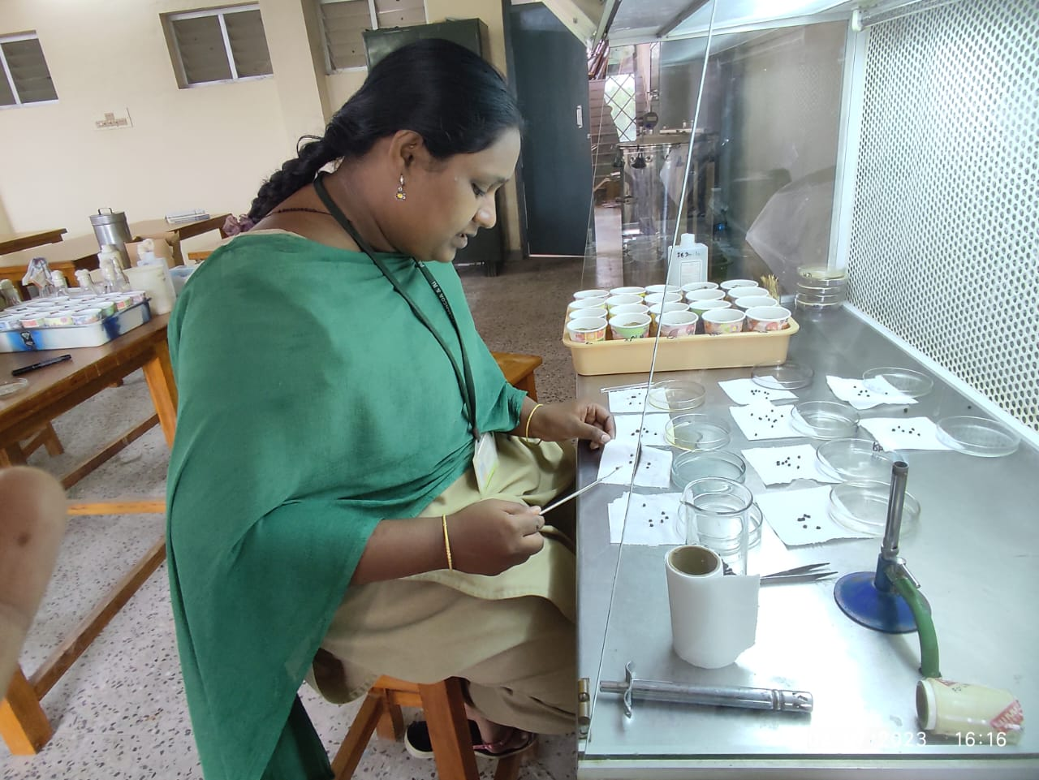
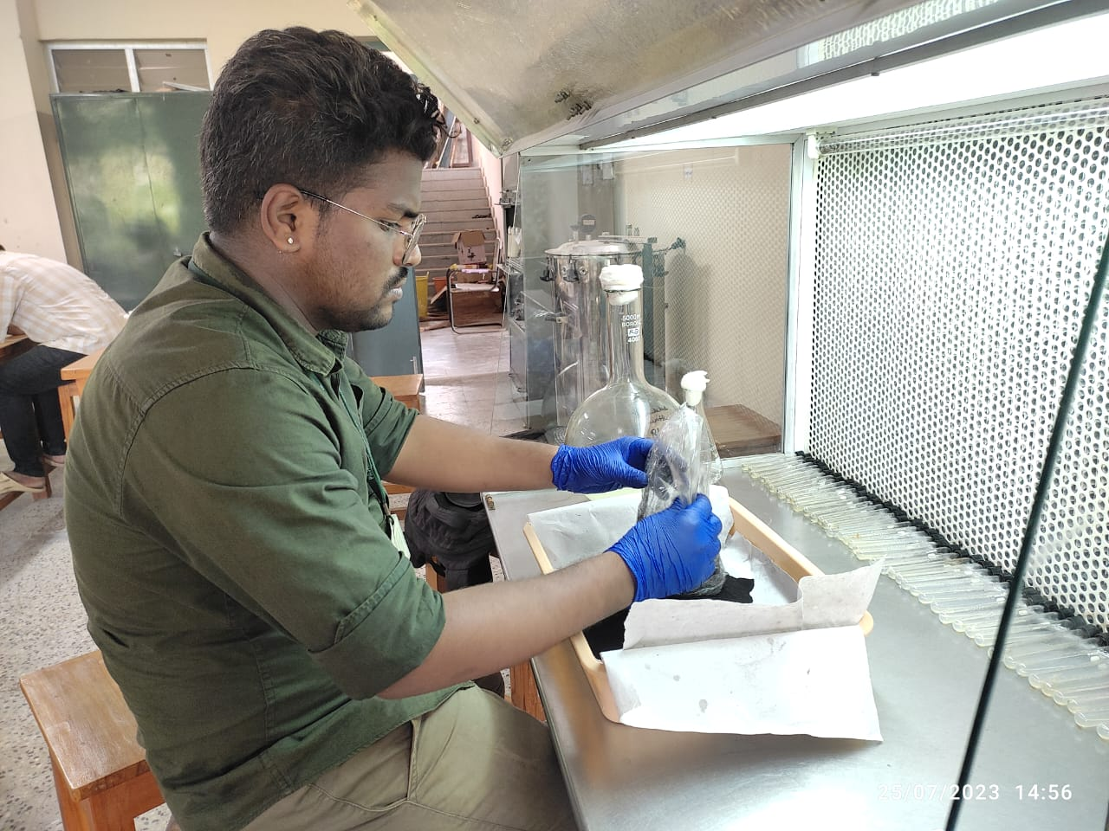
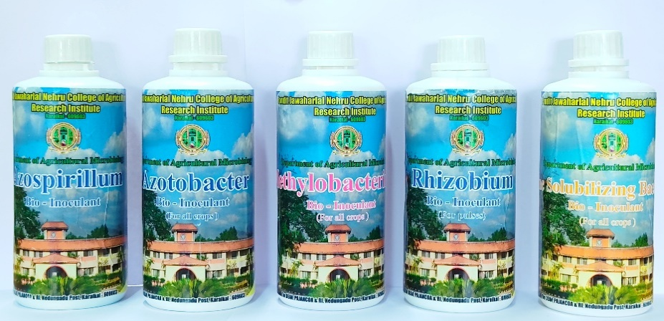
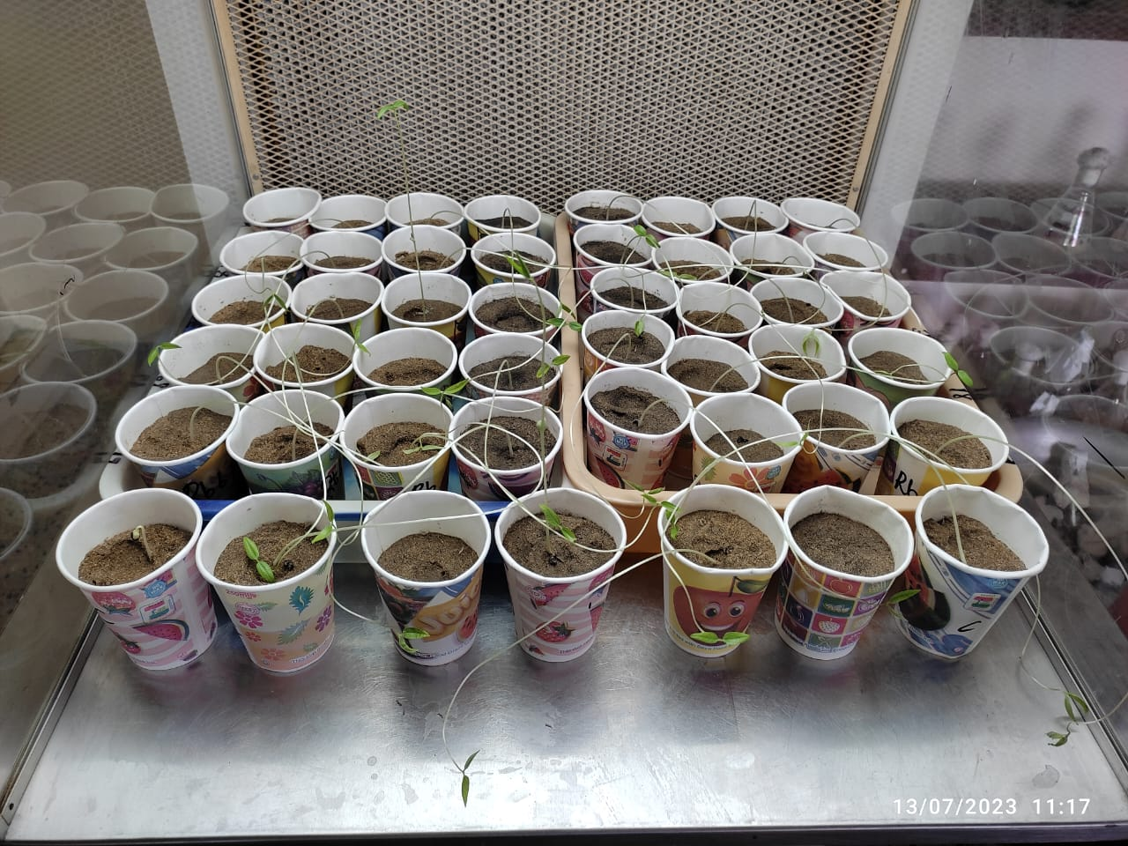
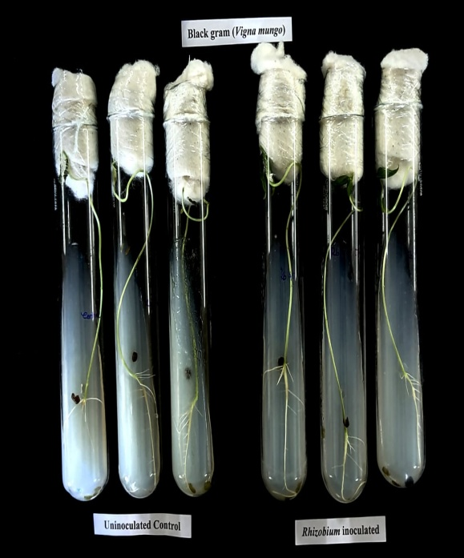
Rhizobium team activities

Slide 13
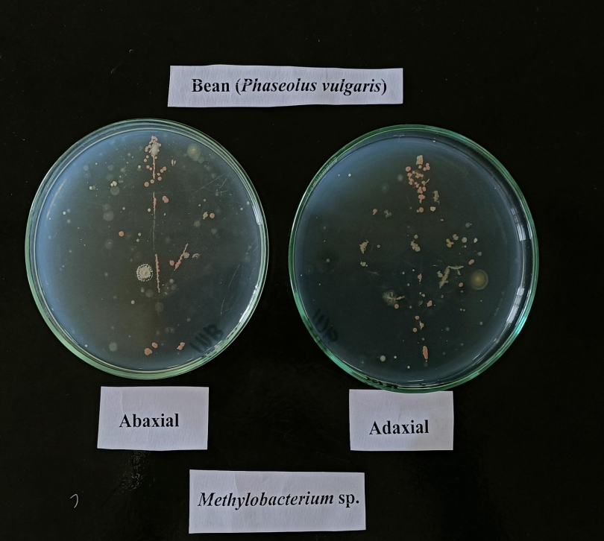

ISOLATION,CHARACTERIZATION AND SCREENING OF EPIPHYTIC PINK PIGMENTED FACULTATIVE METHYLOTROPHS FROM DIFFERENT HOST PLANTS AND THEIR GROWTH PROMOTING EFFECT ON RICE ( Oryzae Sativa )
Team members:
1. AGILA.P
2. GOKULAKRISHNAN.B
3. MALINI.K
4. PRASANNA.A
5. SARUMATHY.S
6. VIDHYA.K

Slide 14
Objectives
1. Isolation of Methylobacterium from Philosphere of different host crops.
2. Characterization of refined isolates for confirmation of Methylobacterium
3. Screening of selected Methylobacterium for their plant growth promoting traits
4. To evaluate the Methylobacterium for their PGP trait by seed inoculation assay

Slide 15
Details of sample collection and the isolate details
HOST CROP | AGE | PREVIOUS CROP | PLACE OF COLLECTION | NO OF COLONY IN Abaxial | NO OF COLONY IN Adaxial | NO OF ISOLATES | NO OF STRAIN IN HAND
BEAN | 50 DAYS | BEAN | PAJANCOA &RI | 69 | 5 | 2 | MB1 ,MB2
SUNFLOWER | 90 DAYS | GROUNDNUT | PAJANCOA &RI | 2 | 2 | 2 | MB 3,MB4
TOMATO | 56 DAYS | BHENDI | PAJANCOA &RI | 49 | 33 | 2 | MB 5,MB6
GROUNDNUT (TMV 7) | 70 DAYS | PADDY | NETTAPAKKAM | 2 | _ | 2 | MB7, MB8
BEAN | 65 DAYS | YARD LONG BEAN | PAJANCOA&RI | 37 | 22 | 2 | MB9 MB10,
EUCALPYTUS | 10 YEARS | - | PAJANCOA&RI | 11 | 6 | 2 | ,MB11, MB12
TOMATO | 45 DAYS | - | SATHANOOR | 2 | 3 | 2 | MB13,MB14
MULBERRY | MORE THAN 4 YEARS | MULBERRY | PAJANCOA &RI | 1 | 2 | 2 | MB15,MB16
GROUNDNUT | 90 days | GROUNDNUT | AMARAVATHIPUTHUR | 2 | 2 | 2 | MB17,MB18

Slide 16
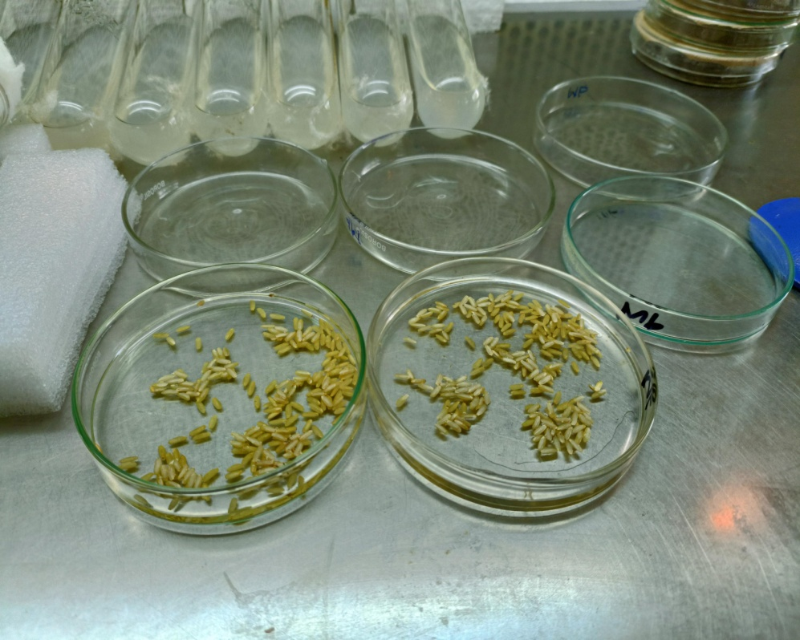
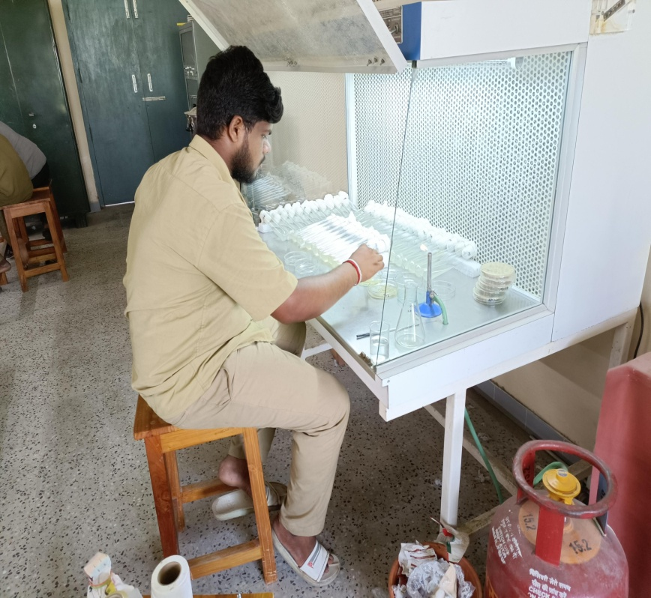
Student activities
Sterilization of paddy seeds
The seeds are sown in test tubes containing water agar media

Slide 17
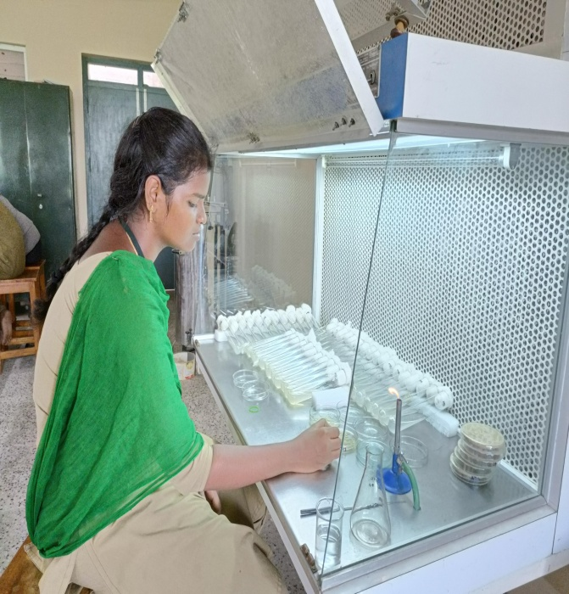
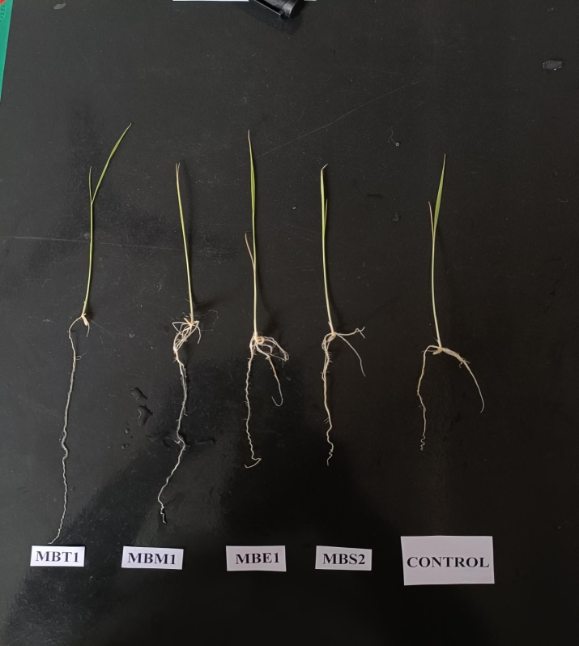
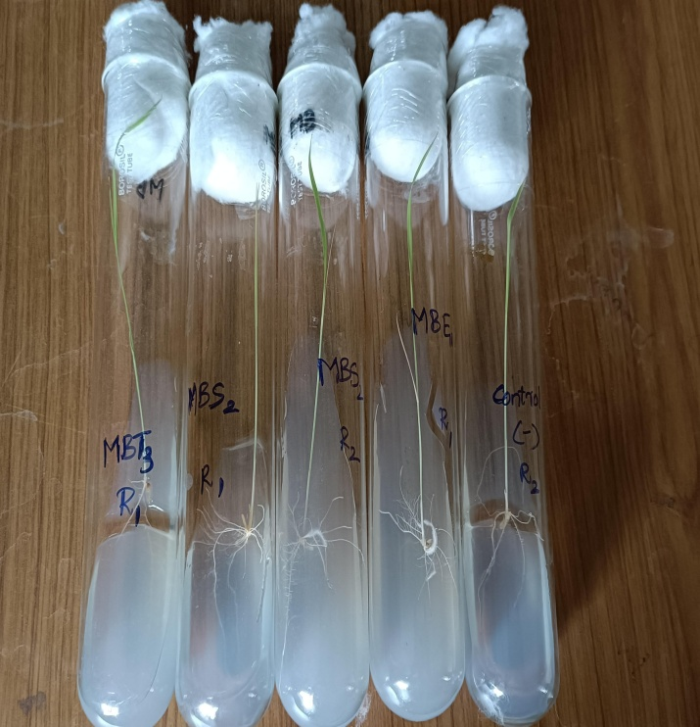
Student activities

Slide 18
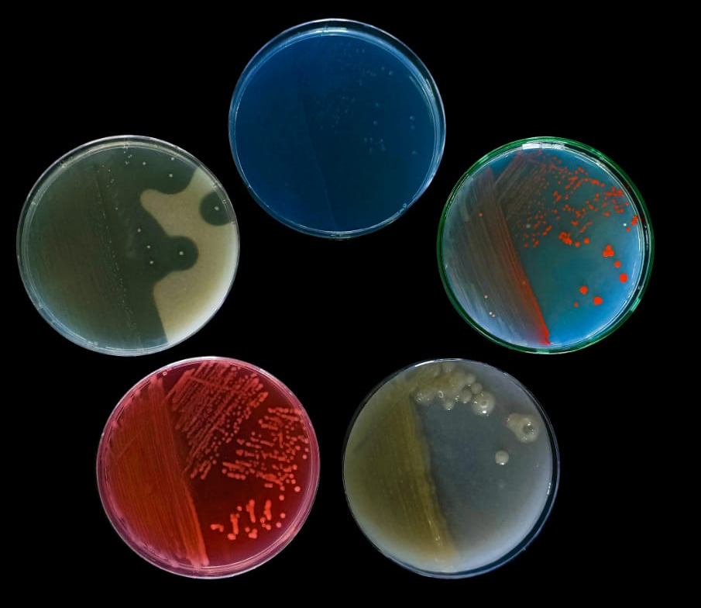

Product launched through ELP-414 course

Slide 19
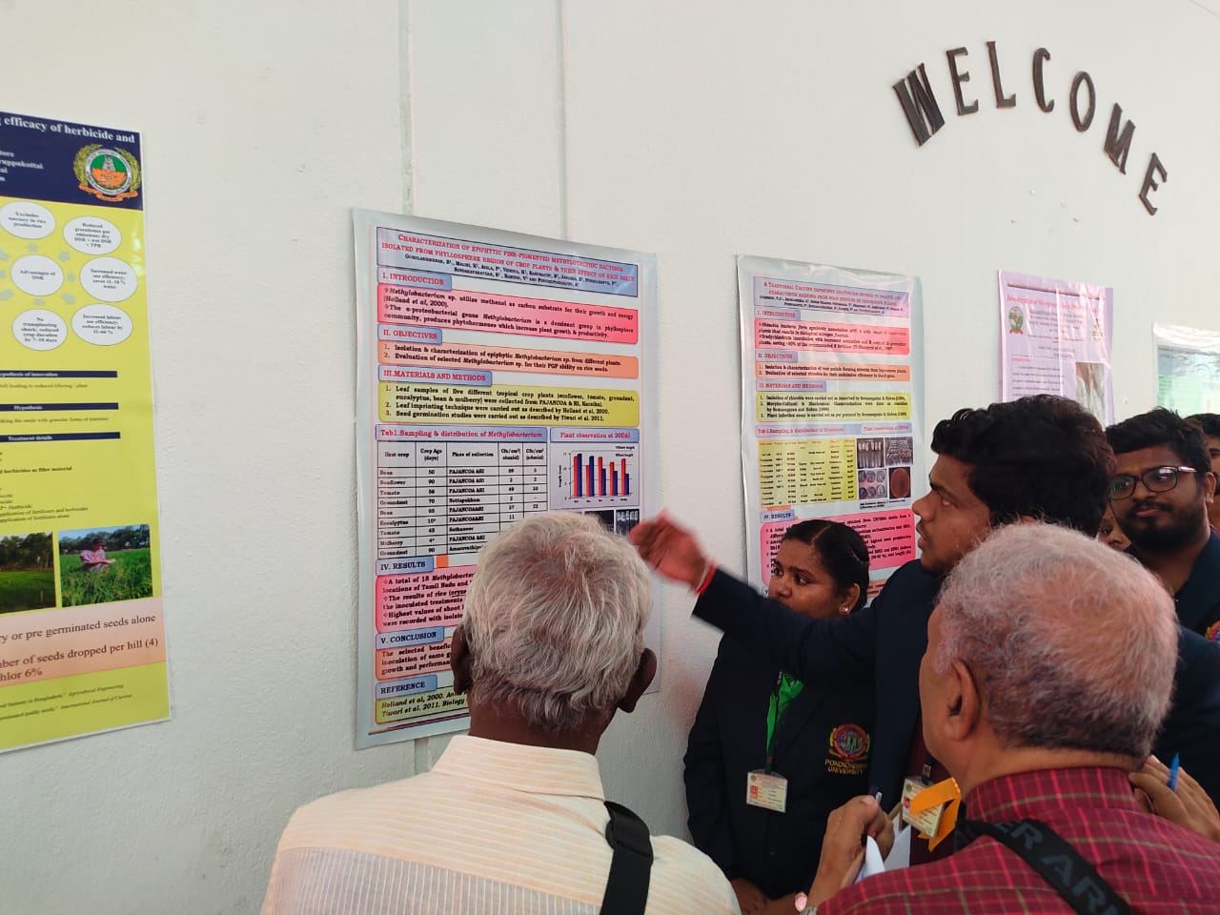
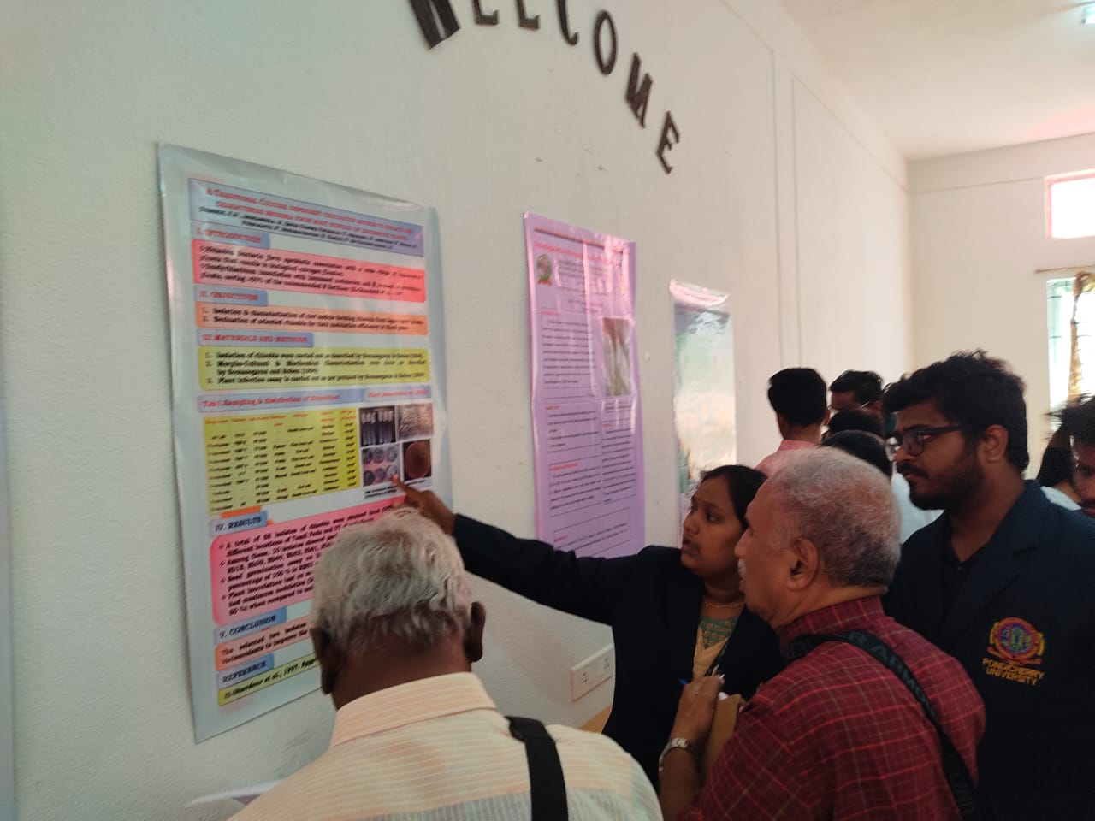
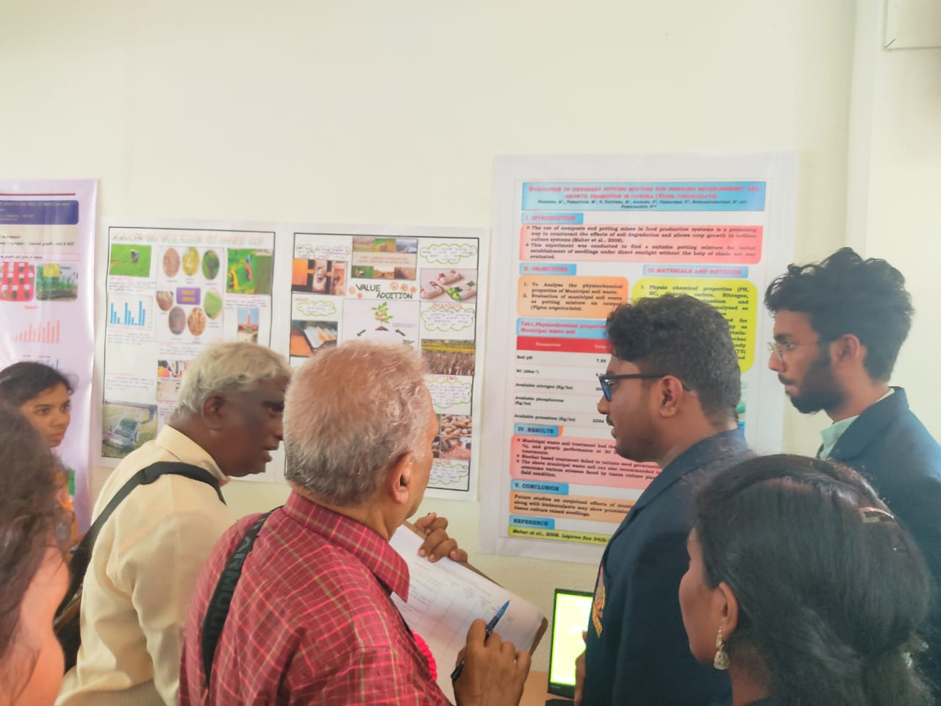
D. Workshops and seminars organized/planned for students by the department supported under the scheme
Among the 5 groups, 3 group (Methylobacterium, Rhizobium and Zinc solubilizing bacteria) were attended for National conference held at SBACRF, karaikudi.
FUNDED BY DBT-SCS

Slide 20
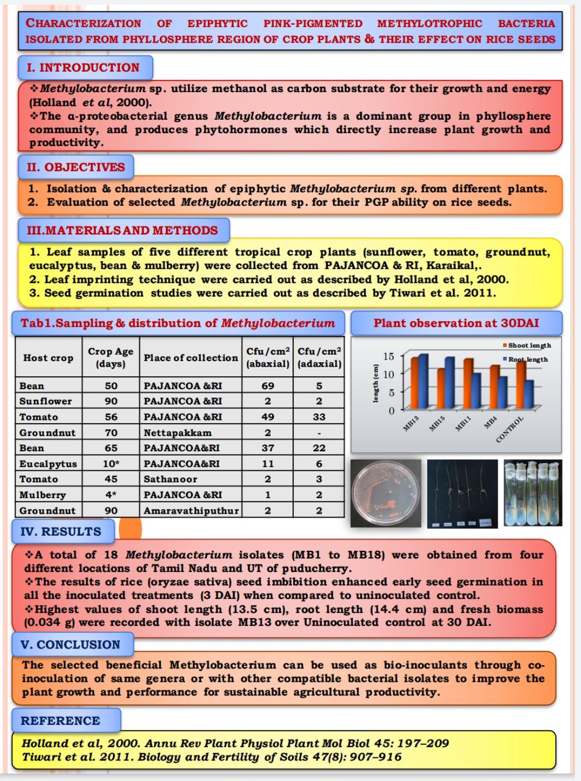
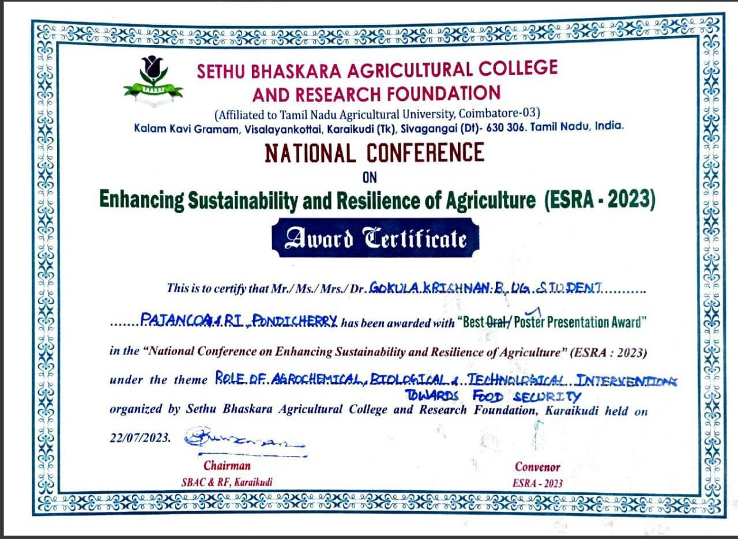
Gokulakrishnan, B., Malini, K, Agila, P, Vidhiya, K, Sarumathy, S, Jananee, S, Pushpakanth, P*, Sundaravarathan, S, Ramesh, V and Pouchepparadjou, A. 2023. National conference on “Enhancing sustainability and resilience of Agriculture” (ESRA-2023). SethuBhaskara Agricultural college and Research foundation, karaikudi. July-22.
BEST POSTER AWARD

Slide 21
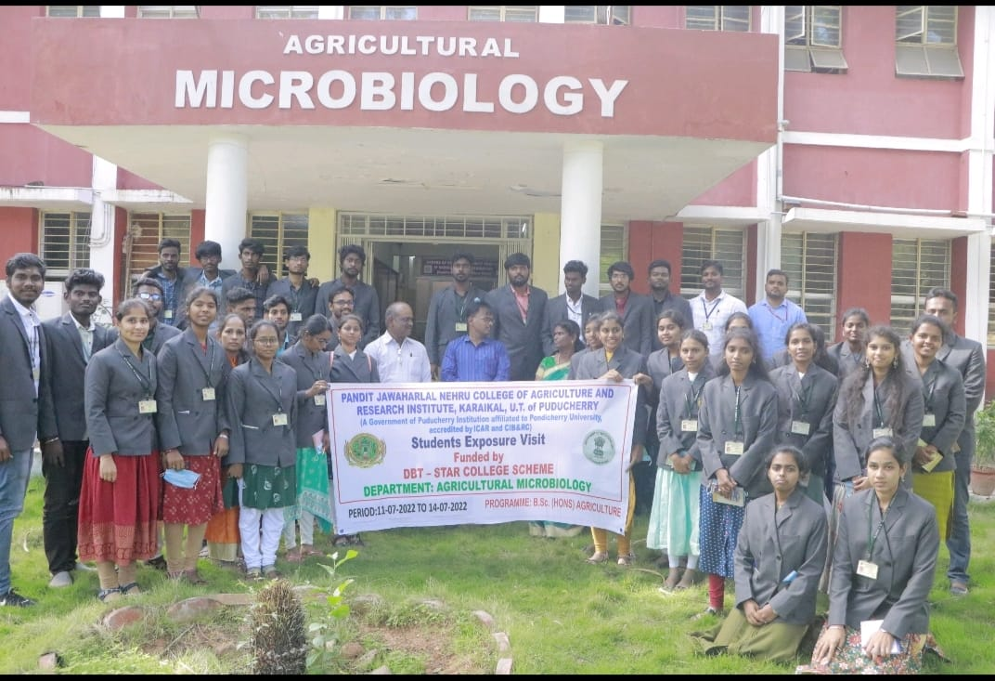
F. Visits to industry &important labs of national eminence
EXPOSURE VISIT UNDER STAR COLLEGE SCHEME (DBT)
Course code & title – EXP424 Bioinoculant production technology (0+5)
Date of visit – 11.07.2022 to 14.07.2022 (4 days)
Organizing department - Agricultural microbiology unit, PAJANCOA & RI
Place of visit- Deprtment of Agricultural Microbiology, TamilNadu Agricultural University, Coimbatore.
Accompanied staff –
Dr. A. Premkumar
Dr. M.Manikandan
No of students engaged- 37 (18 boys and 19 girls)
Outcome :
The students learnt about the large scale production of different biofertilizers because of this exposure visit along with culture preservation, carrier preparation, dos/don’t, production, annual turnover and marketing scenario etc
The students gained greater exposure, knowledge and skills rather than taking classes in classrooms.
It paves way for the students to improve their enterpreneurship skills
As per the objective, an exposure visit has been arranged to learn about the biofertilizer production and processing.

Slide 22
K. Budget expenditure
Budget | Amount alloted (in lakhs) | Amount spent (in 000`) | Balance
Non-Recurring | 3.0 Lakhs | 2,78,863.00 | Nil
Recurring | 0.75 lakhs |  | Nil
a. Chemicals |  | 33660.00
b. Glasswares |  | 20438.00
c. Exposure visit |  | 20902.00
Contigency | 0.10 lakhs | 10000.00 | Nil
Total | 3.85 lakhs | 3,63,863.00 | Nil
(Rs. 21,137 utilized by pathology thro mutual understanding)
Proposed instrument/equipment | Unit Cost (Rs.) | Number of Units | Actual Cost (000) | Date of Placing Order | Date of Receiving Equipment | Remark / Payment Voucher No. with Date
Microscope Micron optic KG-5 | 9735.00 | 17 | 1,65,495.00 | 31.01.2023 | 08.03.2023 | 781/A4 dated 20.03.2023
SANDY” Vertical Autoclave | 62068.00 | 01 | 62068.00 | 31.01.2023 | 08.03.2023 | 781/A4 dated 20.03.2023
REMI R8C PLUS centrifuge | 42704.00 | 01 | 42704.00 | 31.01.2023 | 18.02.2023 | 782/A4 dated 20.03.2023
Centrifuge Rotor | 8596.00 | 01 | 8596.00 | 24.02.2023 | 06.03.2023 | 782/A4 dated 20.03.2023
Total |  |  | 2,78,863.00

Slide 23
L. Future activities
1.
The effective bio inoculants identified with the assistance from DBT – SCS need to be evaluated under both pot culture and field level experiments to market the biofertilizer for the benefit of farmers.
2.
For large scale production, fermentors with larger capacities can adopt for mass multiplication of desired products (carrier and liquid based formulations) in a faster manner.
3.
Moreover students can successfully involved in this mass production activity may leads to enterpreunership development rather than taking students for bioferilizer production units.

