Slide 1
DEPARTMENT OF AGRONOMY
PAJANCOA&RI, KARAIKAL
ADVISORY COMMITTEE MEETING
DBT-SCS
09.08.2023

Slide 2
UNITS IN THE
DEPARTMENT OF AGRONOMY
AGRONOMY
ANIMAL HUSBANDRY
AGRICULTURAL ENGINEERING

Slide 3
Agronomy Courses offered to UG
Degree | Code | Course Title | Cr. Hr
B.Sc. (Hons.) Agri. | AGR 101 | Fundamentals of Agronomy and Agrl. Heritage | 2+1
 | AGR 102 | Introductory Agro-met. & Climate change | 1+1
 | AGR 201 | Irrigation Management | 1+1
 | AGR 202 | Crop Production Technology – I (Kharif crops) | 2+1
 | AGR 203 | Farming System and Sustainable agriculture | 1+0
 | AGR 204 | Geoinformatics & Nano-tech & Precision Fmg. | 1+1
 | AGR 301 | Practical Crop Production – I (Kharif crops) | 0+1
 | AGR 302 | Crop Production Technology –II (Rabi crops) | 2+1
 | AGR 303 | Rainfed Agriculture and Watershed Mgt. | 1+1
 | AGR 304 | Practical Crop Production – II (Rabi crops) | 0+1
 | AGR 305 | Principles of Organic Farming | 1+1
B.Sc. (Hons.) Horti. | AGR 111 | Weed Mgt. in Horticultural Crops | 1+1
 | AGR 211 | Agro-climatology and Climate Change | 1+1
 | AGR 212 | Water Mgt. in Horticultural Crops | 1+1
 | AGR 311 | Introduction to Major Field Crops | 1+1
 | AGR 312 | Organic Farming | 2+1

Slide 4
Ag. Engg. Courses offered to UG
Degree | Code | Course Title | Cr. Hr
B.Sc. (Hons.) Agri. | AEG 201 | Farm Machinery and Power | 1+1
 | AEG 202 | Soil & Water Conservn. Engg. | 1+1
 | AEG 301 | Renewable Energy & Green Tech | 1+1
 | AEG 302 | Protected Cultivn. and Secondary Agri. | 1+1
B.Sc. (Hons.) Horti. | AEG 211 | Farm Power and Machinery | 1+1
AH Courses offered to UG
Degree | Code | Course Title | Cr. Hr
B.Sc. (Hons.) Agri. | AMP 201 | Livestock & Poultry Mgt. | 2+1

Slide 5
Experiential Learning Courses offered
Degree | Code | Course Title | Cr. Hr
B.Sc. (Hons.) Agri. | ELP 406 | Integrated Farming System | 0+10
 | ELP 407 | Poultry production Technology | 0+10

Slide 6
PHYSICAL ACHIEVEMENTS

Slide 7
LIST OF INSTRUMENTS/EQUIPMENTS PURCHASED
Sl. No. | Instrument | Amount (Rs.)
1 | Hot air oven (2 No.) | 103740
2 | Water distillation unit | 59535
3 | Flame photometer | 49350
4 | Spectrophotometer | 56175
5 | Wiley Mill 0.25 HP | 23506
6 | Aneroid barometer | 19268
7 | Macro-kjeldahl distillation (Stove) | 7900
8 | Soxhlet apparatus | 12443
9 | Gypsum blocks with Multimeter | 59000
10 | Double ring infiltrometer | 24190

Slide 8
LIST OF INSTRUMENTS/EQUIPMENTS PURCHASED
Sl. No. | Instrument | Amount (Rs.)
11 | Tubular soil sampler | 14750
12 | Tensiometer (2 No.) | 14868
13 | Handheld GPS (2 No.) | 50798
14 | Digital planimeter | 45902
15 | Precision Analytical balance | 62948
16 | Spades (50 nos.) | 37500
17 | Sickles (15 nos.) | 4500
18 | LCD projector | 52332
 | Agronomy Total (A) | 6,98,705

Slide 9
LIST OF INSTRUMENTS/EQUIPMENTS PURCHASED
Sl. No. | Instrument | Amount (Rs.)
19 | Poultry Equipments (Feeder, Water etc.) | 15800
20 | Chaff cutter (2.0 HP) | 33936
 | Animal Husbandry Total (B) | 49,736

Slide 10
LIST OF INSTRUMENTS/EQUIPMENTS PURCHASED
Sl. No. | Instrument | Amount (Rs.)
21 | Cultivator cup feed seeddriller – Miniature model | 9713
22 | Improved gorru seed cum fertilizer drill (Animal drawn) | 5040
23 | Helical blade puddler – miniature model | 3623
24 | Indigeneous plough – miniature model | 6142
25 | Disc harrow – miniature model | 6153
26 | Basin lister – miniature model | 9345
27 | Biogas plant – miniature model (Deenapandhu) | 6773
28 | Threashing drums – spike tooth | 7087

Slide 11
LIST OF INSTRUMENTS/EQUIPMENTS PURCHASED
Sl. No. | Instrument | Amount (Rs.)
29 | Hand operated eight rows paddy drum seeder | 6500
30 | Tractor operated seed cum fertilizer drill for paddy | 72800
31 | Power operated paddy thresher | 50000
32 | Power operated paddy weeder | 45459
33 | Manual cum battery operated knapsack sprayer (3 No.) | 12800
 | Agricultural Engineering Total ( C ) | 2,41,435
 | GRAND TOTAL (A+B+C) | 9,89,876

Slide 12
NEW PRACTICALS STRENGTHENED
Measurement of field boundaries using GPS meters
Recording coordinates for the conversion of off-line map to digital map
Measurement of Atm. Pressure using aneroid barometer
Measurement of Infiltration rate of soil
Core sampling technique
Measurement of soil moisture using tensiometers
Measurement of soil moisture using electrical resistance blocks
Plant Nutrient Analysis using Spectrophotometer/
Flame photometer
Rearing of poultry birds and gaining practical experience in ELP course
Operation of power weeder during crop production course
Operation of paddy thresher during crop production course
Operation of seed-cum-fertilizer drill during crop production course

Slide 13
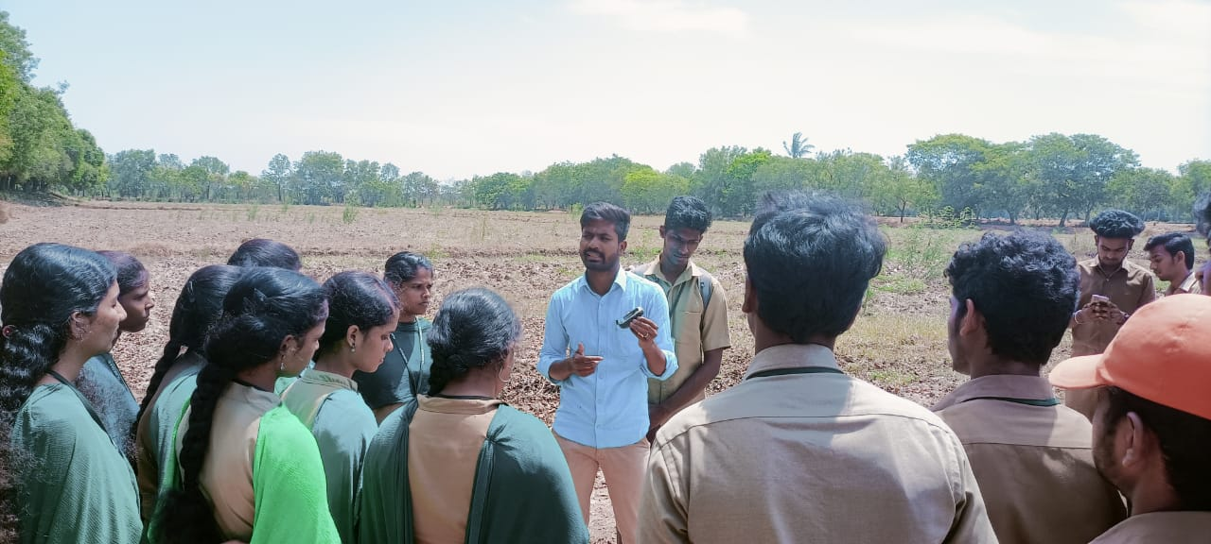
USING GPS METERS

Slide 14
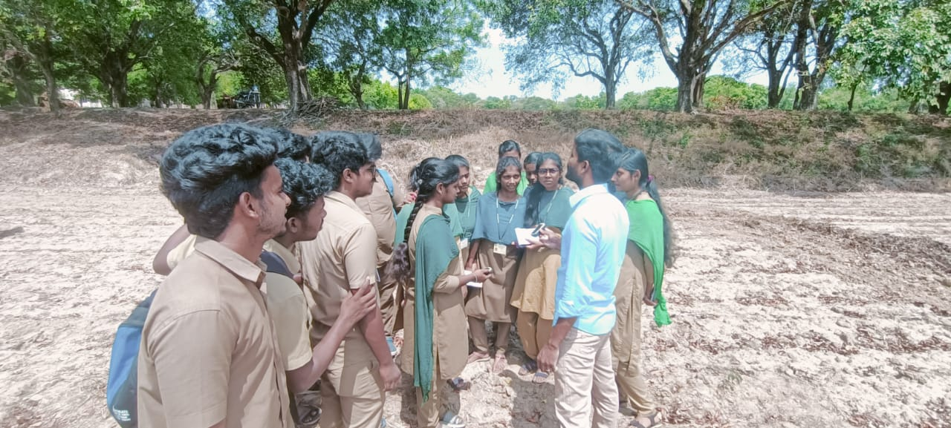
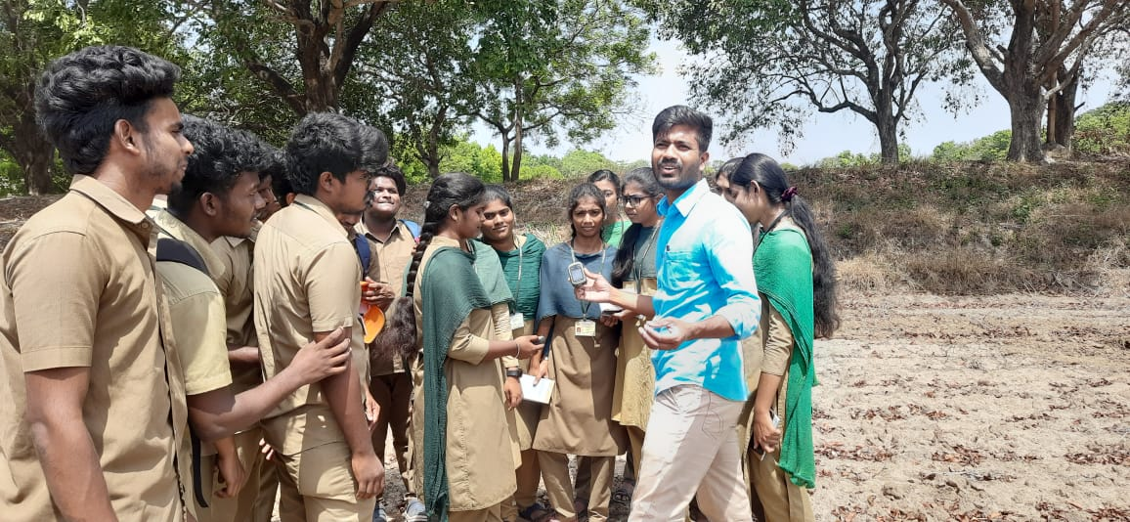
USING GPS METERS

Slide 15
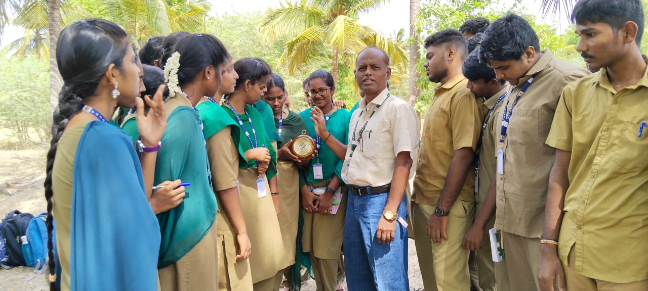
USING ANEROID BAROMETER

Slide 16
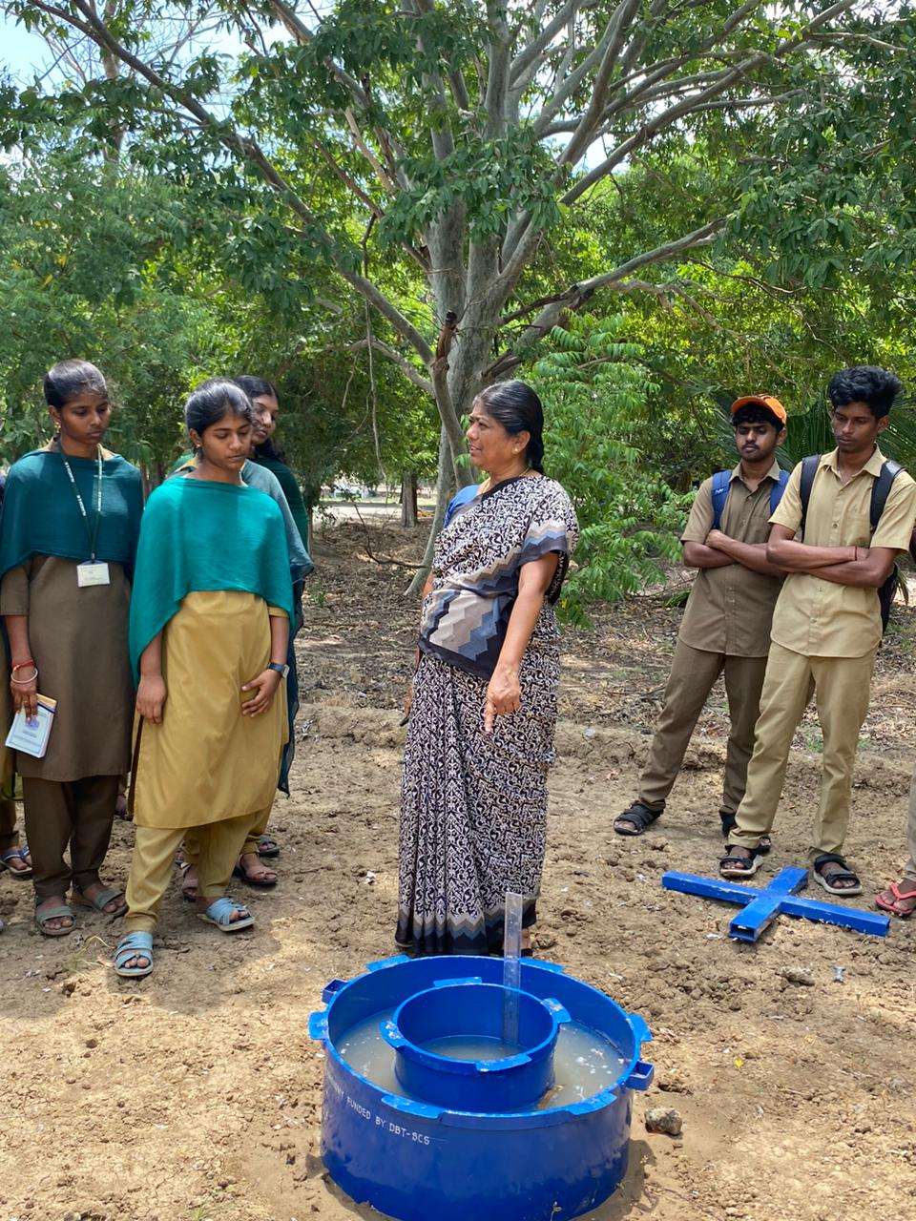
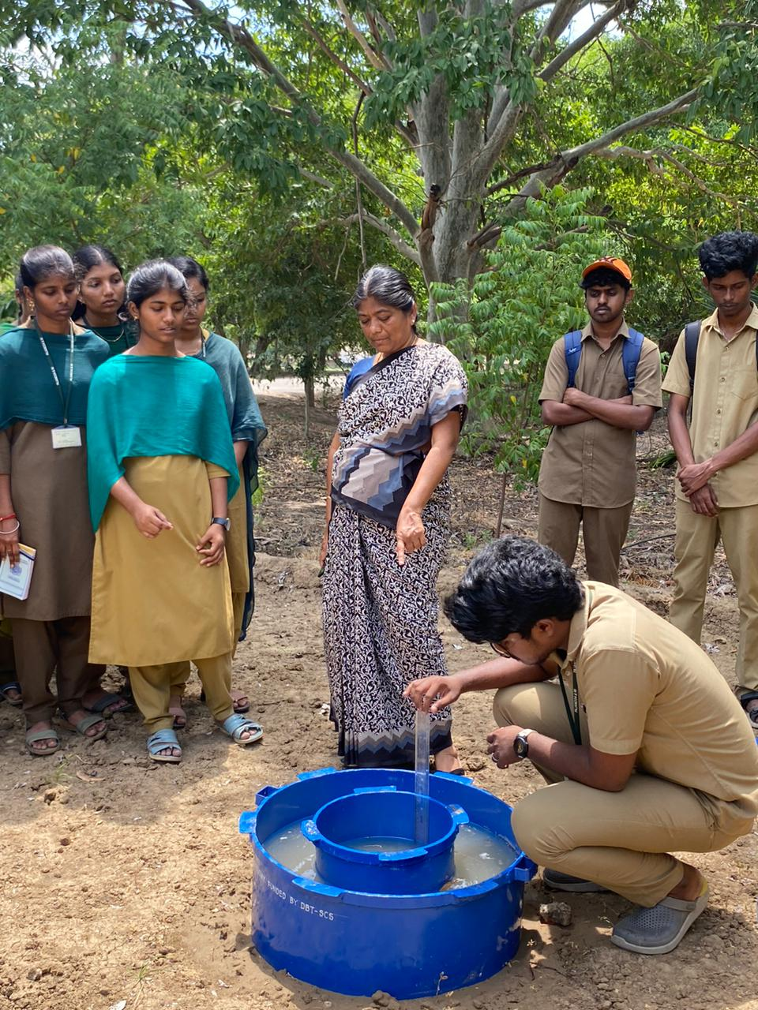
MEASURING INFILTRATION RATE

Slide 17
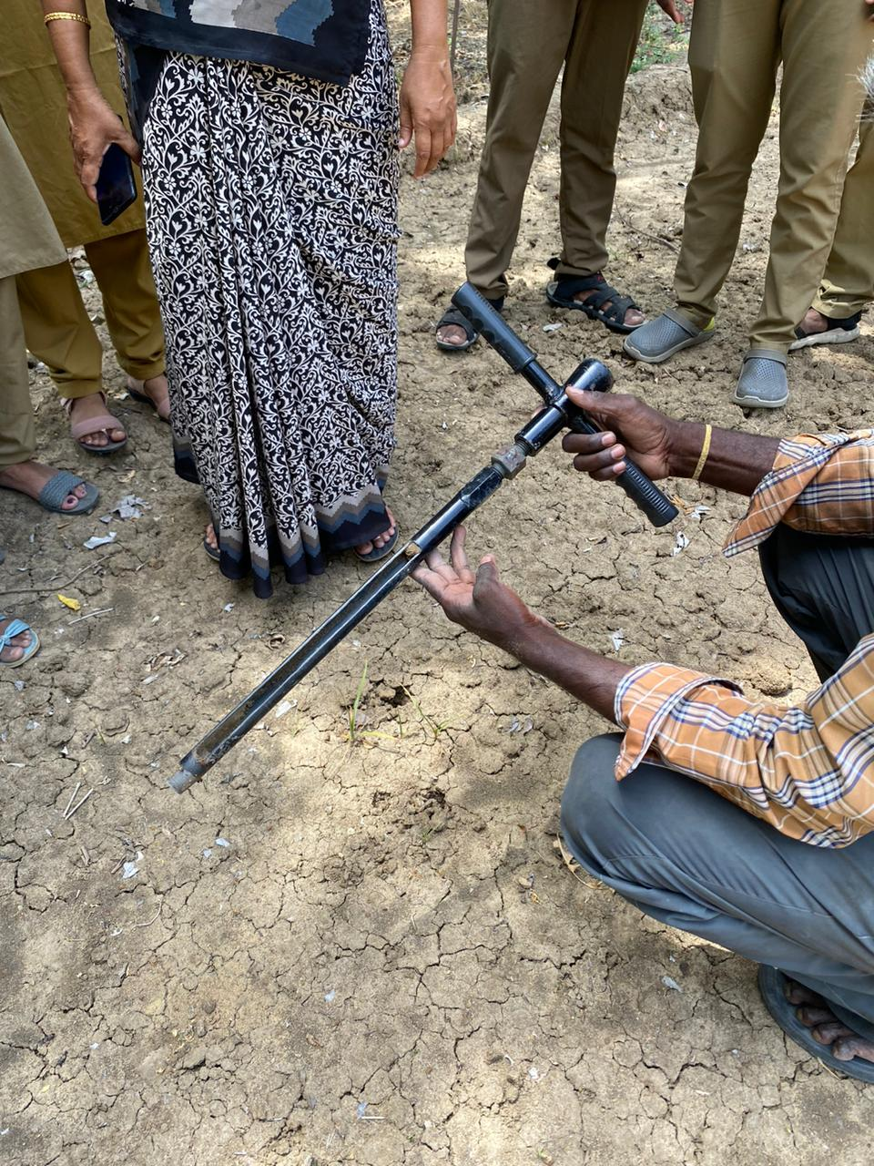
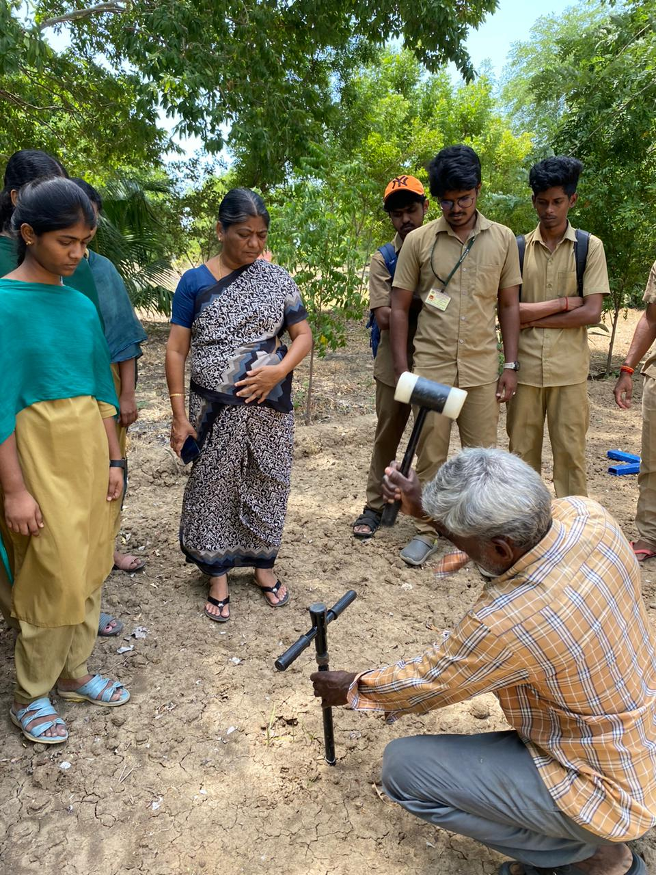
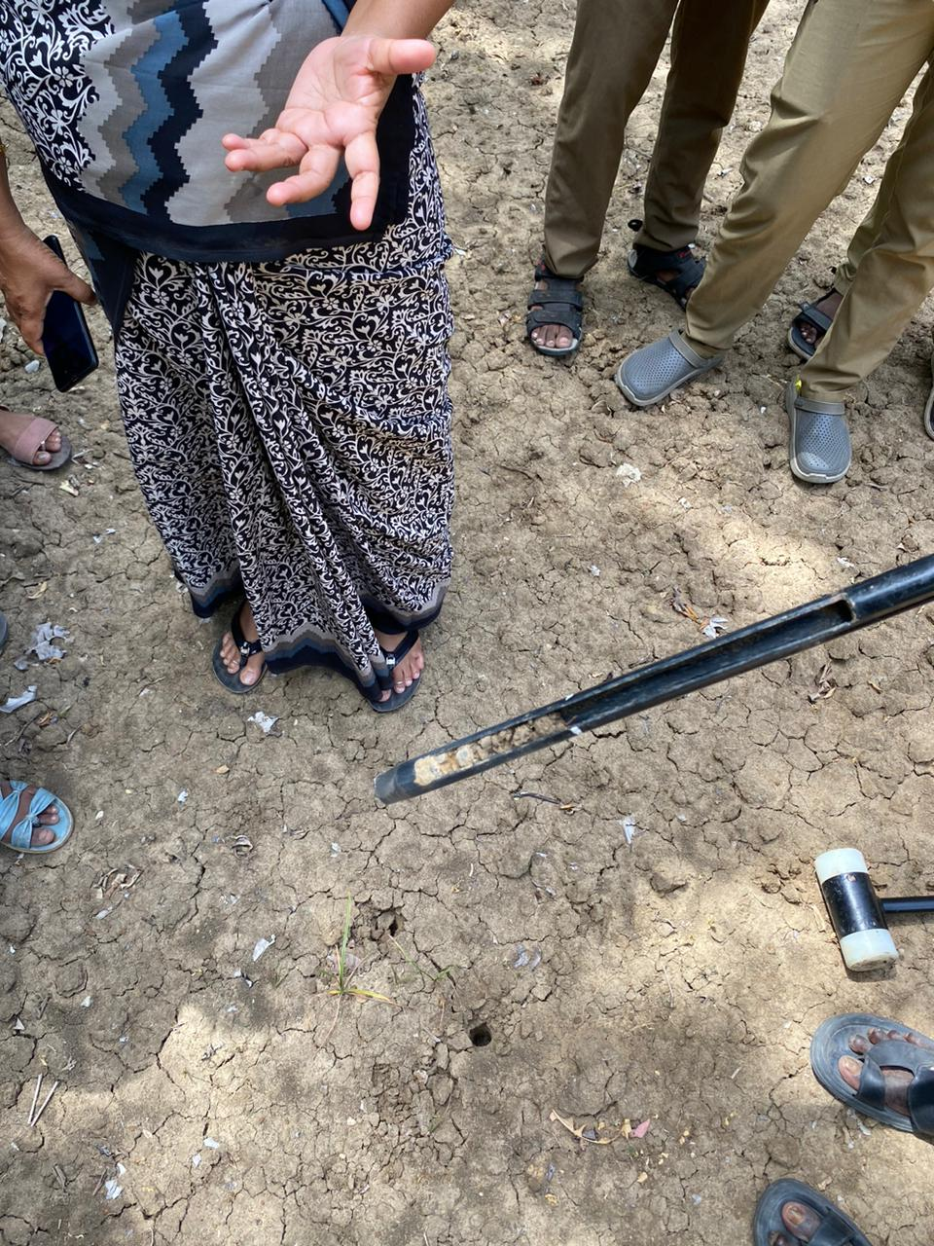
USING TUBULAR SOIL AUGER

Slide 18
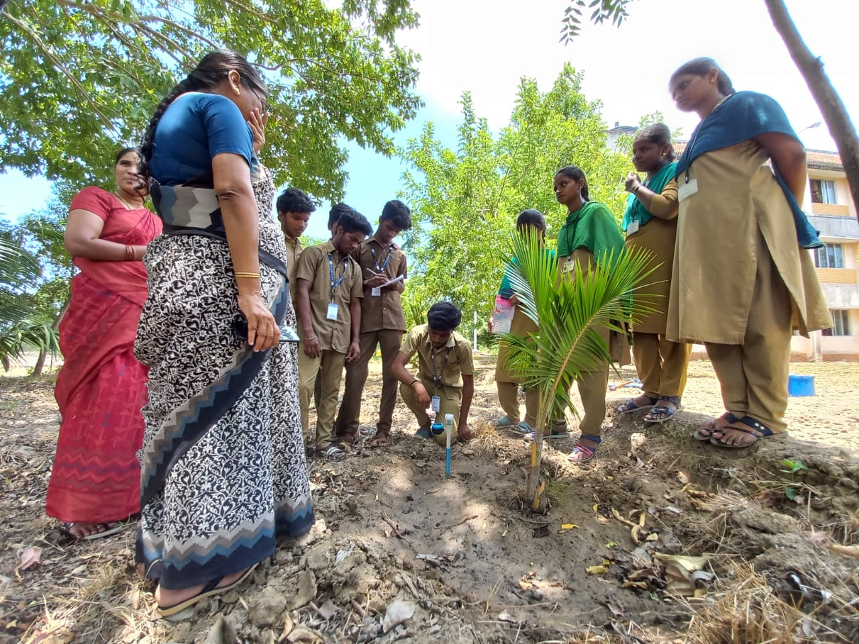
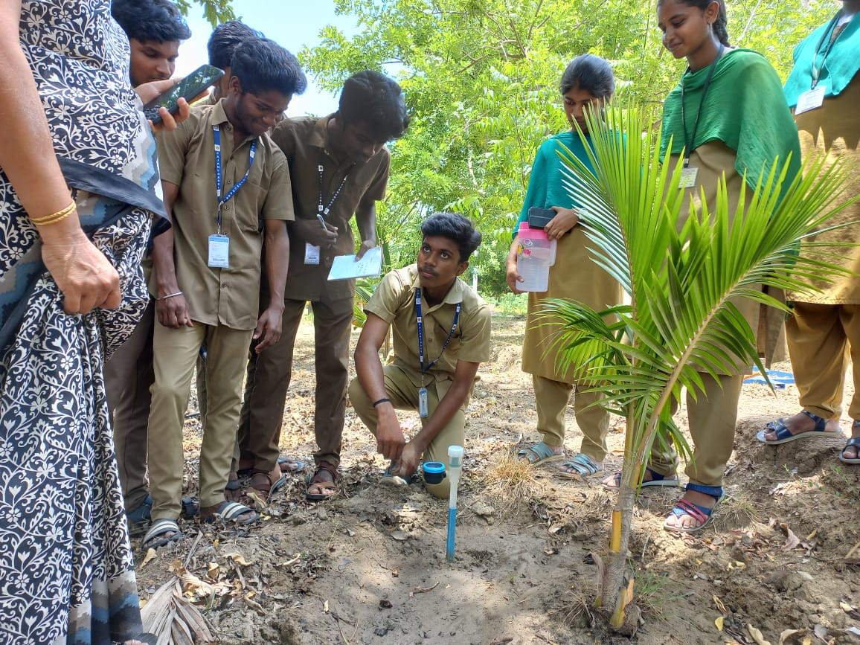
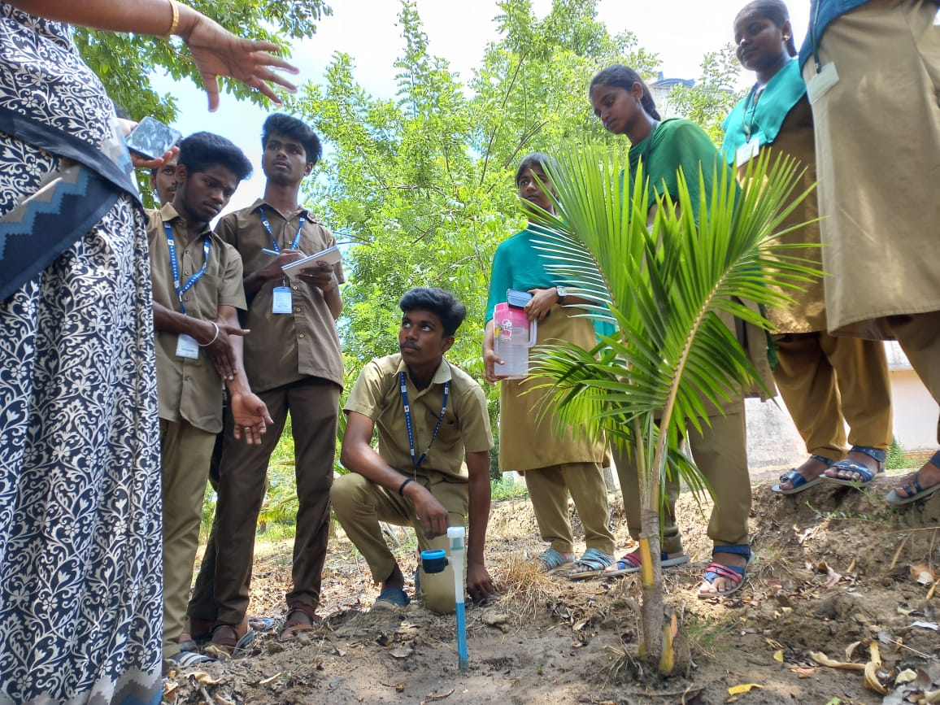
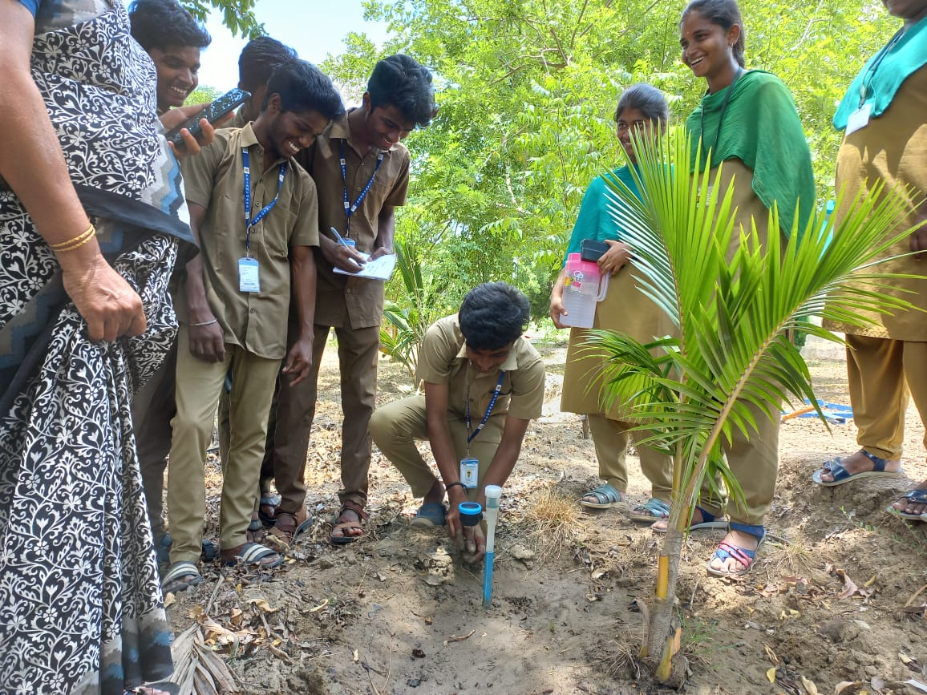
SOIL MOISTURE MEASUREMENT USING TENSIOMETER

Slide 19
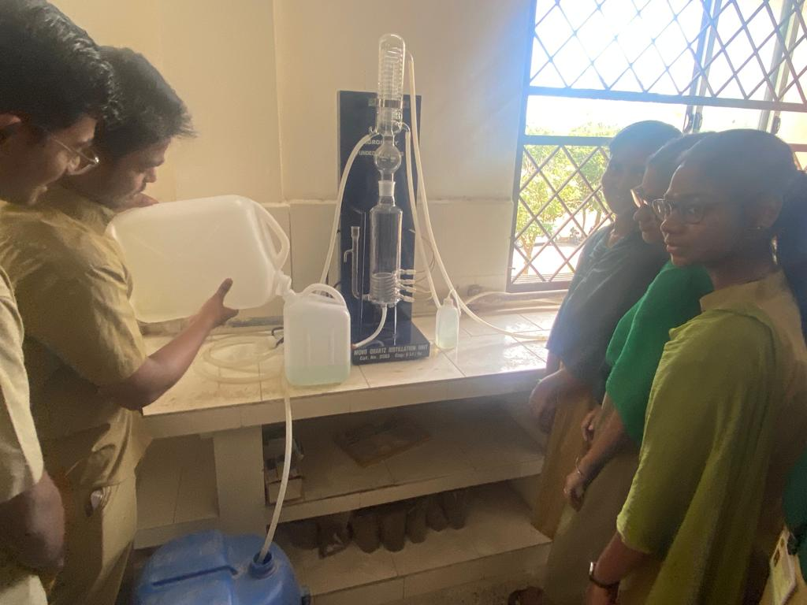
COLLECTION OF DISTILLED WATER FOR LABOROTARY EXPERIMENTS

Slide 20
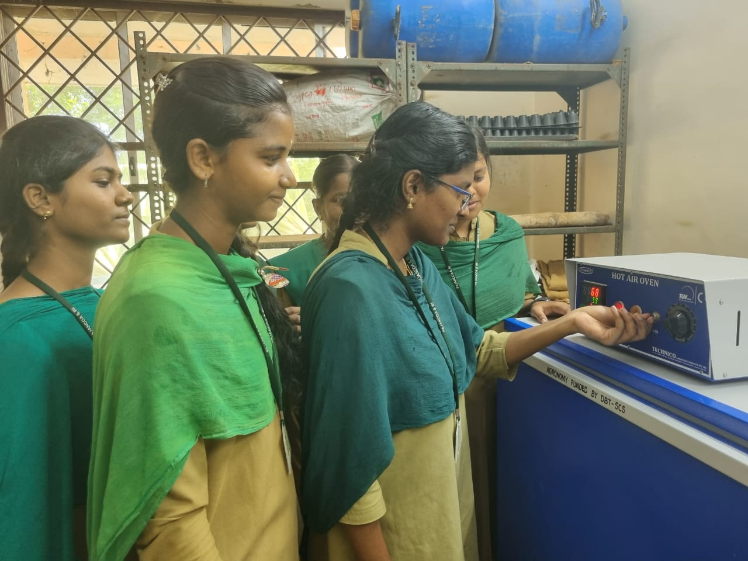
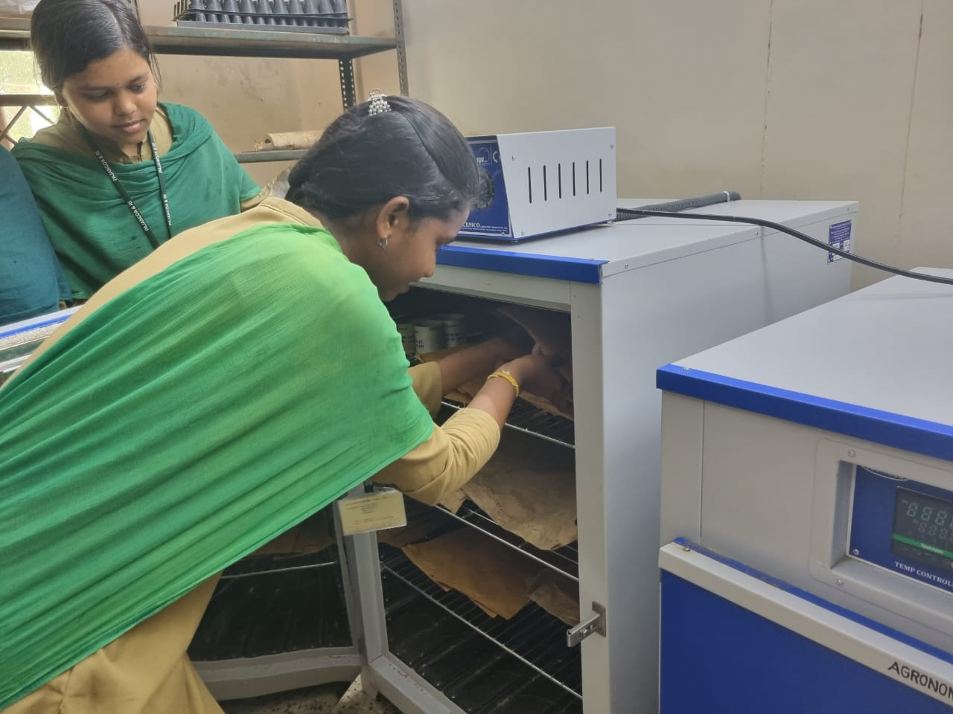
DRYING OF PLANT SAMPLES
IN HOT AIR OVEN

Slide 21
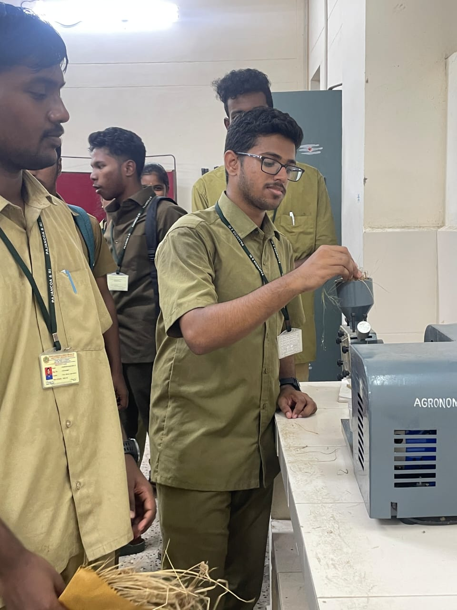
PROCESSING PLANT SAMPLES USING WILLEY MILL

Slide 22
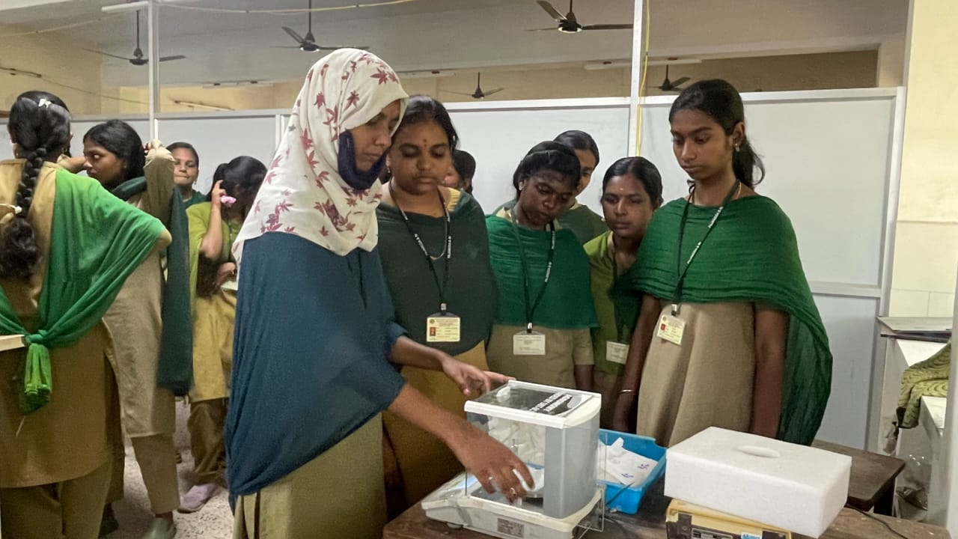
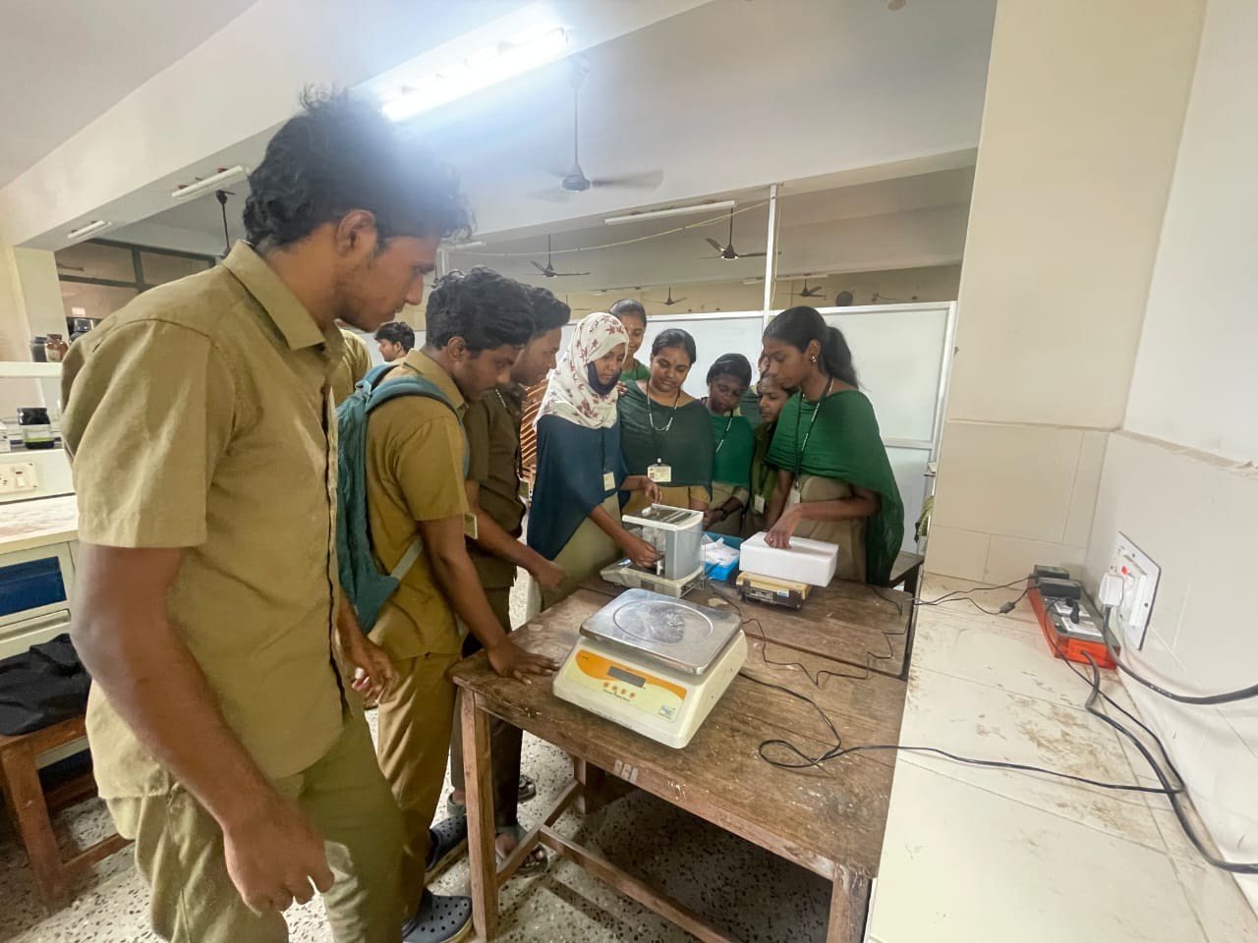
WEIGHING PLANT SAMPLES

Slide 23
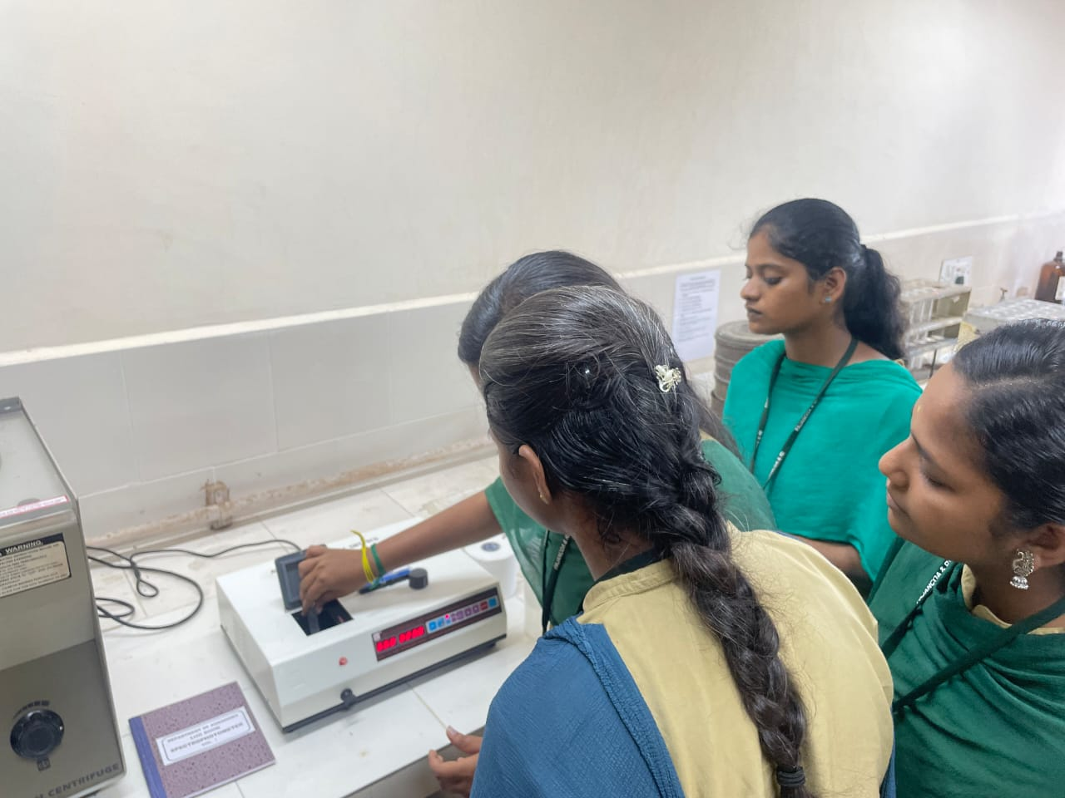
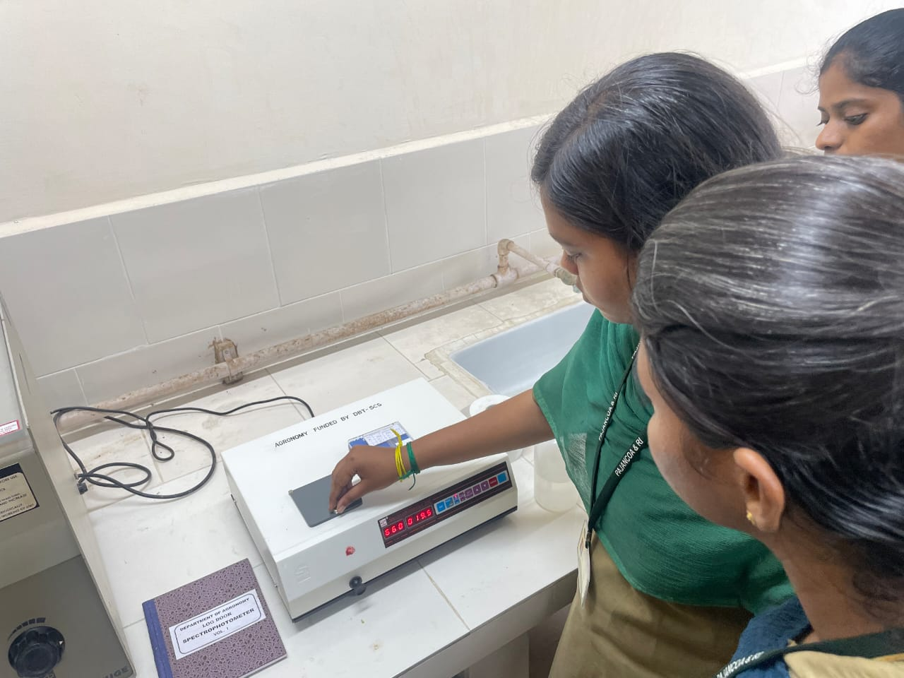
ANALYSIS USING SPECTROPHOTOMETER

Slide 24
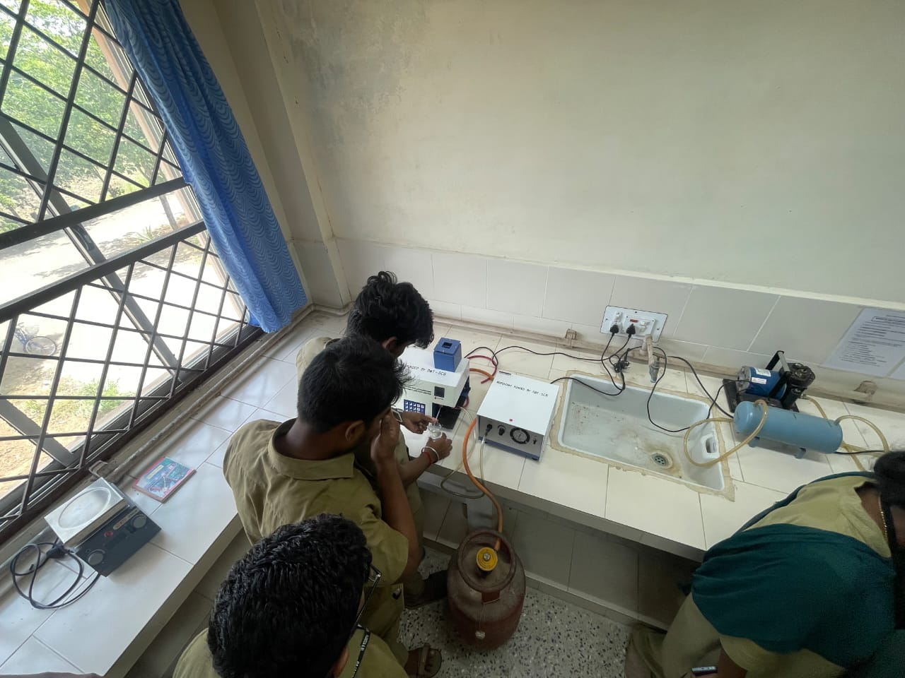
ANALYSIS USING
FLAMEPHOTOMETER

Slide 25
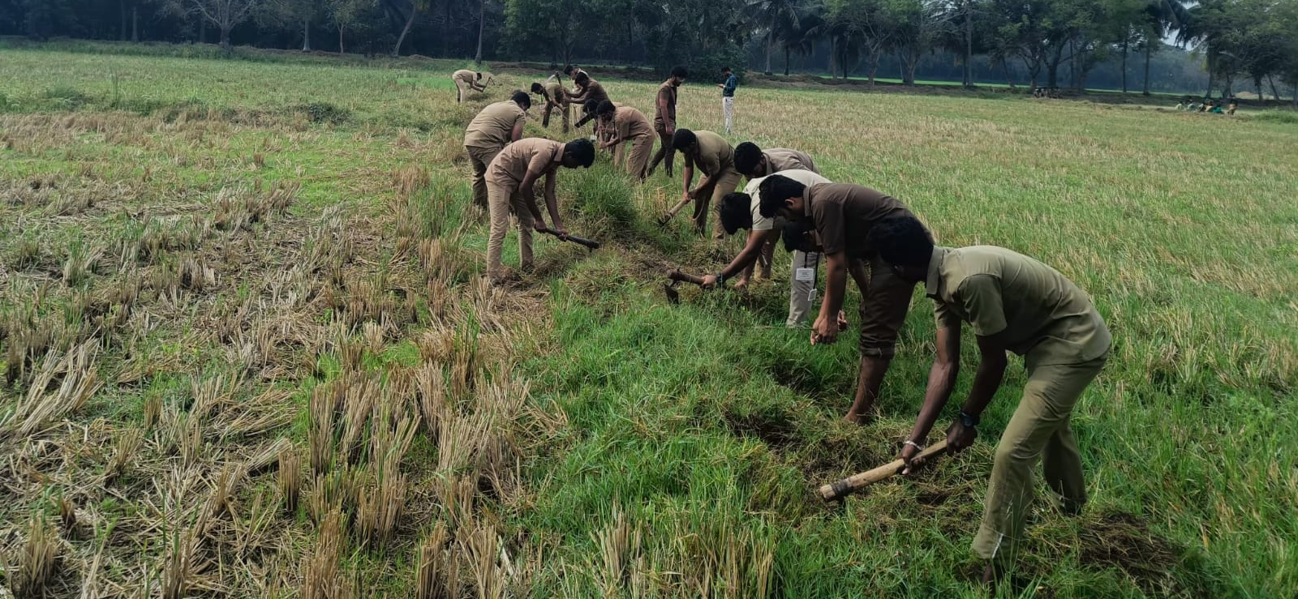
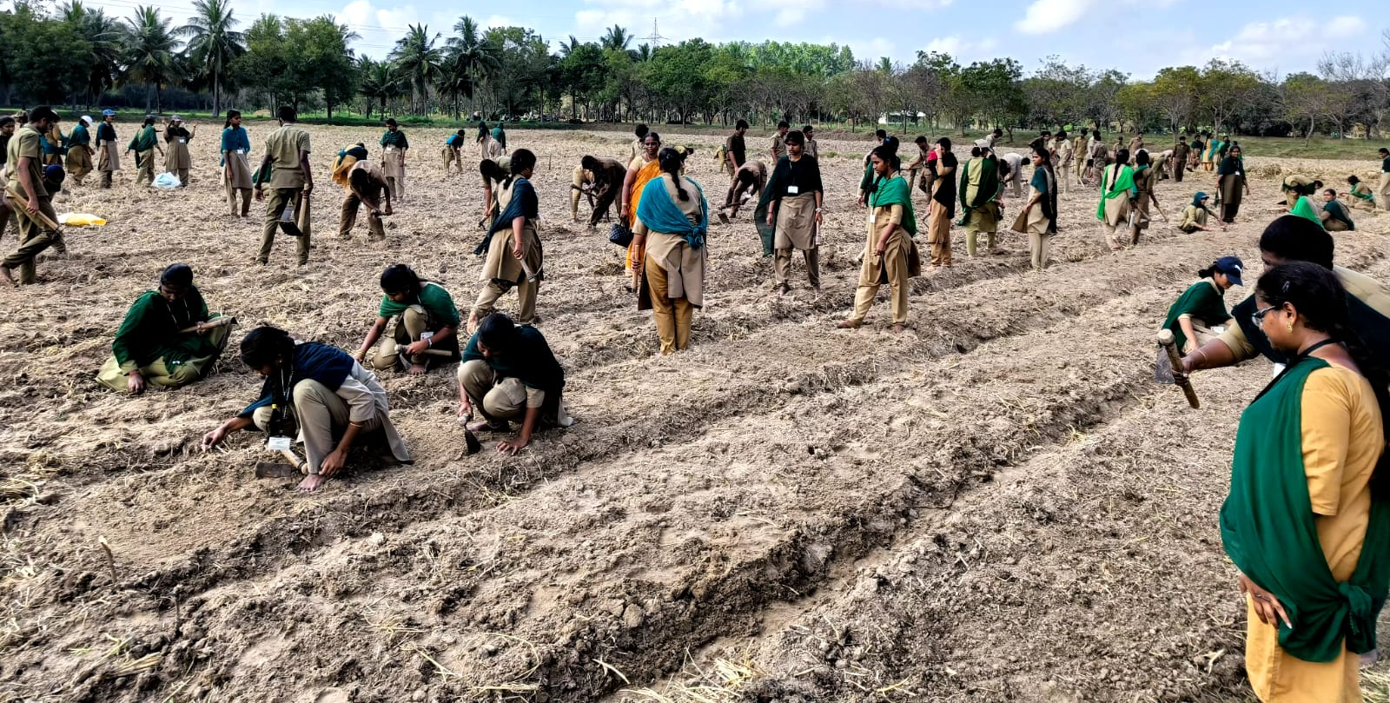
WORKING WITH FARM TOOLS

Slide 26
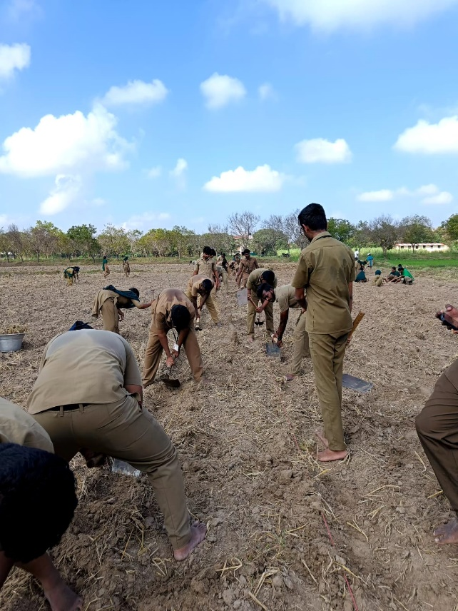
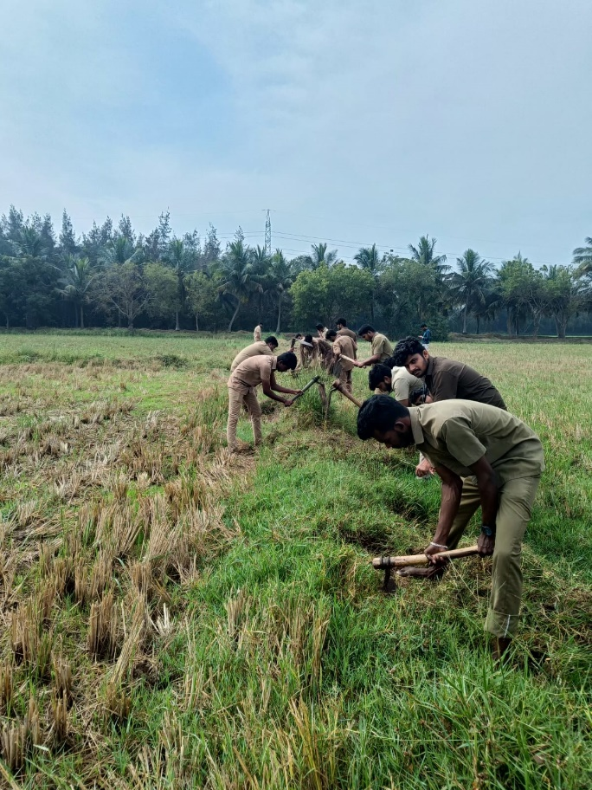
WORKING WITH FARM TOOLS

Slide 27
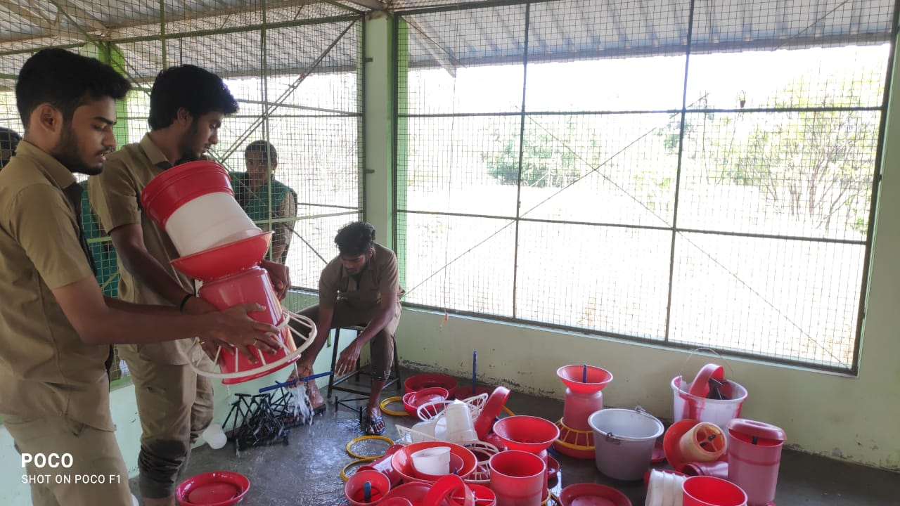
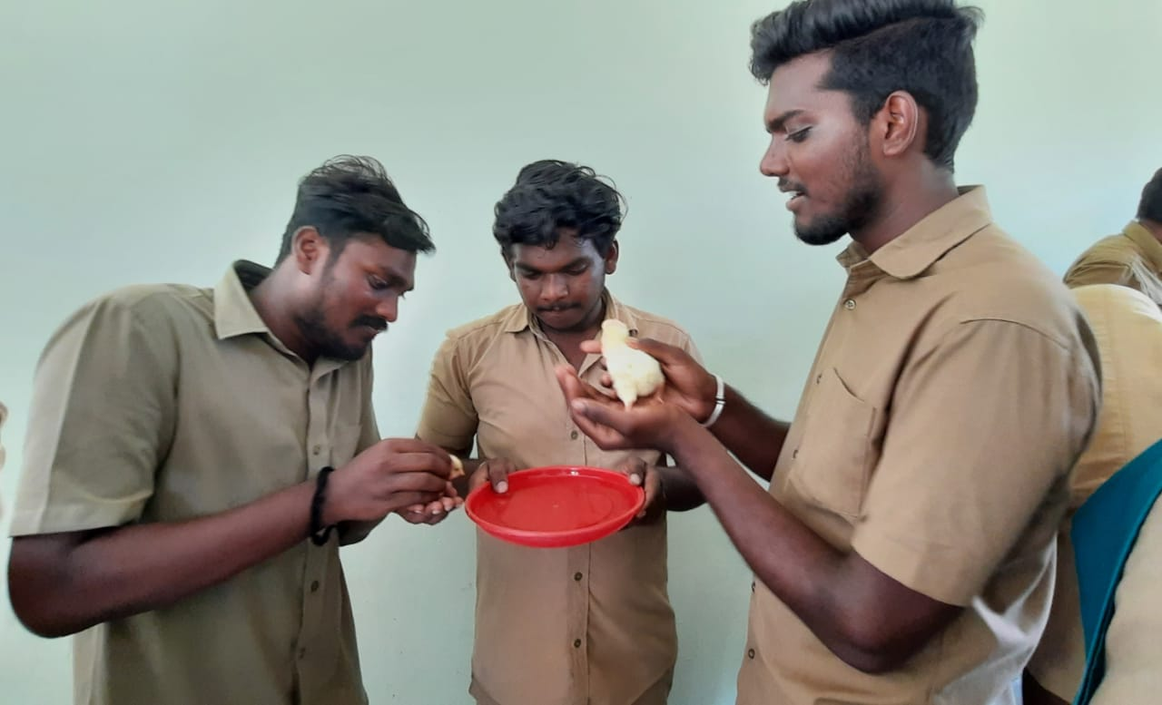
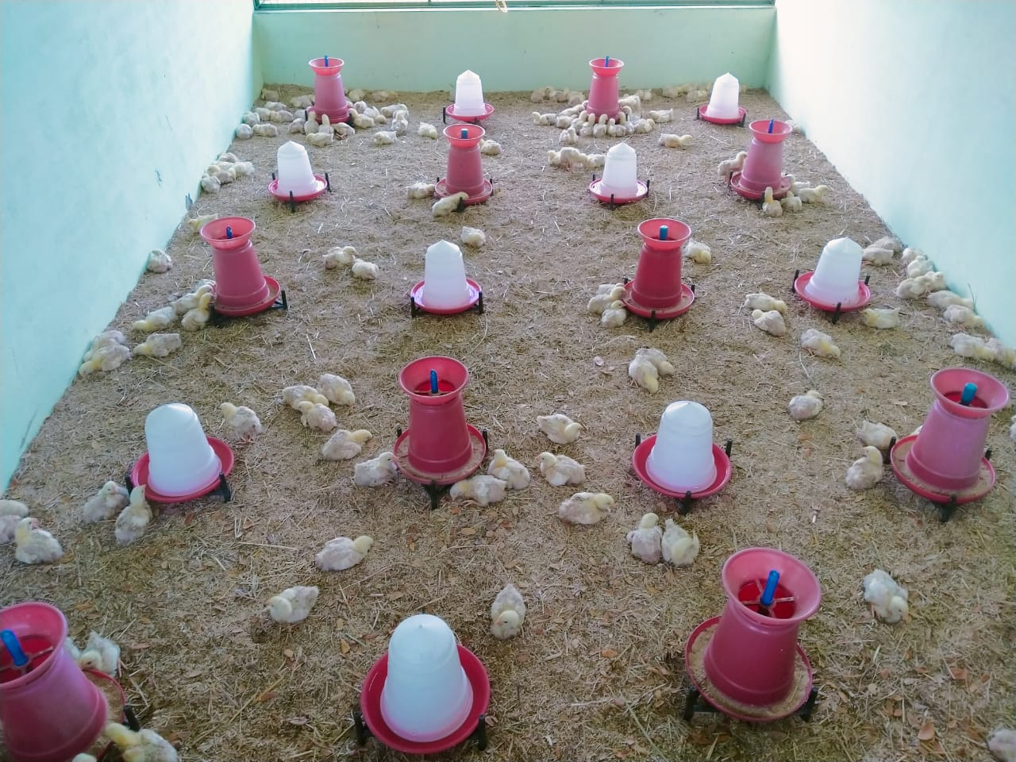
POULTRY PRODUCTION

Slide 28
OPERATION OF POWER WEEDER
Power Weeder

Slide 29
OPERATION OF PADDY THRESHER
Paddy Thresher

Slide 30
OPERATION OF SEED DRILL
Seed Drill

Slide 31
Visits to industry / labs of national eminence

Slide 32
Visits to industry/labs
Year : IV B.Sc. (Agri) – 2018-19 Batch
Period : 26.06.2022 to 29.06.2022
Place of visit | Skill learning by the students
IFS unit in Farmers Field, Erode; | The students learnt about organic farming in banana and linkage of IFS units.
IFS Unit, TNAU, Coimbatore | Students had learnt about wetland and gardenland IFS models
Department of Remote sensing and GIS, TNAU, Coimbatore | Students learnt the applications of remote sensing and drone in agriculture; Use of remote sensing in soil fertility mapping and identification of problem soils.

Slide 33
Visits to industry/labs
Year : IV B.Sc. (Agri) – 2018-19 Batch
Period : 26.06.2022 to 29.06.2022
Place of visit | Skill learning by the students
Soil Testing Lab, Coimbatore | Students were exposed to collection, processing, coding and analysis of soil samples.
Rose Nursery, Coimbatore | Students had hands on training on propagation methods in rose and other horticultural crops
Indian Institute of Soil and Water conservation, Ooty | Students learnt about water conservation and watershed management activities.

Slide 34
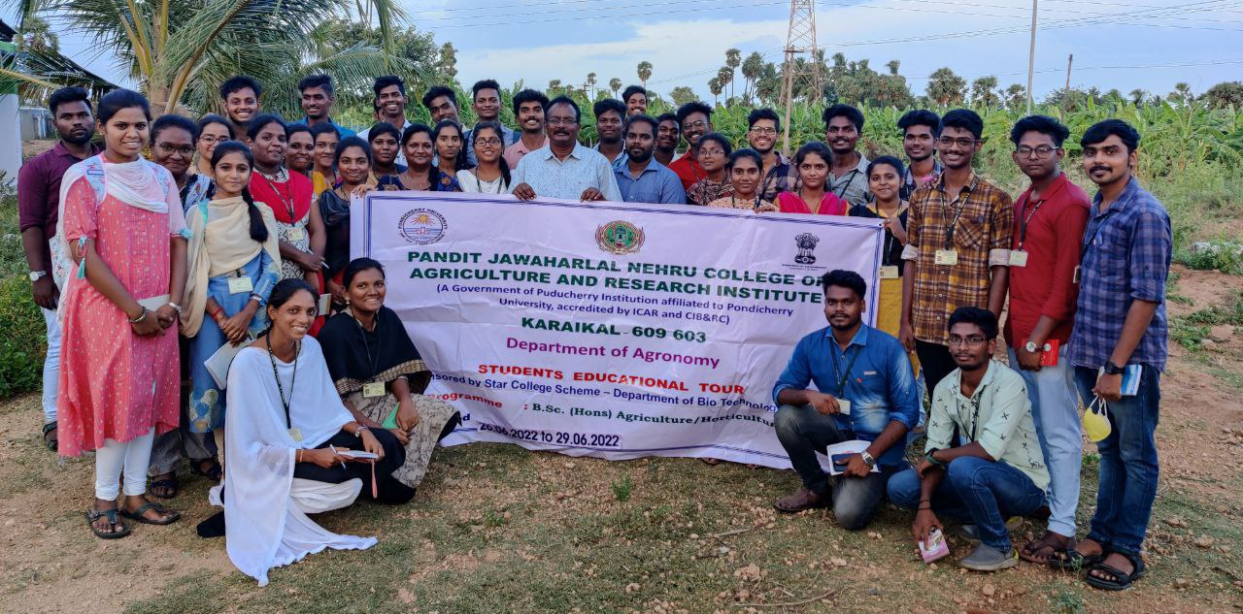
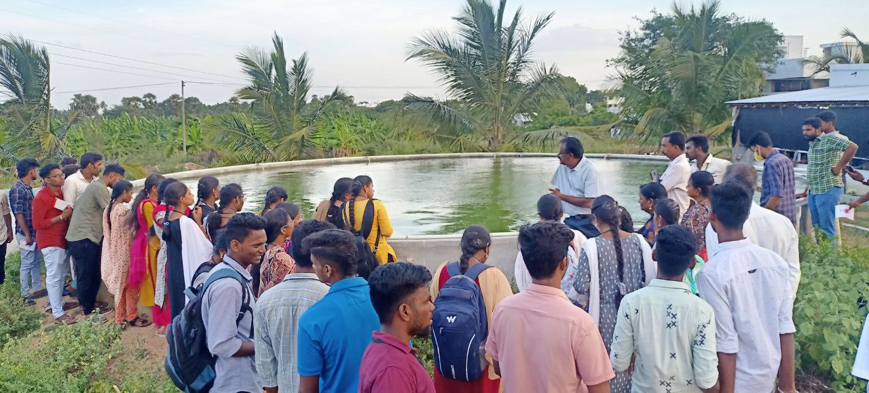
Visit to IFS Farm, Erode, TN

Slide 35
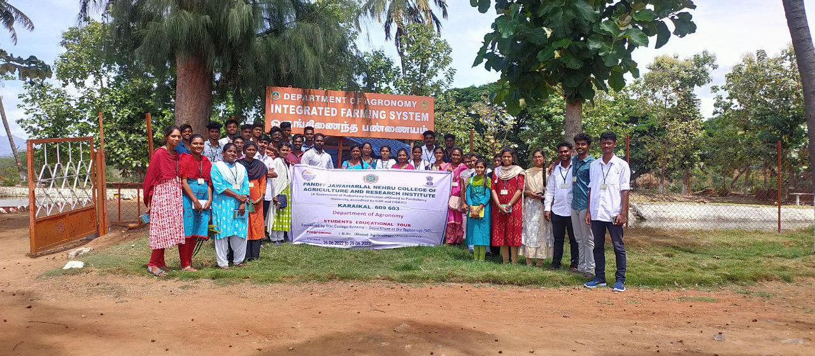
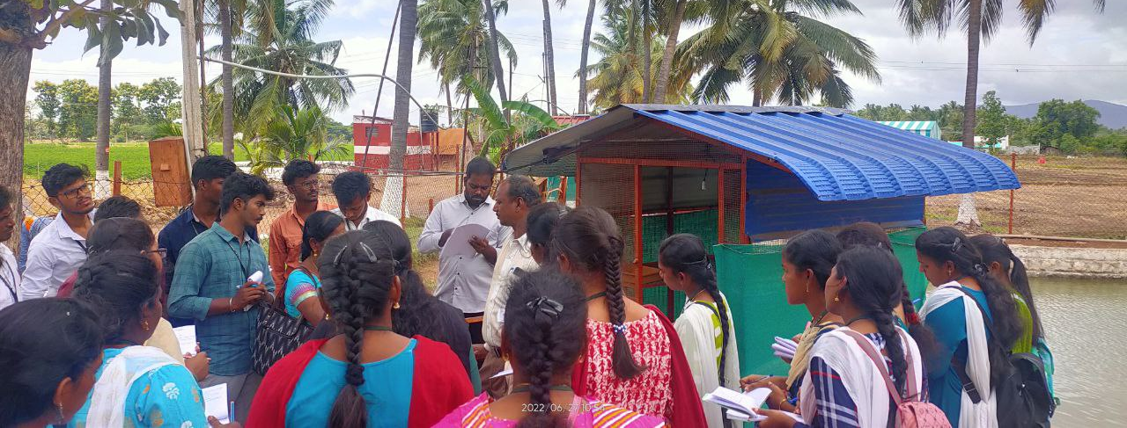
Visit to IFS Farm, TNAU, Coimbatore

Slide 36
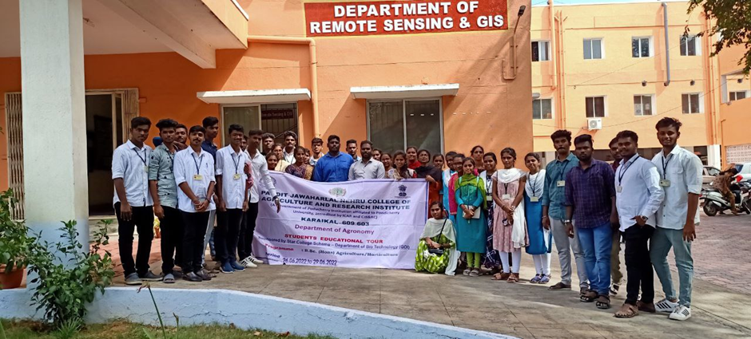
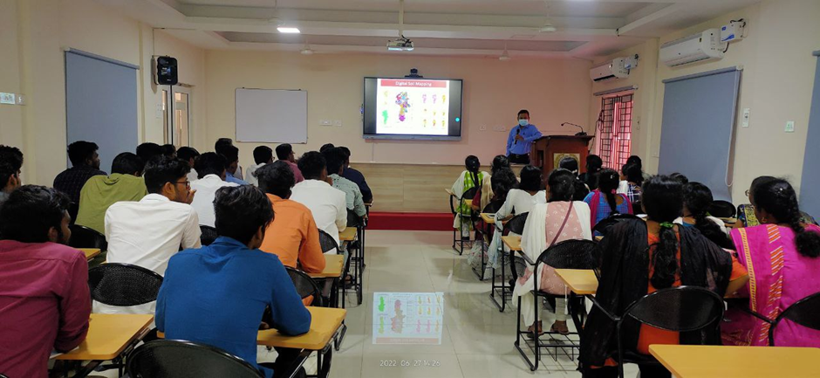
Visit to Remote Sensing Dept., TNAU, Coimbatore

Slide 37
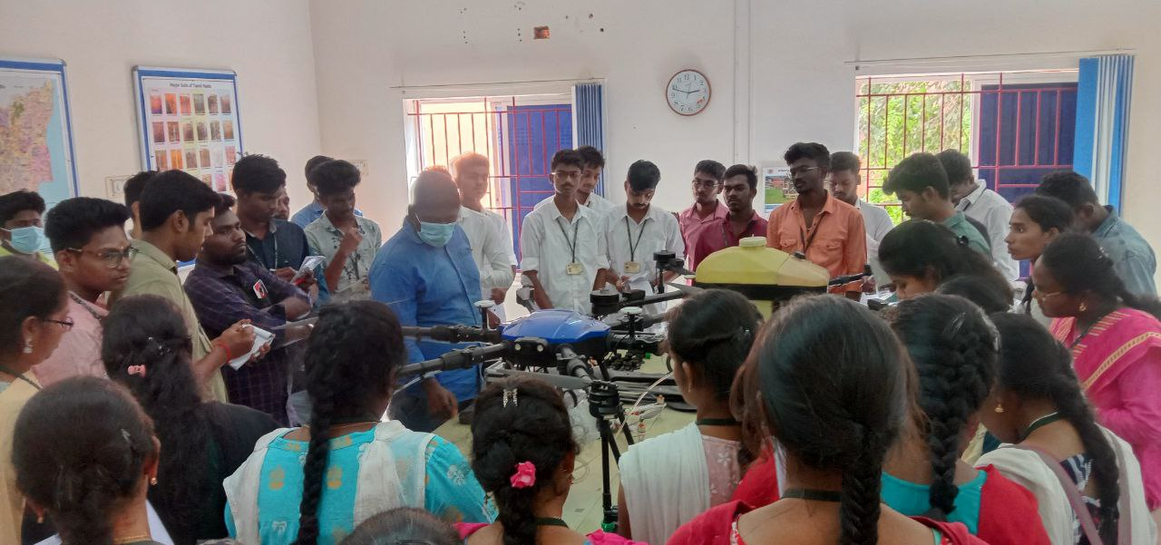
Visit to Remote Sensing Dept., TNAU, Coimbatore
Working of drones

Slide 38
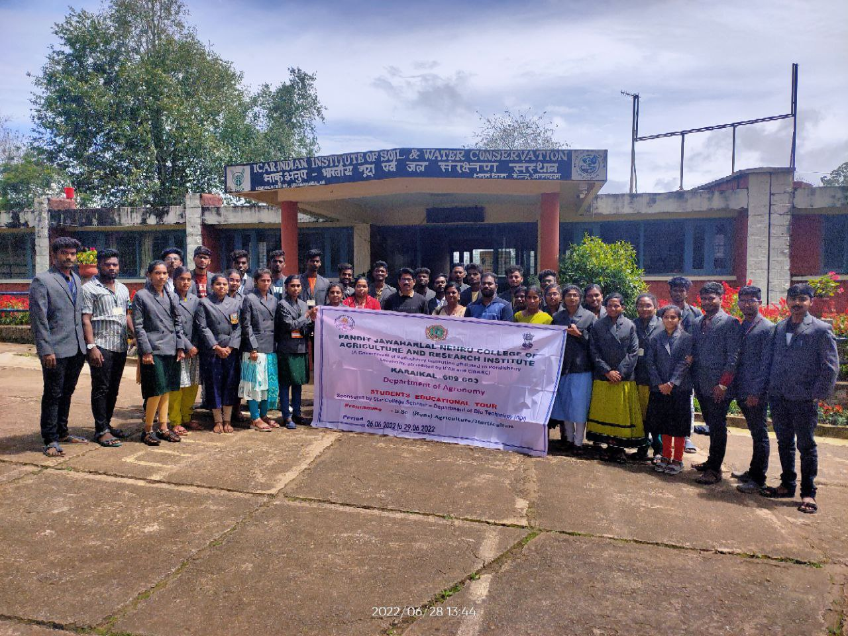
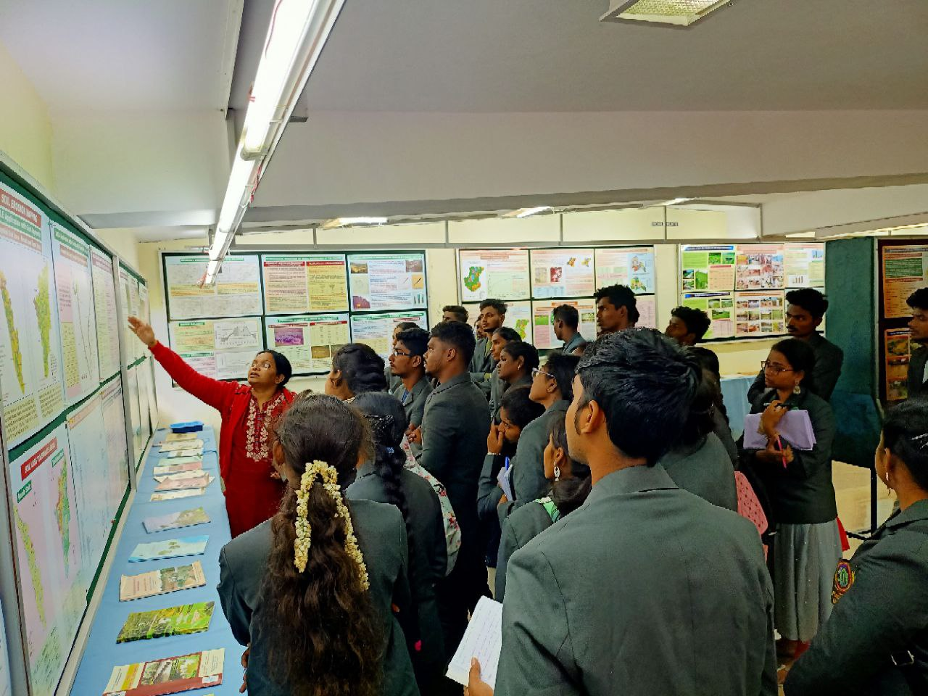
Visit to Indian Institute of Soil and Water Conservation, Ooty

Slide 39
Exposure Visits
Year : II B.Sc. (Agri) – 2020-21 Batch
Period : 29.06.2022
Place of visit | Skill learning by the students
Irrigation Management Training Institute, Trichy; Grand Anicut, Kallanai | Hands on training on irrigation structures; construction of irrigation and drainage channels; water measuring devices

Slide 40
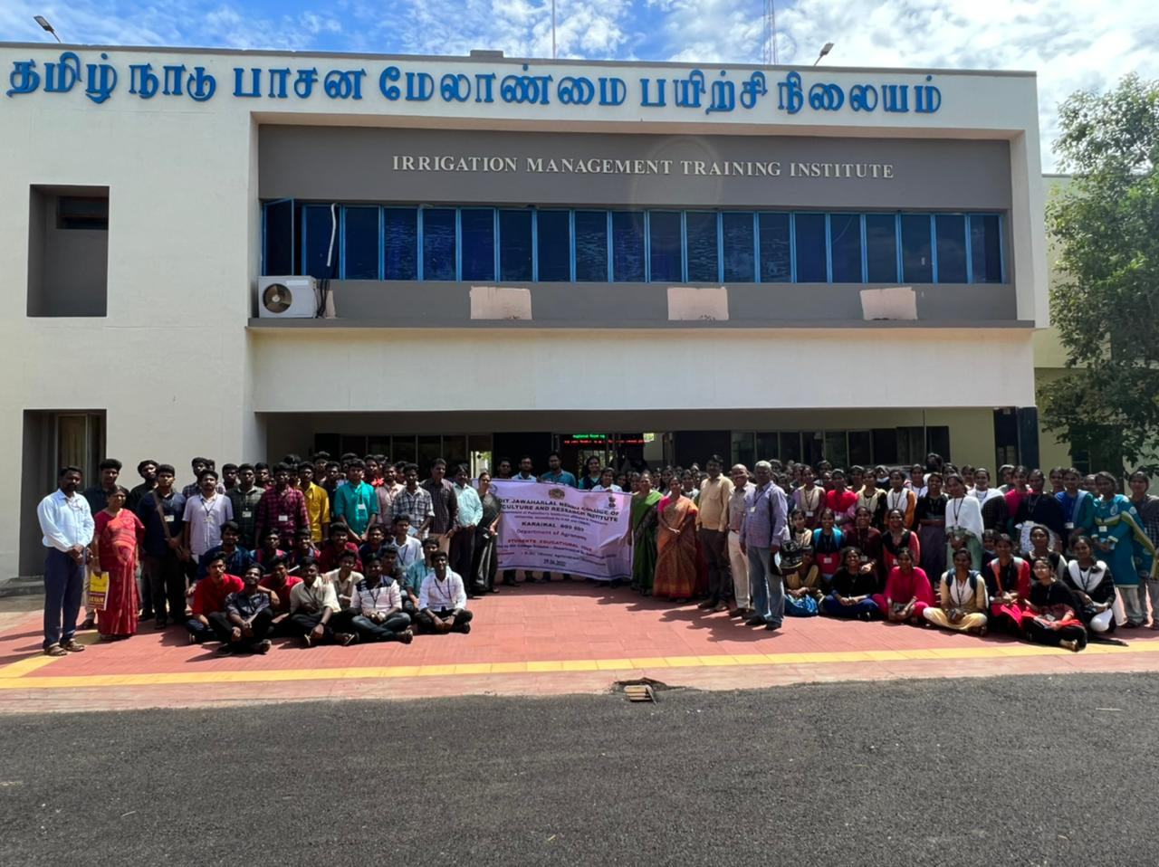

Slide 41
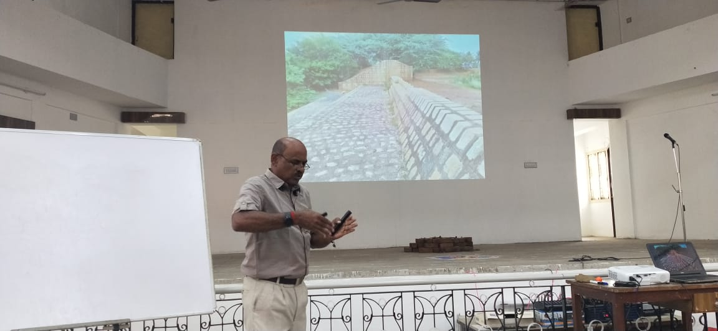
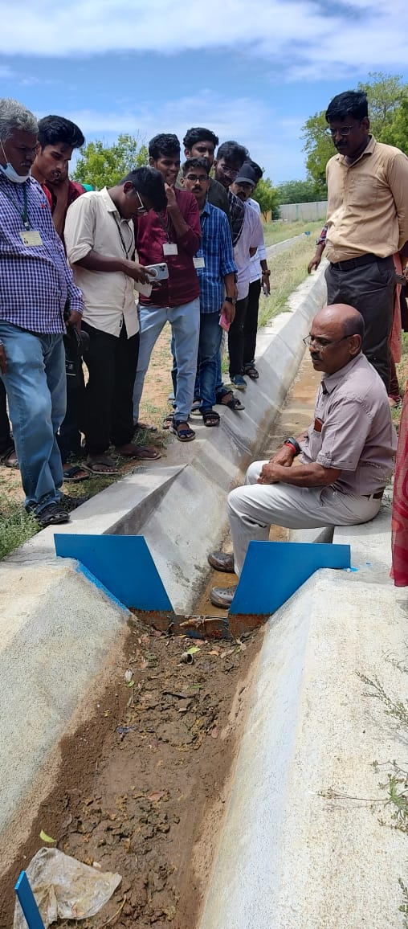
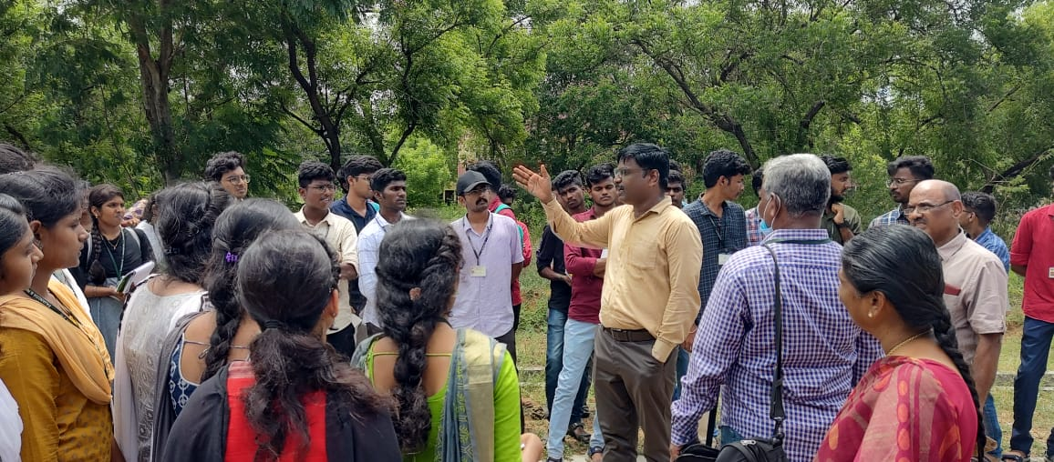

Slide 42
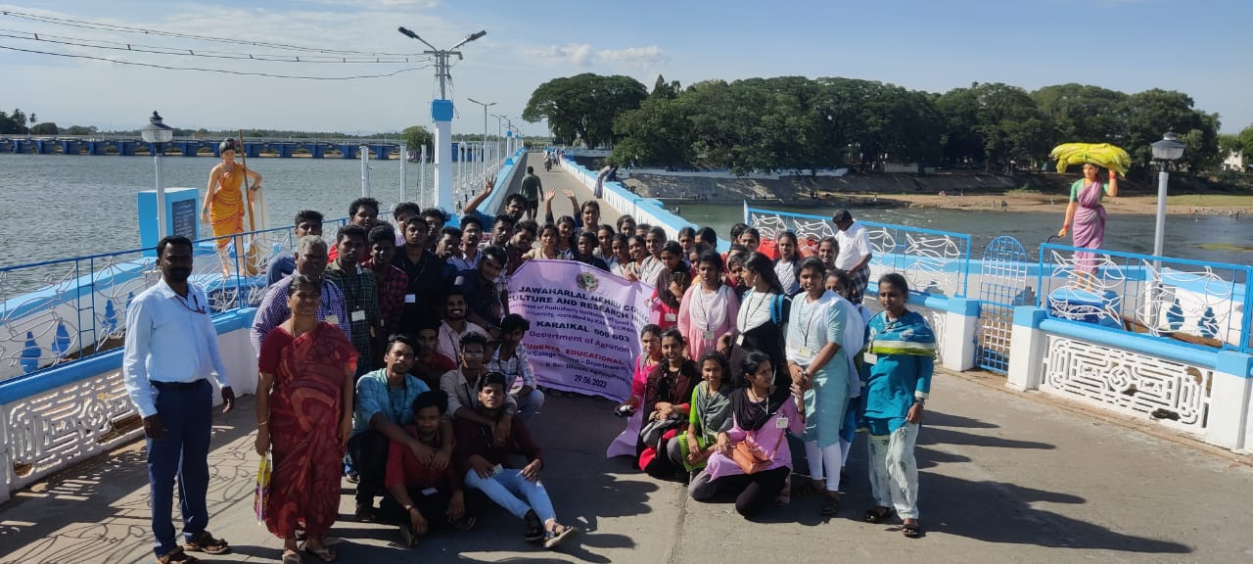
Exposure Visits – Grand Anicut

Slide 43
Exposure Visits
Year : III B.Sc. (Agri) and III B.Sc. (Horti) – 2019-20 Batch
Period : 06.08.2022
Place of visit | Skill learning by the students
Vallanadu sustainable agriculture producer company limited, Sirkali | Hands on training on Organic rice cultivation practices Vermicomposting ITK preparations

Slide 44
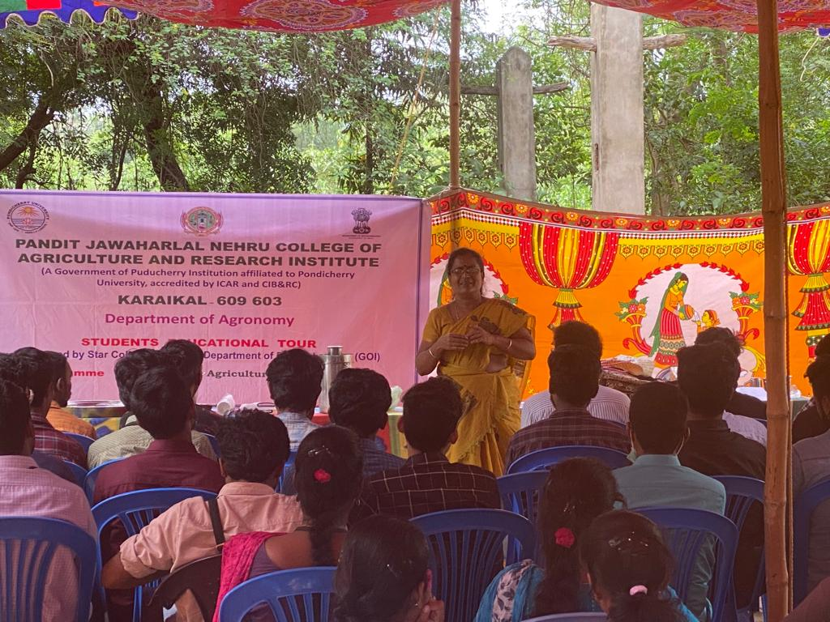
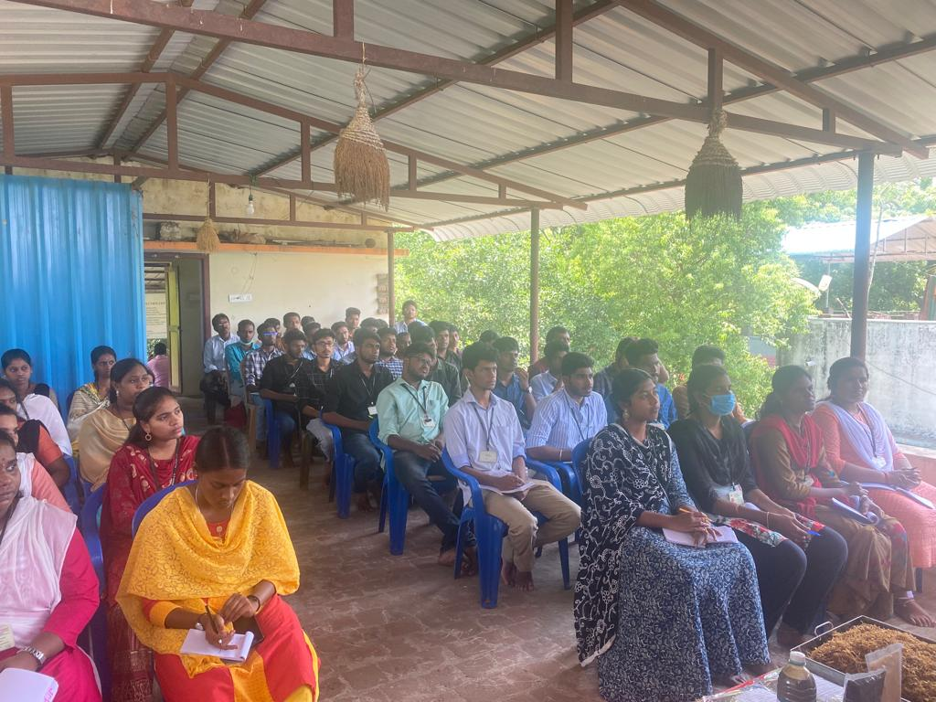
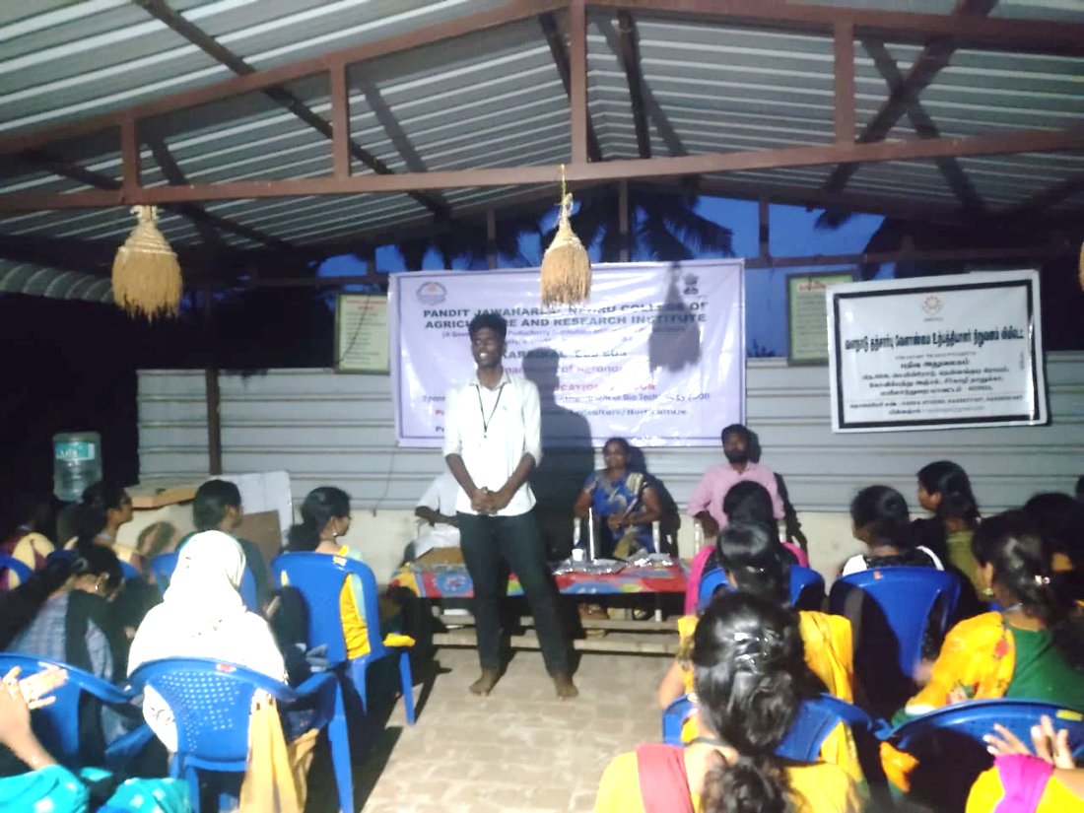
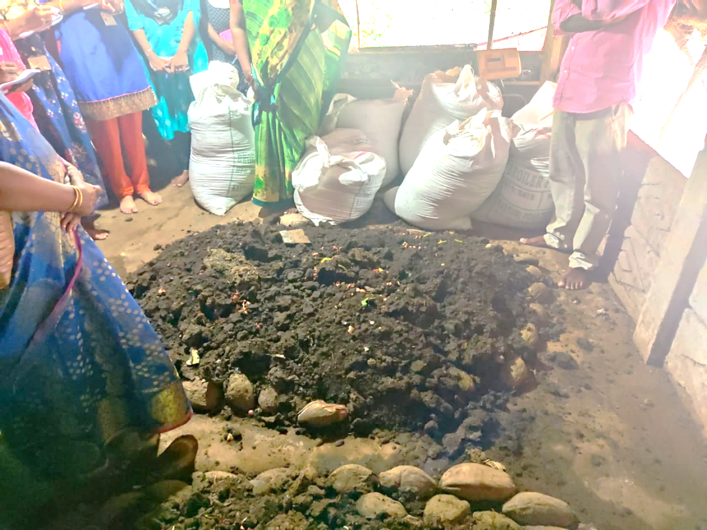

Slide 45
FINANCIAL ACHIEVEMENTS

Slide 46
OVERVIEW OF BUDGET
Sl. No. | Particulars | Amount sanctioned (Rs.) | Expenditure incurred (Rs.) | Balance (Rs.)
1. | Non-Recurring Expenses | 10,00,000 | 9,89,876 | 10,124*
2. | Recurring Expenses | 3,00,000 | 2,99,992 | 8
3. | Contingencies | 30,000 | 29,936 | 64
* Supply order has been placed and supply yet to be effected

Slide 47
THANK YOU

